Slide 1
Chapter 2

Slide 2
Atomic Theory of Matter
The theory that atoms are the fundamental building blocks of matter reemerged in the early 19th century, championed by John Dalton.
Notes:
Figure 2.1 John Dalton (1766-1844)

Slide 3
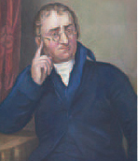
Dalton’s Postulates
All matter is composed of tiny particles called atoms.

Slide 4
Dalton’s Postulates
All atoms of a given element have identical chemical properties. Atoms of different elements have distinct properties.

Slide 5
Dalton’s Postulates
In chemical reactions, atoms of an element are not changed into different types of atoms; instead, a chemical reaction changes the way atoms are combined. Atoms are neither created nor destroyed.

Slide 6
Dalton’s Postulates
Atoms form chemical compounds by combining in whole-number ratios. All samples of a pure compound have the same combination of atoms.

Slide 7
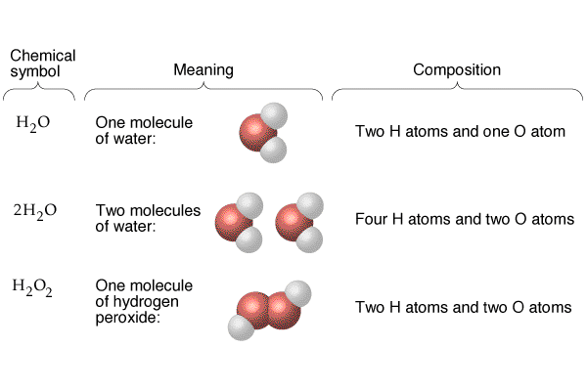

Slide 8
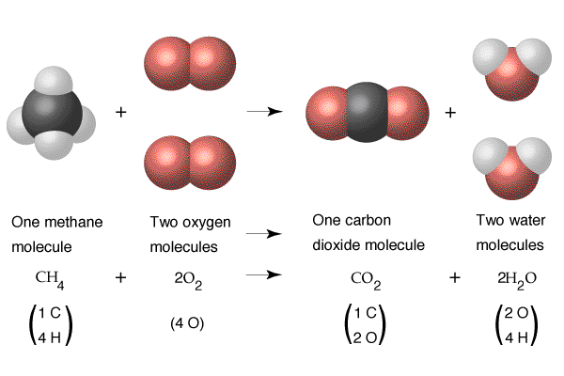

Slide 10
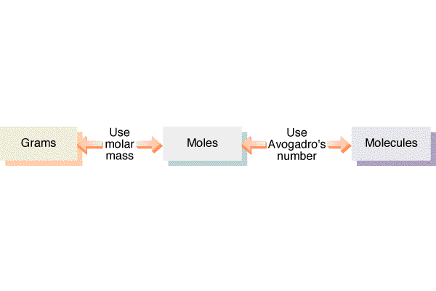

Slide 11
The Nuclear Atom
Notes:
Figure 2.12

Slide 12
Subatomic Particles
Protons and electrons are the only particles that have a charge.
Protons and neutrons have essentially the same mass.
The mass of an electron is so small we sometimes ignore it.
Notes:
Table 2.1

Slide 13
Atomic Mass
Atomic and molecular masses can be measured with great accuracy with a mass spectrometer.
First one electron is stripped off of each molecule or atom of sample (left side)
Next the positive ions (cations) are accelerated toward the magnet
Magnet’s strength is adjusted so that only ions with a certain mass hit detector
Heavier ions aren’t turned enough by the magnet; light ions turned too much
Notes:
Figure 2.13

Slide 14
Average Mass
Because in the real world we use large numbers of atoms and molecules, we use average masses in calculations.
Average mass is calculated from the isotopes of an element weighted by their relative abundances.
First a weighted mass is calculated for each isotope
Weighted mass is mass of isotope times fractional abundance of isotope (ie. 50% abundance = 0.5 fractional abundance)
Just add up the weighted masses for all of the isotopes to get the average mass of an atom of a particular element

Slide 15
Periodic Table
The rows on the Periodic Table are periods.
Columns are groups.
Elements in the same group have similar chemical properties.

Slide 16
Periodic Table
Metals are on the left side of the table.

Slide 17
Periodic Table
Nonmetals are on the right side of the Periodic Table (with the exception of H).

Slide 18
Periodic Table
Metalloids are on a diagonal line down and to the right from B and include Ge and Sb.
Learn the position of the “metal line” which contains the metalloids!

Slide 19
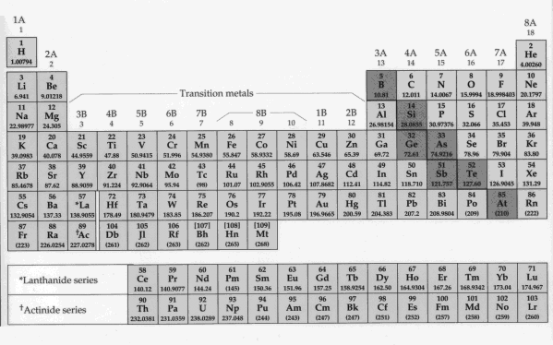
Periodic Table Summary
The Periodic Table is used to organize elements in a meaningful way.
There are periodic (cyclic) properties associated with the periodic table.
Columns in the periodic table are called groups and rows called periods.
Metals are located on the left-hand side (orange) and non-metals are located in the top right-hand side (green) of the Periodic Table and include hydrogen (top left).
Elements with properties between metals and non-metals called metalloids (dark blue) and are located on the “metal line” between the metals and non-metals.
Group 1A called alkalai metals (except H) - remember this and learn all names and symbols in 1A
Group 2A called alkaline earth metals - remember this and learn all names and symbols in 2A
Group 6A called chalcogens - remember this and learn all names and symbols in Group 6A
Group 7A called halogens - remember this and learn all symbols and names in this group
Group 8A called noble gases - remember this and learn names and symbols of all noble gases
Learn names and symbols of Pd, Pt, Groups 1B, 2B, 3A, 4A, 5A, and first row of transition metals

Slide 20
Ions and Molecules
Molecules are ultrasmall particles made from more than one atom where the particle has no charge (equal protons and electrons)
Molecules are made from H, metalloids and nonmetals ONLY - no metals!
Ions are ultrasmall particles made from one or more atoms where these particles have some charge (unequal protons and electrons)
Ions with POSITIVE charges are called CATIONS
Ions with NEGATIVE charges are called ANIONS
Ions can be made from any kind of atoms, metals, H, metalloids, and/or nonmetals

Slide 21
Molecular Chemical Formulas
Chemical formulas of MOLECULAR compounds tell you what kinds of atoms are bonded together to make a molecule of a compound.
The subscript to the right of the symbol of an element tells the number of atoms of that element in one molecule of the compound.
The chemical formula for water is H₂O because each water MOLECULE contains two hydrogen atoms and one oxygen atom.
If a chemical formula has NO METALS in it, NO CHARGE (positive or negative), and no NH₄ it is usually a MOLECULAR chemical formula (exceptions later in the course). LEARN THIS!

Slide 22
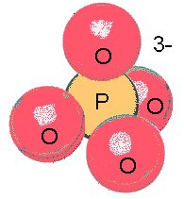
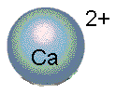
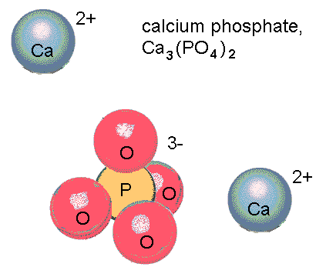
Ionic Chemical Formulas
Ionic formulas are a little trickier than molecular ones
The formula for an ION works like a molecular formula, except that a charge is included as a superscript to the right of the formula
The formula for calcium ion is Ca²⁺
The formula for phosphate ion is PO₄³⁻
Ionic COMPOUNDS have formulas which are NEUTRAL (no charges written) because the total amount of positive charge equals the total amount of negative charge in the formula
Calcium phosphate’s formula has 6 positive charges from the 3 calcium ions, and 6 negative charges from the 2 phosphate ions, so this formula is neutral overall (the positive and negative charges cancel)
In this course ionic compounds have formulas with metals AND nonmetals in them or they have ammonium (NH₄) in the beginning of the formula

Slide 23
Writing Ionic Formulas
The charge on the cation becomes the subscript on the anion.
The charge on the anion becomes the subscript on the cation.
If these subscripts are not in the lowest whole-number ratio, divide them by the greatest common factor (ie. Pb⁴⁺ + O²⁻ makes PbO₂ and NOT Pb₂O₄

Slide 24
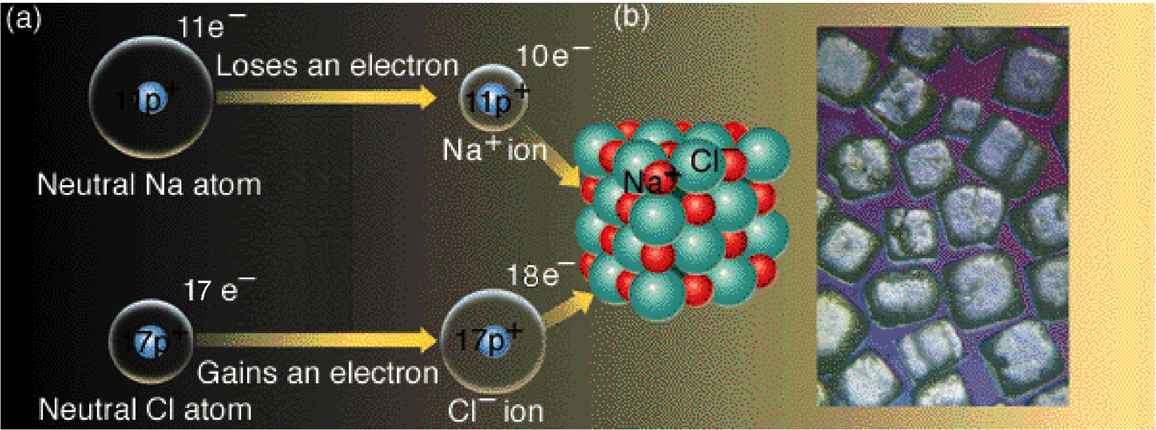
Ionic Bond Formation
When a metal atom meets a nonmetal atom the metal atom can give one or more electrons to the nonmetal atom
Nonmetal atoms like electrons more than metal atoms do.
The metal atom loses negative-charged electron(s) and becomes a (positive) cation
The nonmetal atom gains negative-charged electron(s) and becomes a (negative) anion
The anion and cation are now held together by opposite charge attraction, an IONIC BOND
Lots of atoms doing this leads to an IONIC LATTICE shown in picture above
Notice there are no distinct pairs of sodium and chloride ions - the formula NaCl doesn’t describe individual particles like molecules

Slide 25
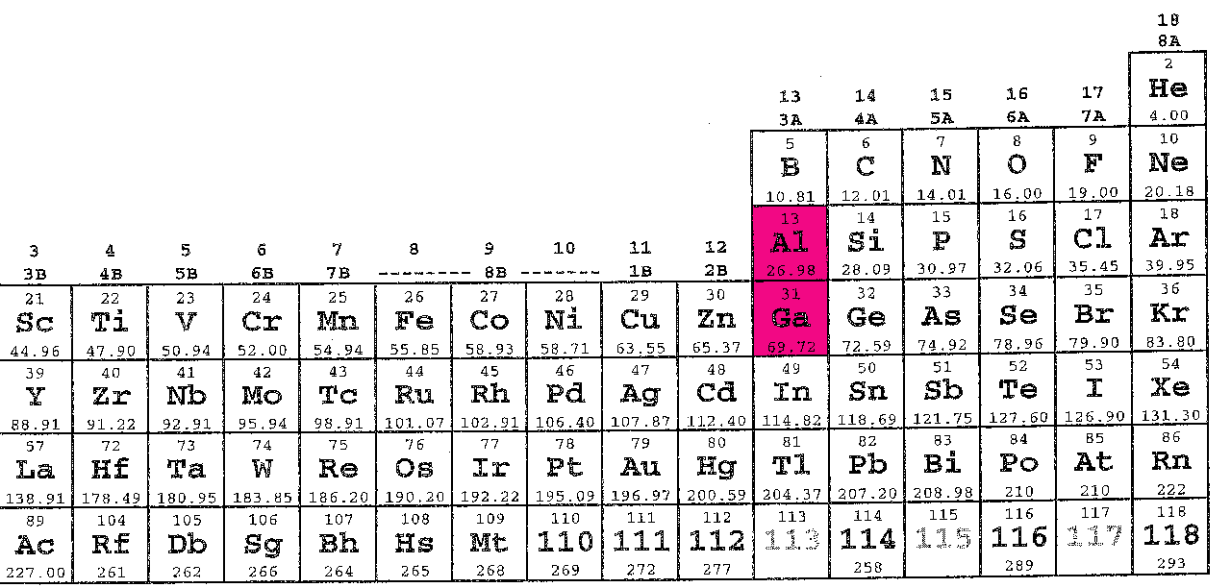
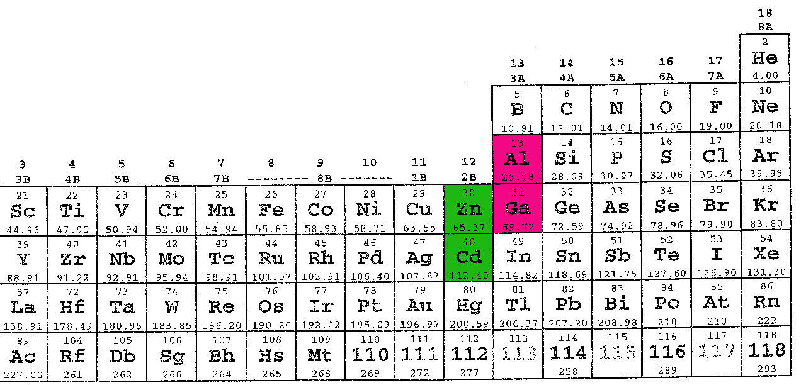
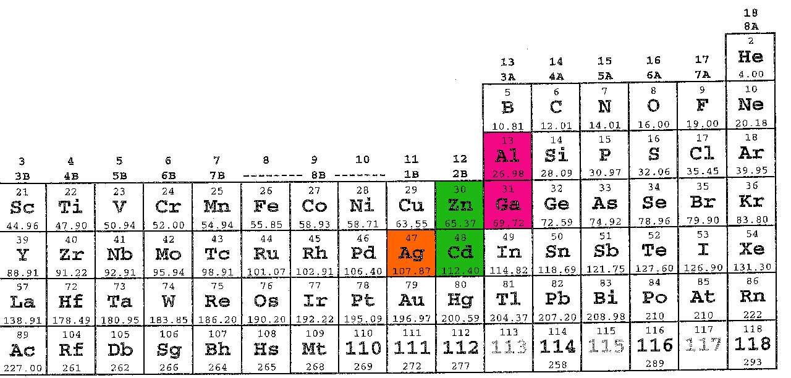
Cations
Cations are easier to name than anions
The METAL cations from column 1A (not H), the cations from column 2A, Al, Ga, Zn, Cd, and Ag have the same names as the neutral atoms they are made from
Ex: Ca²⁺ is calcium ion
The METAL cations in column 1A always have +1 charge, ie. potassium ion, K⁺
The cations in column 2A always have +2 charge, ie. Barium ion, Ba²⁺
The cations made from Al and Ga always have +3 charge, Al³⁺ and Ga³⁺
The cations made from Zn and Cd always have +2 charge, ie. Zn²⁺ and Cd²⁺
Silver ion always has +1 charge, ie. Ag⁺

Slide 26
Cations
Most of the metallic elements on the Periodic Table can form at least two DIFFERENT cations which have different charges (yellow highlighted elements)
For example manganese can form manganese(II), Mn²⁺ or manganese(IV), Mn⁴⁺ or manganese(VII), Mn⁷⁺
To name cations where there is more than one possible charge for the ion you need to use Roman numerals and parentheses like in the manganese case above
If a cation is made from an alkalai metal, an alkaline earth metal, or aluminum you are NOT ALLOWED to use Roman numerals in parentheses.

Slide 27
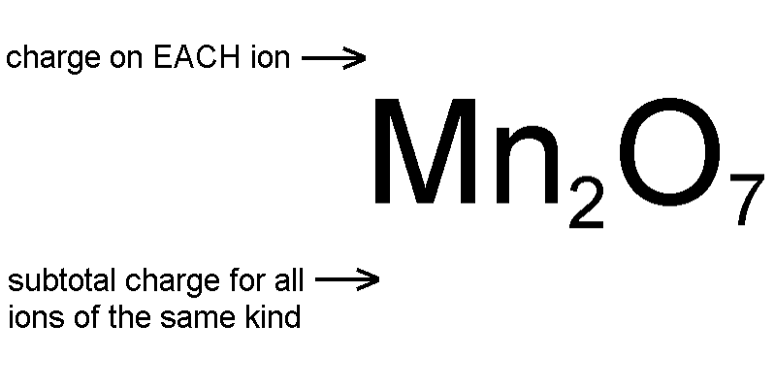
Figuring Out Cation Charges
Each oxide ion has a charge of -2
7 oxide ions have a subtotal charge of -2 x 7 = -14
Since the formula has to be uncharged the 2 manganese ions have to have a +14 subtotal
The +14 subtotal divided evenly over 2 manganese ions gives each manganese +14 / 2 = +7
This compound is manganese(VII) oxide

