Slide 1
Chapter 3

Slide 2
The Nuclear Atom
Notes:
Figure 2.12

Slide 3
Subatomic Particles
Protons and electrons are the only particles that have a charge.
Protons and neutrons have essentially the same mass.
The mass of an electron is so small we sometimes ignore it.
Notes:
Table 2.1

Slide 4
Isotope Designations
Elements are symbolized by one or two letters.
The atomic number is integer ABOVE Periodic Table symbol
Uncharged atoms have equal protons and electrons
Negative ions (anions) have EXTRA negative electrons
Positive ions (cations) are MISSING some negative electrons

Slide 5
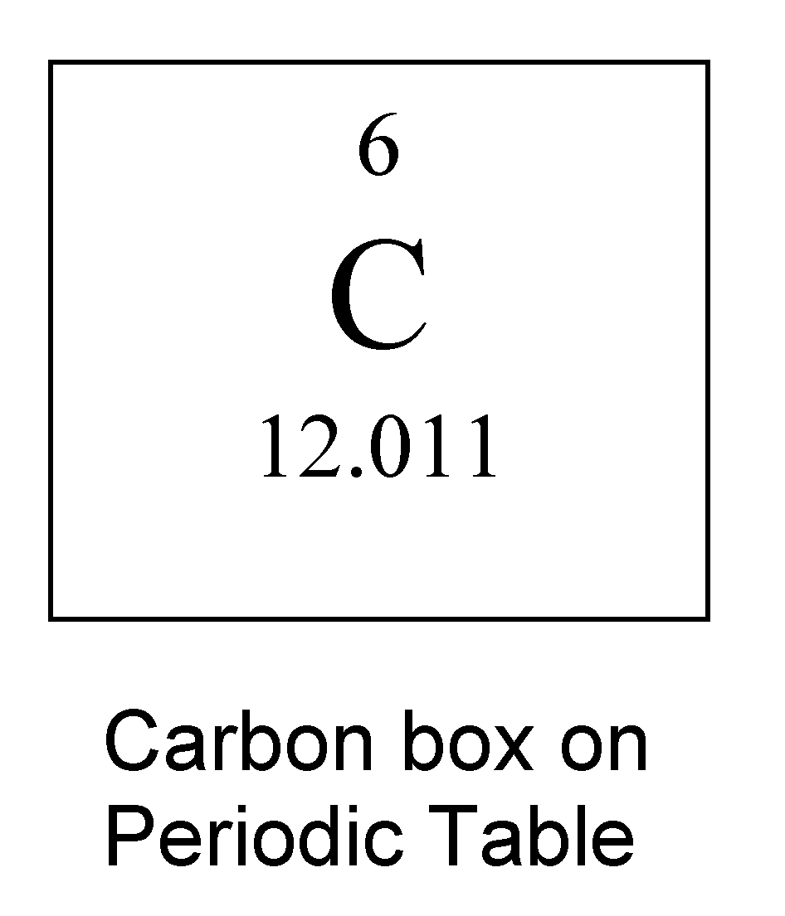
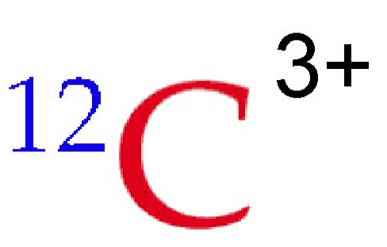
Isotope Designation
Atomic number is number of protons, found ABOVE atom symbol. ALL carbon atoms have 6 protons.
This atom is MISSING 3 NEGATIVE electrons (a double negative is positive). An atom with 6 protons which is missing three electrons has 3 electrons left.
This isotope of carbon has a total of 12 protons and neutrons. Since it has 6 protons it must have 12 - 6 = 6 neutrons

Slide 6
Isotopes:
Atoms of the same element with different masses.
Isotopes have different numbers of neutrons.
All atoms with the same symbol have same proton count
11
12
13
14
C
C
C
C

Slide 7
Atomic Mass
Atomic and molecular masses can be measured with great accuracy with a mass spectrometer.
First one electron is stripped off of each molecule or atom of sample (left side)
Next the positive ions (cations) are accelerated toward the magnet
Magnet’s strength is adjusted so that only ions with a certain mass hit detector
Heavier ions aren’t turned enough by the magnet; light ions turned too much
Notes:
Figure 2.13

Slide 8
Average Mass
Because in the real world we use large numbers of atoms and molecules, we use average masses in calculations.
Average mass is calculated from the isotopes of an element weighted by their relative abundances.
First a weighted mass is calculated for each isotope
Weighted mass is mass of isotope times fractional abundance of isotope (ie. 50% abundance = 0.5 fractional abundance)
Just add up the weighted masses for all of the isotopes to get the average mass of an atom of a particular element

Slide 9
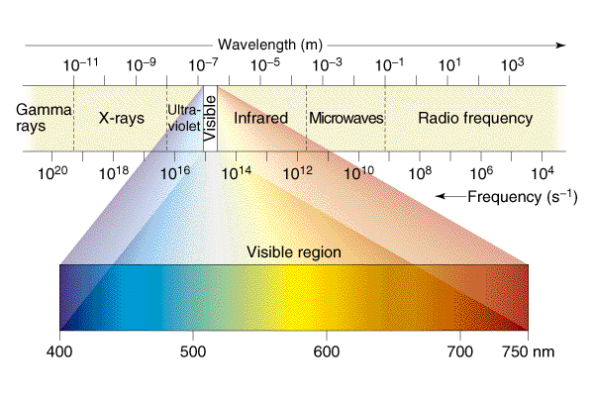

Slide 10
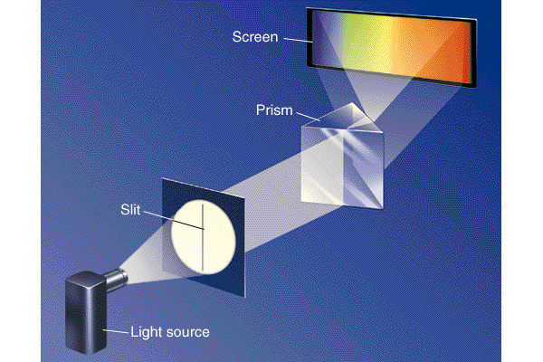

Slide 11
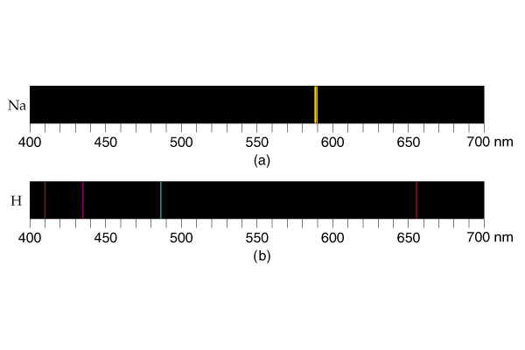

Slide 12
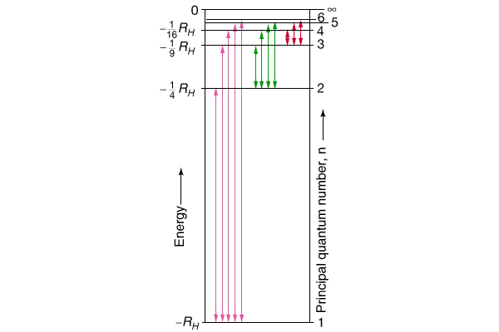

Slide 13
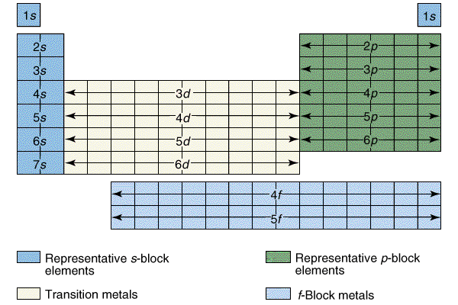

Slide 14
