Slide 1
Chapter 5

Slide 2
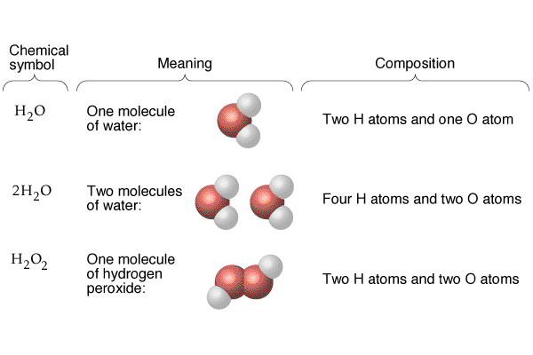

Slide 3
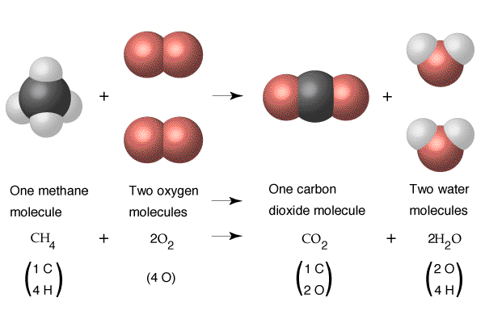

Slide 6
