Slide 1
Stoichiometry

Slide 2
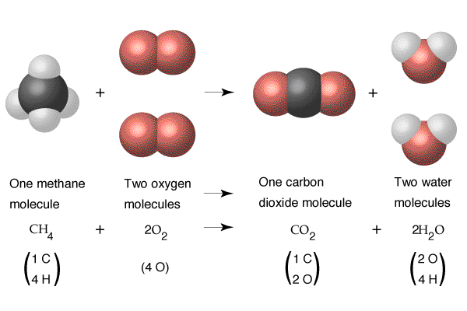

Slide 4
