Slide 1
Chapter 7

Slide 2
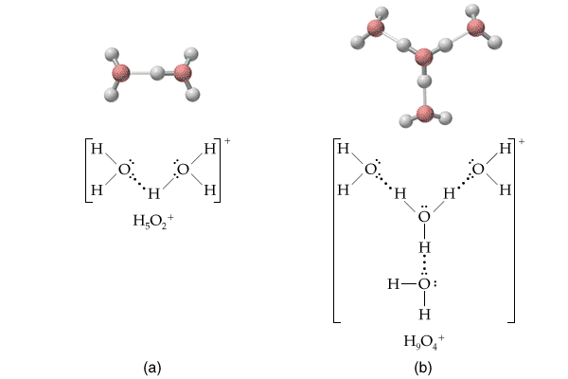

Slide 3
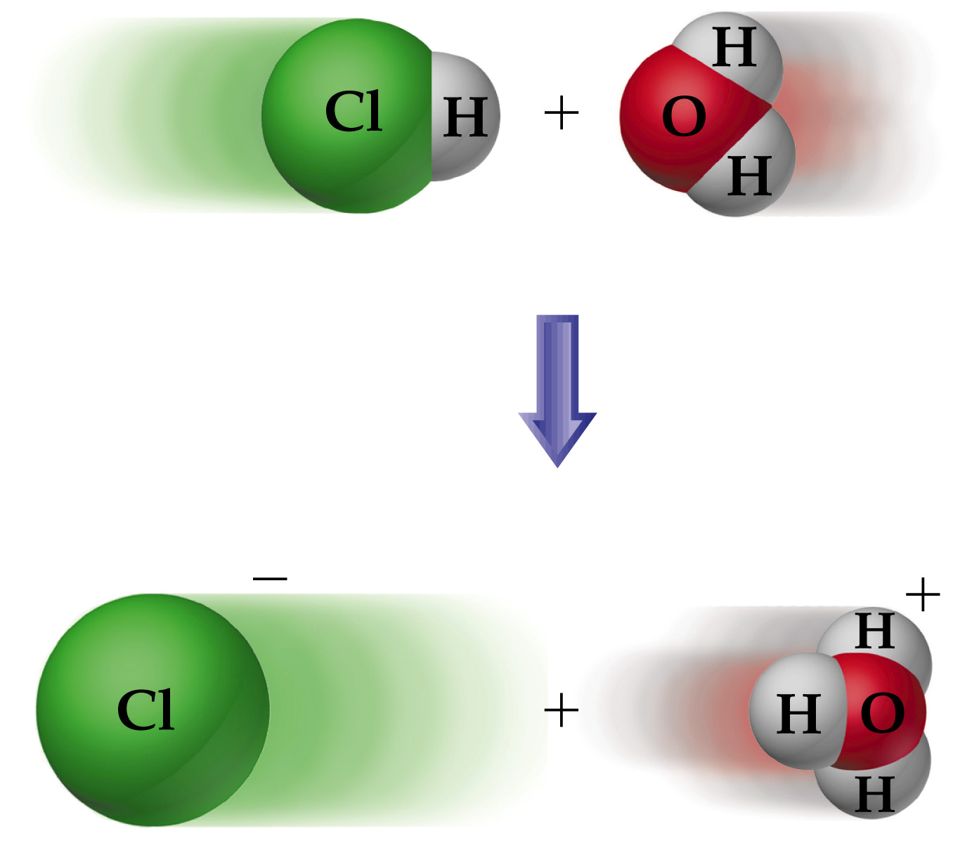

Slide 5
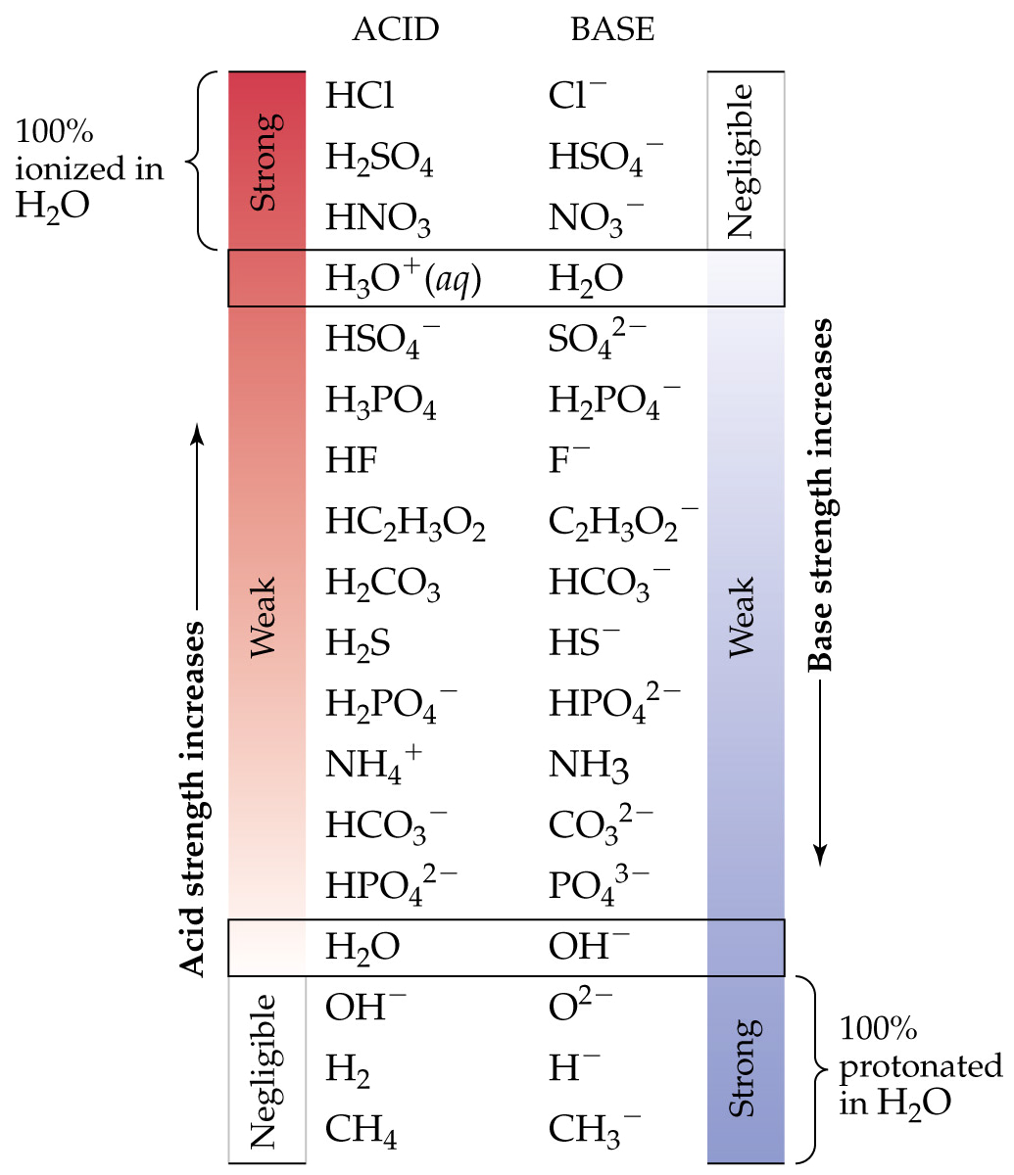

Slide 6
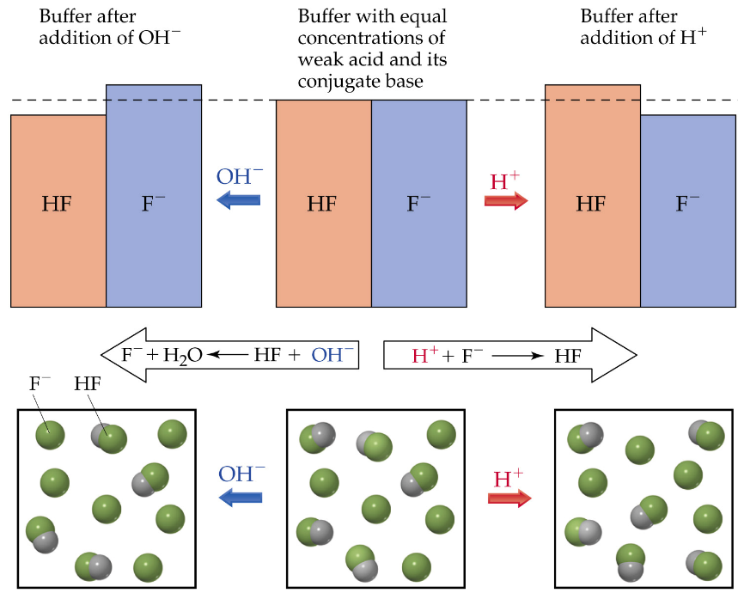

Slide 8
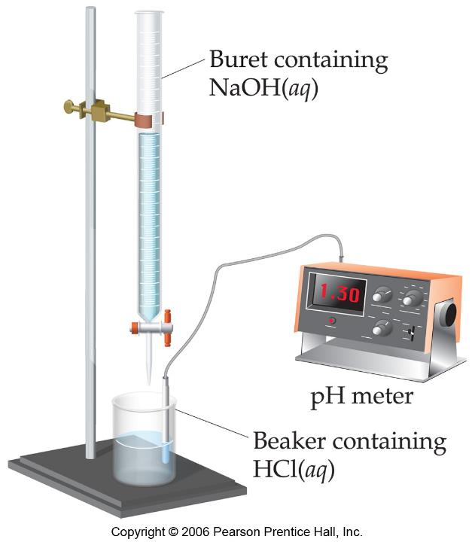

Slide 9
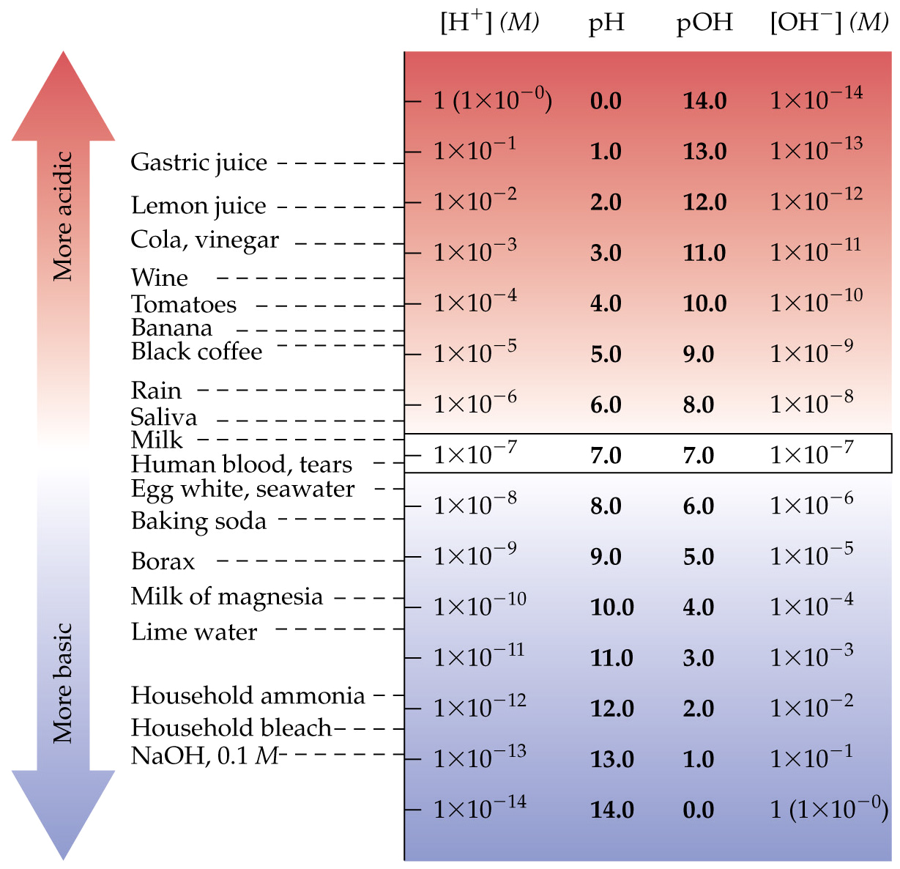

Slide 10
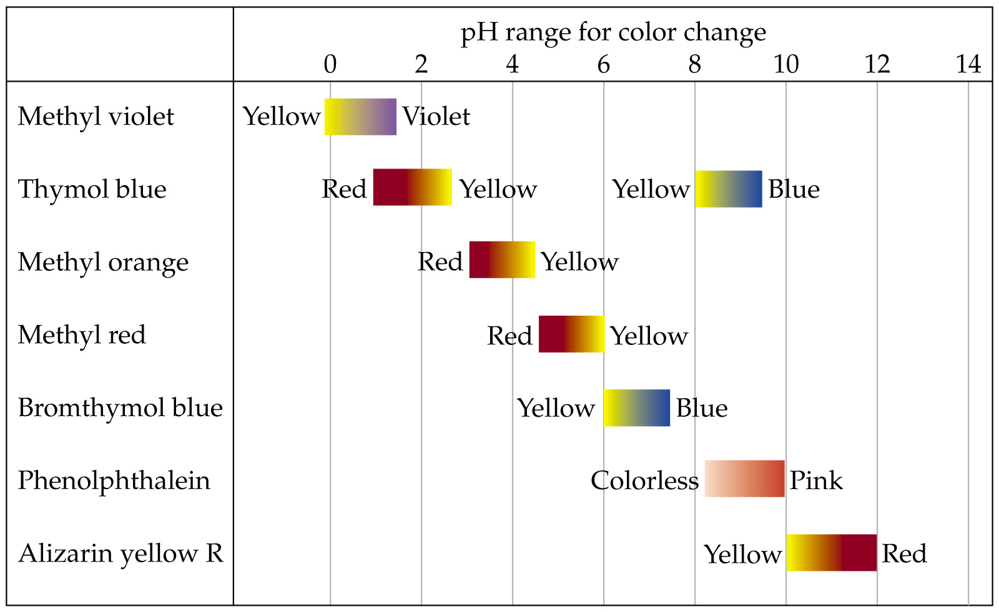

Slide 11
Formulas of Acids and Bases
Ammonium (NH₄⁺) and acetate (C₂H₃O₂⁻) are water-soluble ions (no exceptions), but are NOT spectators because they react with water.
Ammonium is a weak acid.
Acetate is a weak base.
Cations are weak acids except H⁺ (strong acid) and spectators (not acidic).
Anions are weak bases except OH⁻ (strong base) and spectators (not basic).
Always break formulas into left and right halves and analyze acid/base character of each half.
Example: HC₂H₃O₂ is combination of strong acid (H⁺) and weak base (C₂H₃O₂⁻); combination results in overall weak acid.

