Slide 1
Chapter 8

Slide 3
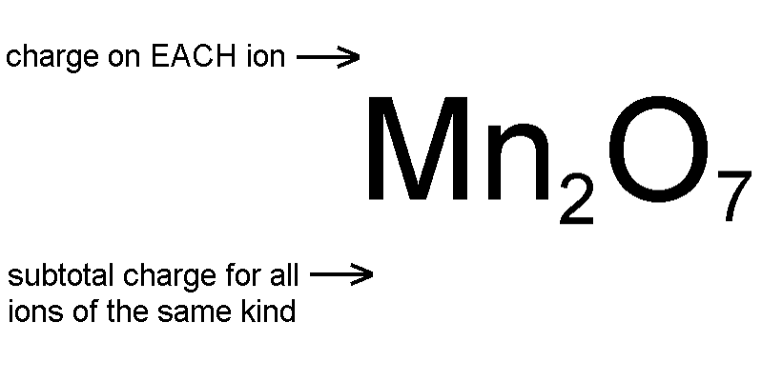
Calculating Oxidation Numbers
Each oxide ion has a charge of -2
7 oxide ions have a subtotal charge of -2 x 7 = -14
Since the formula has to be uncharged the 2 manganese ions have to have a +14 subtotal
The +14 subtotal divided evenly over 2 manganese ions gives each manganese +14 / 2 = +7
This compound is manganese(VII) oxide
Work oxidation numbers of Cr and S in Cr₂(SO₄)₃ (Hint: treat SO₄²⁻ as a single particle)

Slide 5
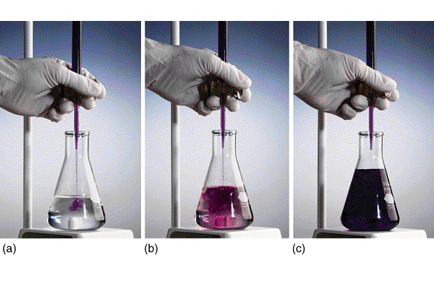

Slide 6
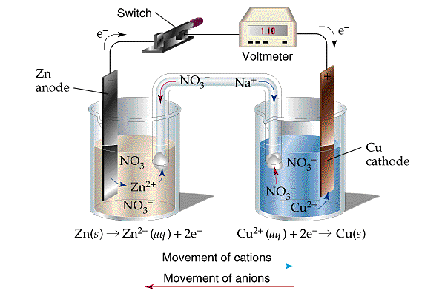

Slide 7
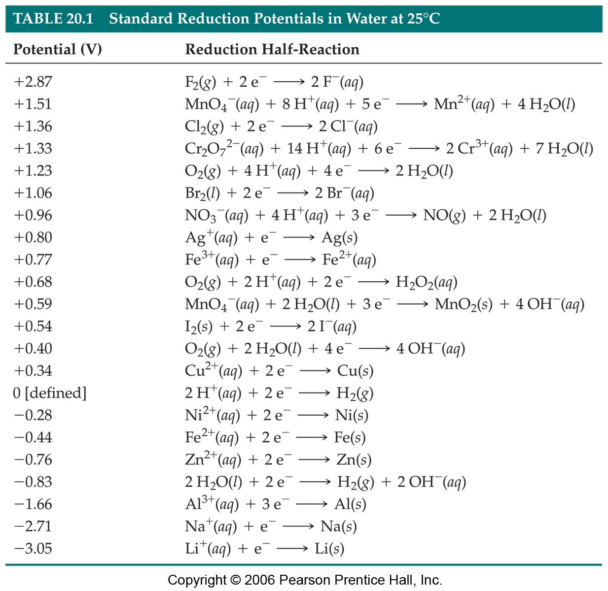

Slide 8
