Slide 1
CHAPTER 1

Slide 2
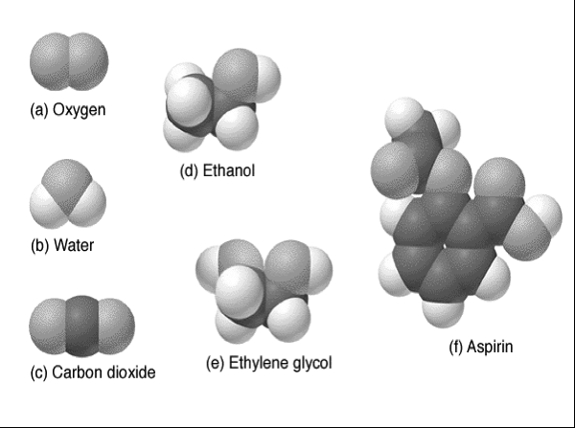

Slide 3
Changes of State
Play Video on YouTube
Notes:
AN26_035.MOV

Slide 4
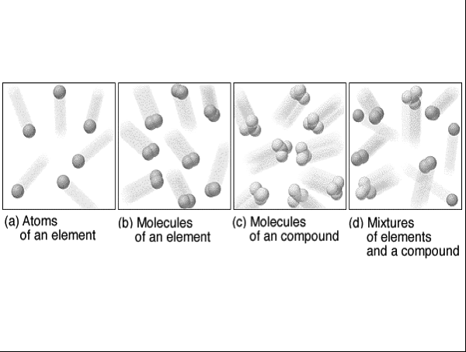

Slide 5
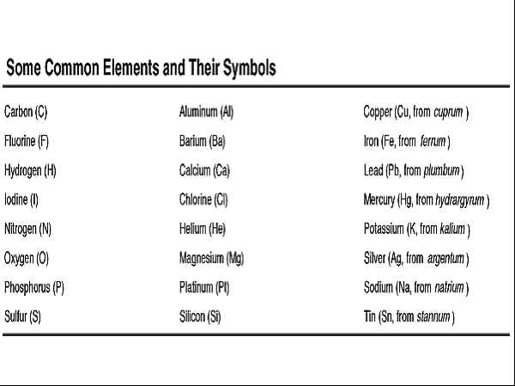

Slide 6
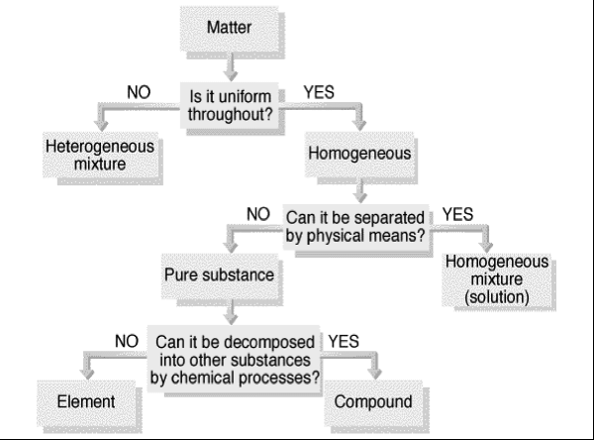

Slide 7
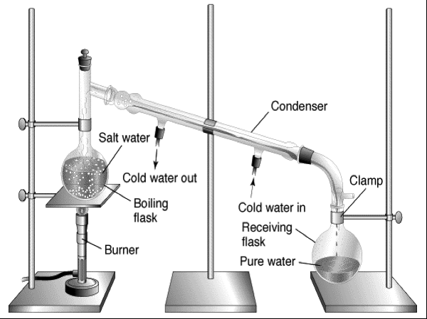

Slide 8
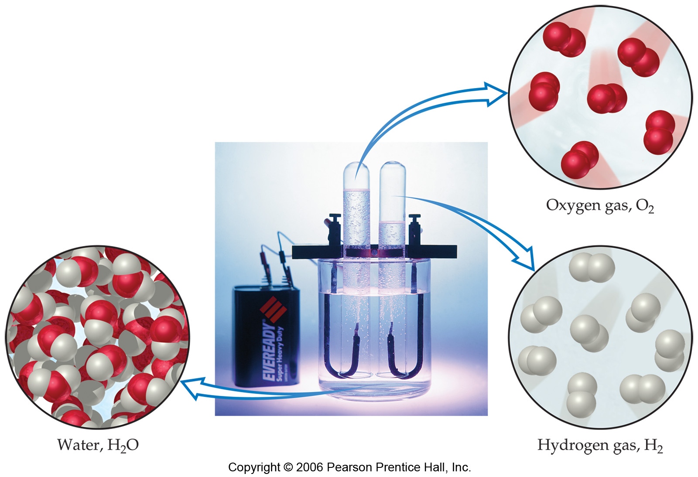

Slide 9
Electrolysis of Water
Play Video on YouTube
Notes:
AN26_005.mov

Slide 11
Hydrogen Balloon
Play Video on YouTube
Notes:
DM27_002.mov

Slide 13
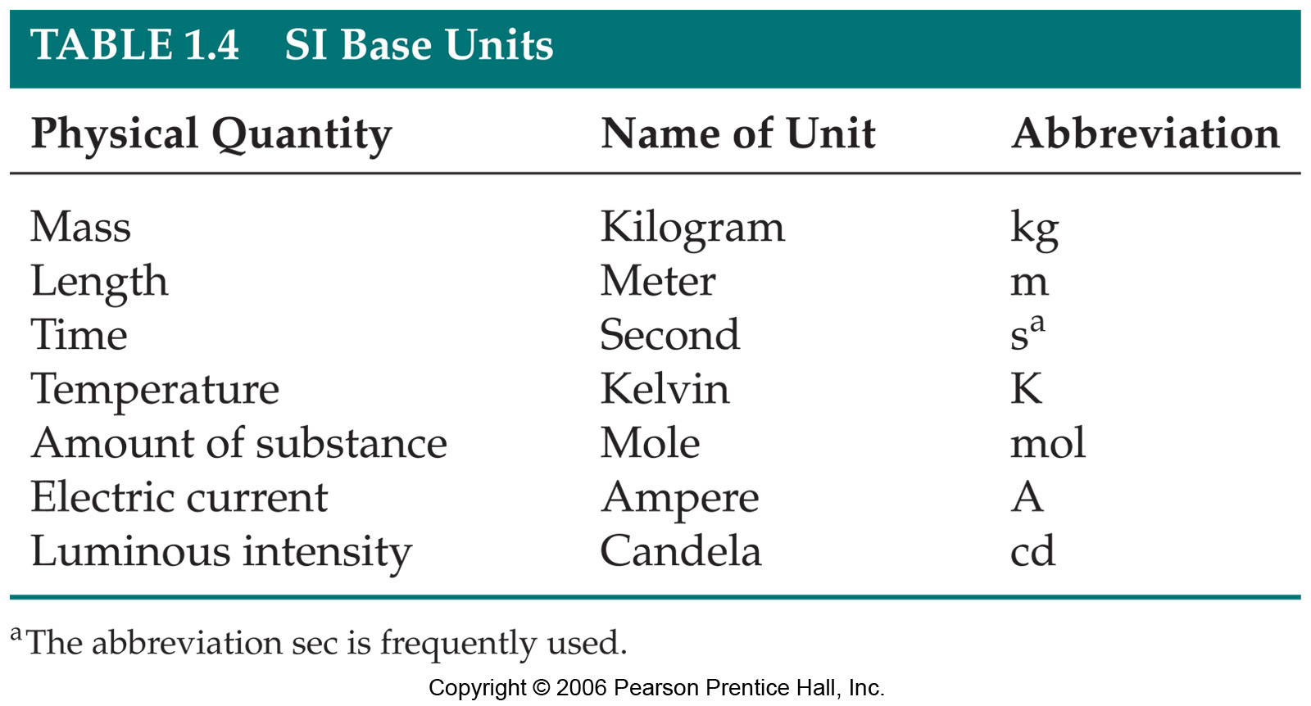

Slide 15
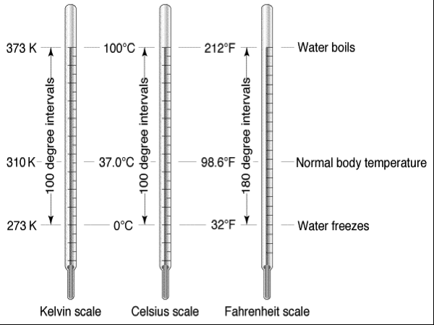

Slide 16
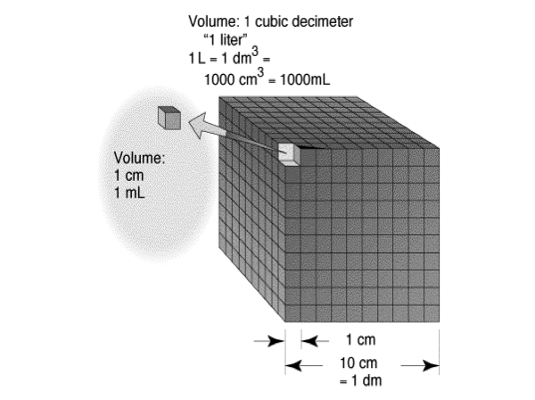

Slide 17
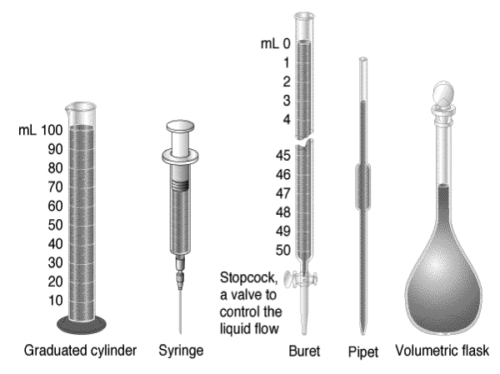

Slide 18
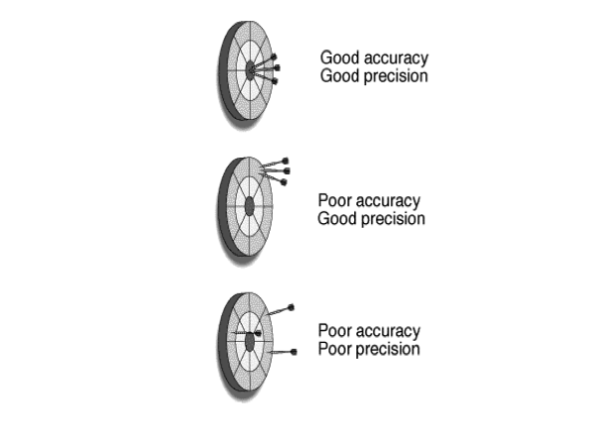

Slide 19
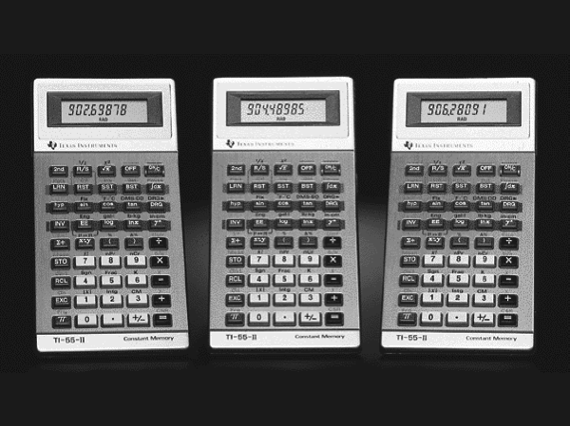

Slide 20
Dimensional Analysis
Dimensional analysis involves converting a quantity from one set of units to another set of units by multiplying the original quantity by a series of conversion factors.
Conversion factors are determined by choosing units for numerators and denominators which cancel original units algebraically to produce new set of units.
Conversion factors have numbers placed in numerators and denominators which make the quantities (numbers AND units) in numerators equal to those in denominators (ie they are a form of 1).
Example: convert 1.55 kg/m³ to mg/L

Slide 21
Dimensional Analysis
Example: Convert 1.55 kg/m³ to mg/L

