Slide 1
Chapter 10

Slide 2
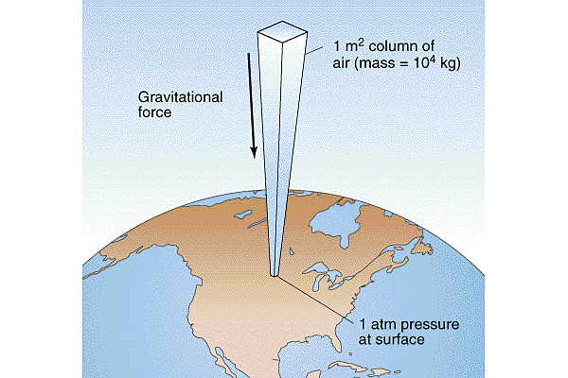

Slide 3
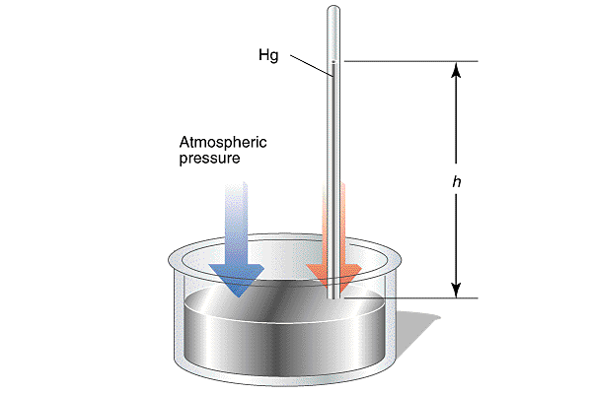

Slide 4
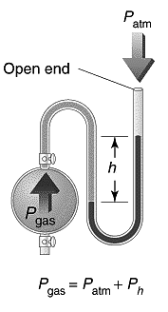

Slide 5
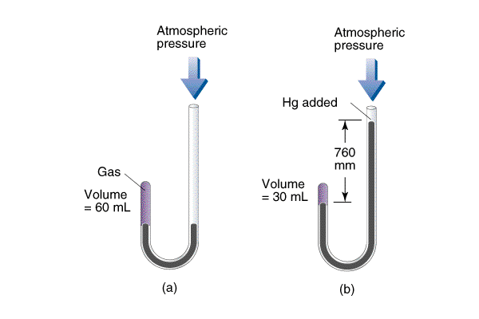

Slide 6
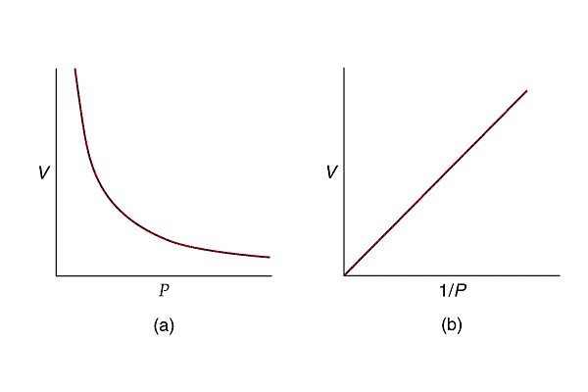

Slide 7
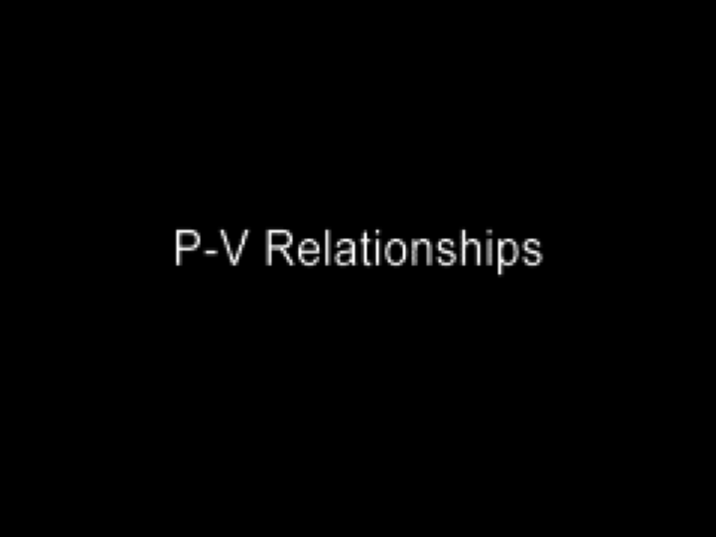
Pressure-Volume Relationships
Play Video On YouTube
Notes:
AN26_031.mov

Slide 8
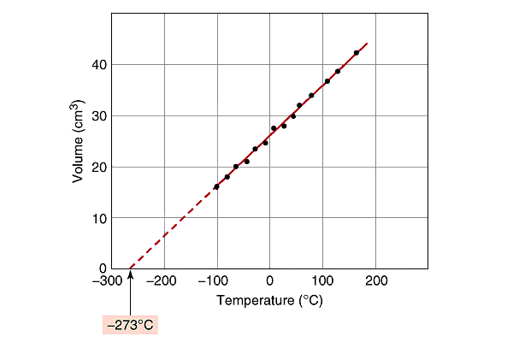

Slide 9
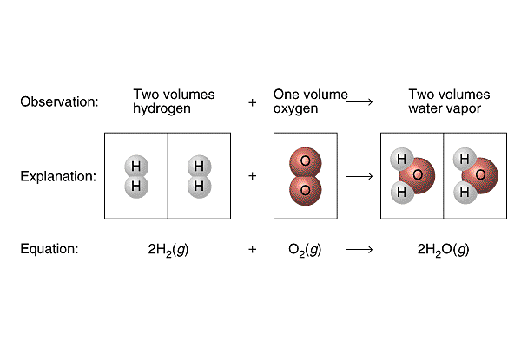

Slide 10
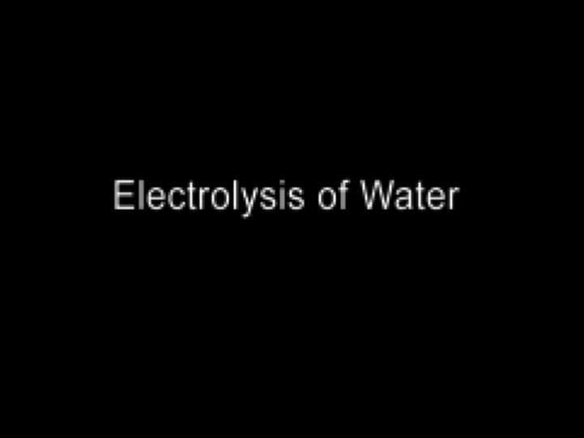
Electrolysis of Water
Play Video On YouTube
Notes:
AN26_005.mov

Slide 13
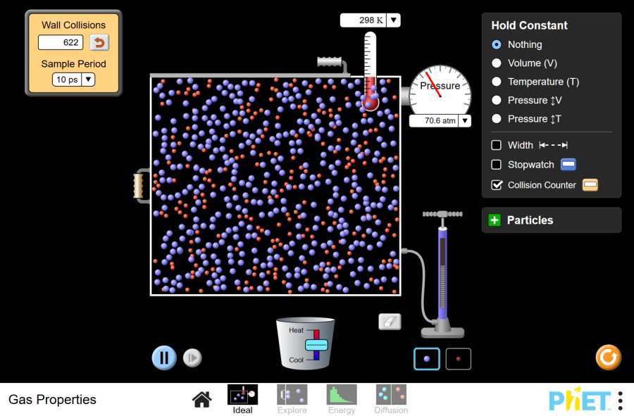
Play Gas Properties Animation

Slide 14
0

Slide 15
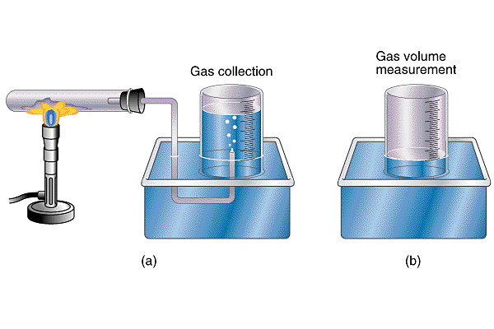
0

Slide 16
0

Slide 17
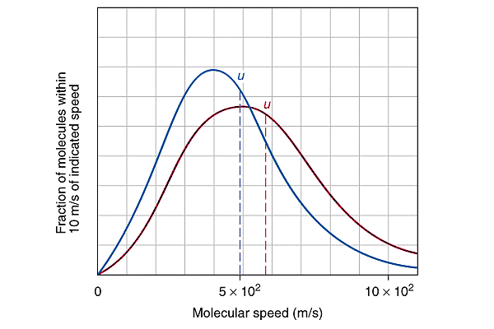
0

Slide 18
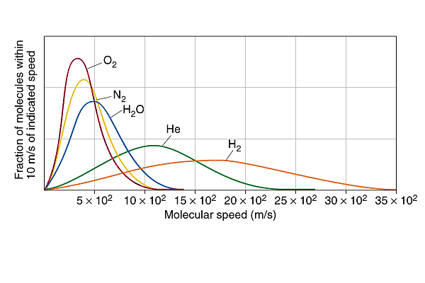
0

Slide 19
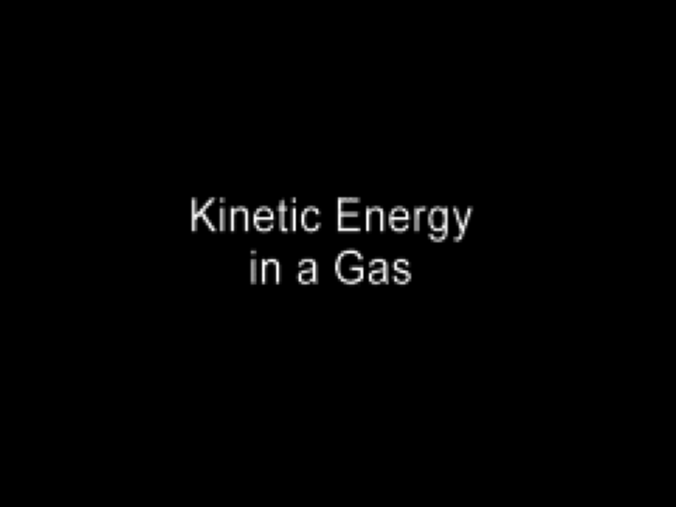
Kinetic Energy in a Gas
Play Video On YouTube
Notes:
AN26_032.mov

Slide 20
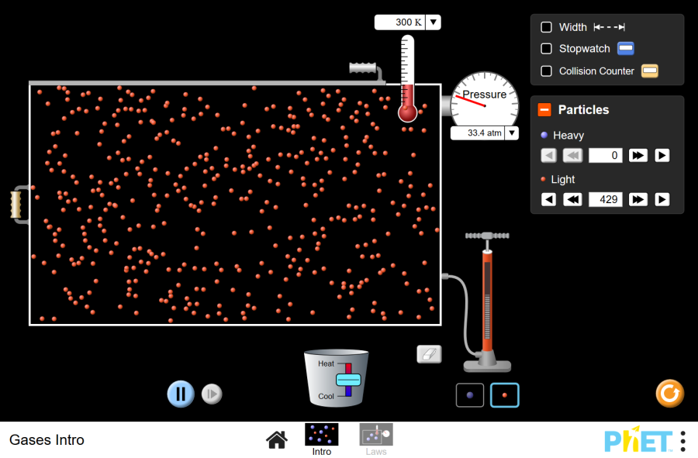
Play Kinetic Molecular Animation

Slide 21
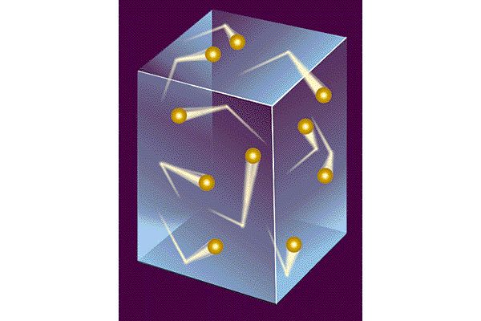
0

Slide 22
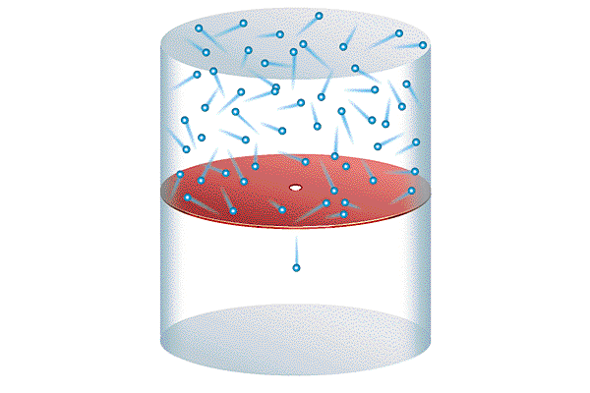
0

Slide 23
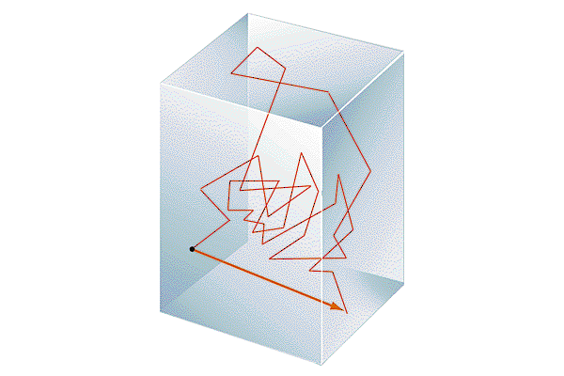
0

Slide 24
0

Slide 25
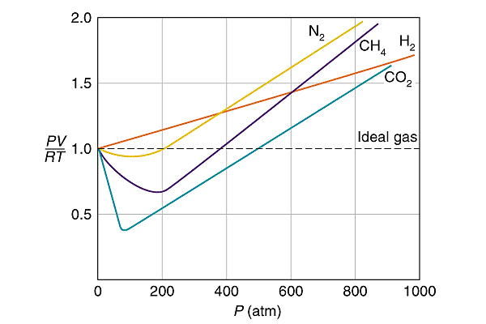

Slide 26
