Slide 1
Chapter 11

Slide 2
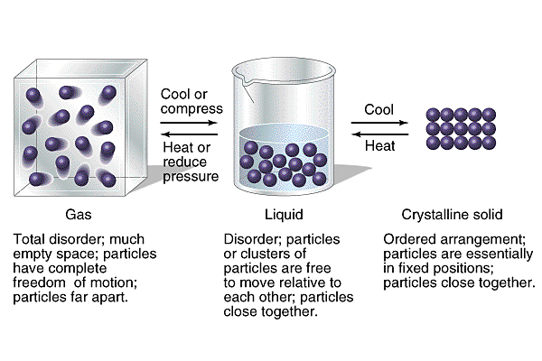

Slide 3
Changes of State
Play Video On YouTube
Notes:
AN26_035.mov

Slide 4
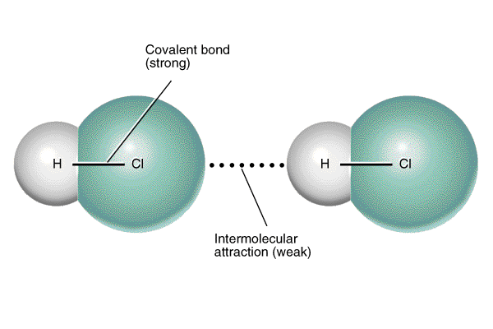

Slide 5
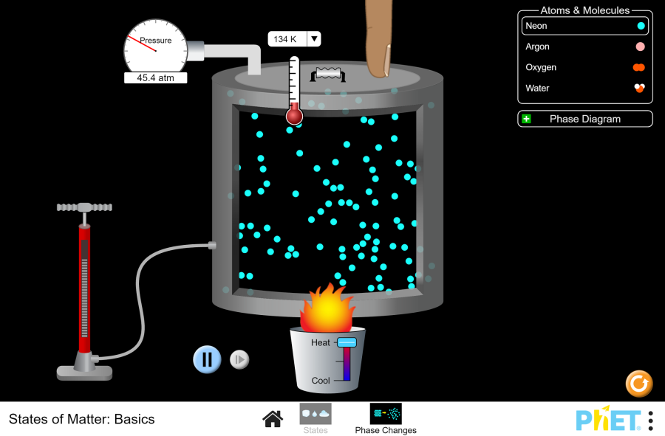
Play States of Matter Animation

Slide 6
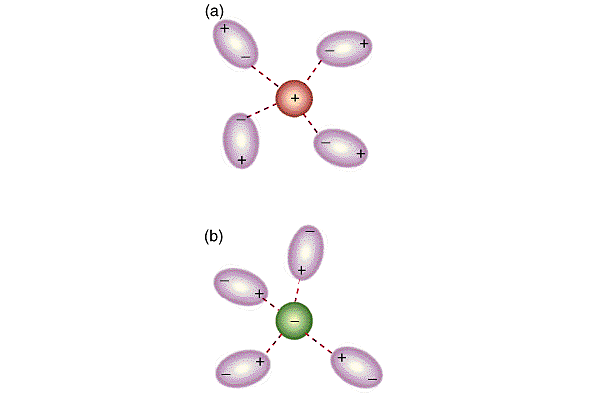

Slide 7
Dissolution of KMnO₄
Play Video On YouTube
Notes:
AN26_040.mov

Slide 8
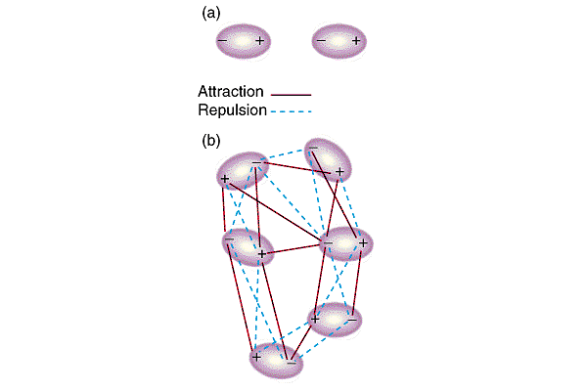

Slide 9
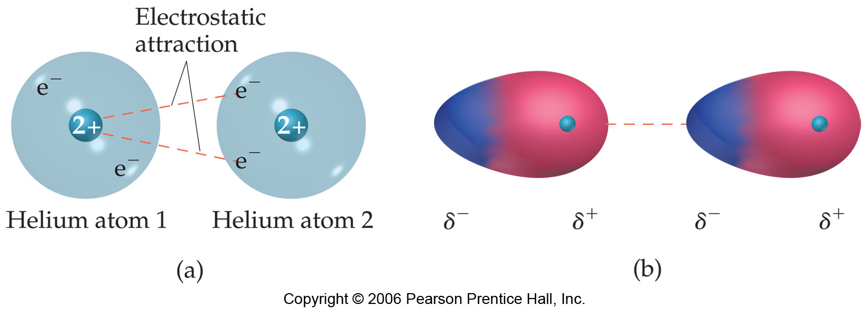

Slide 10
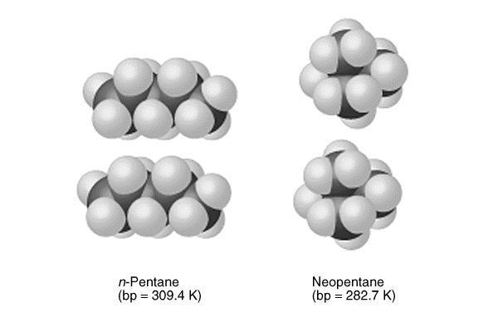

Slide 11
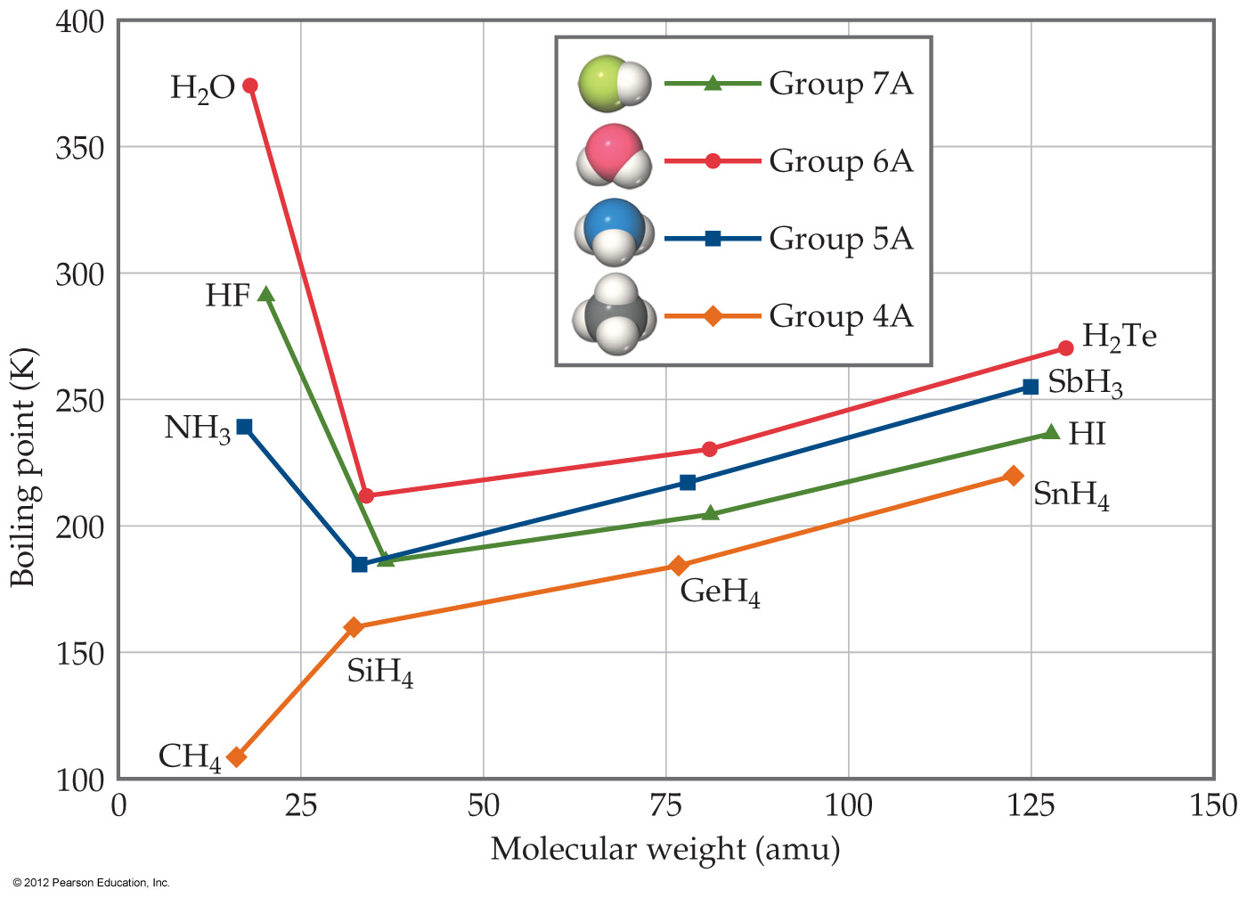

Slide 12
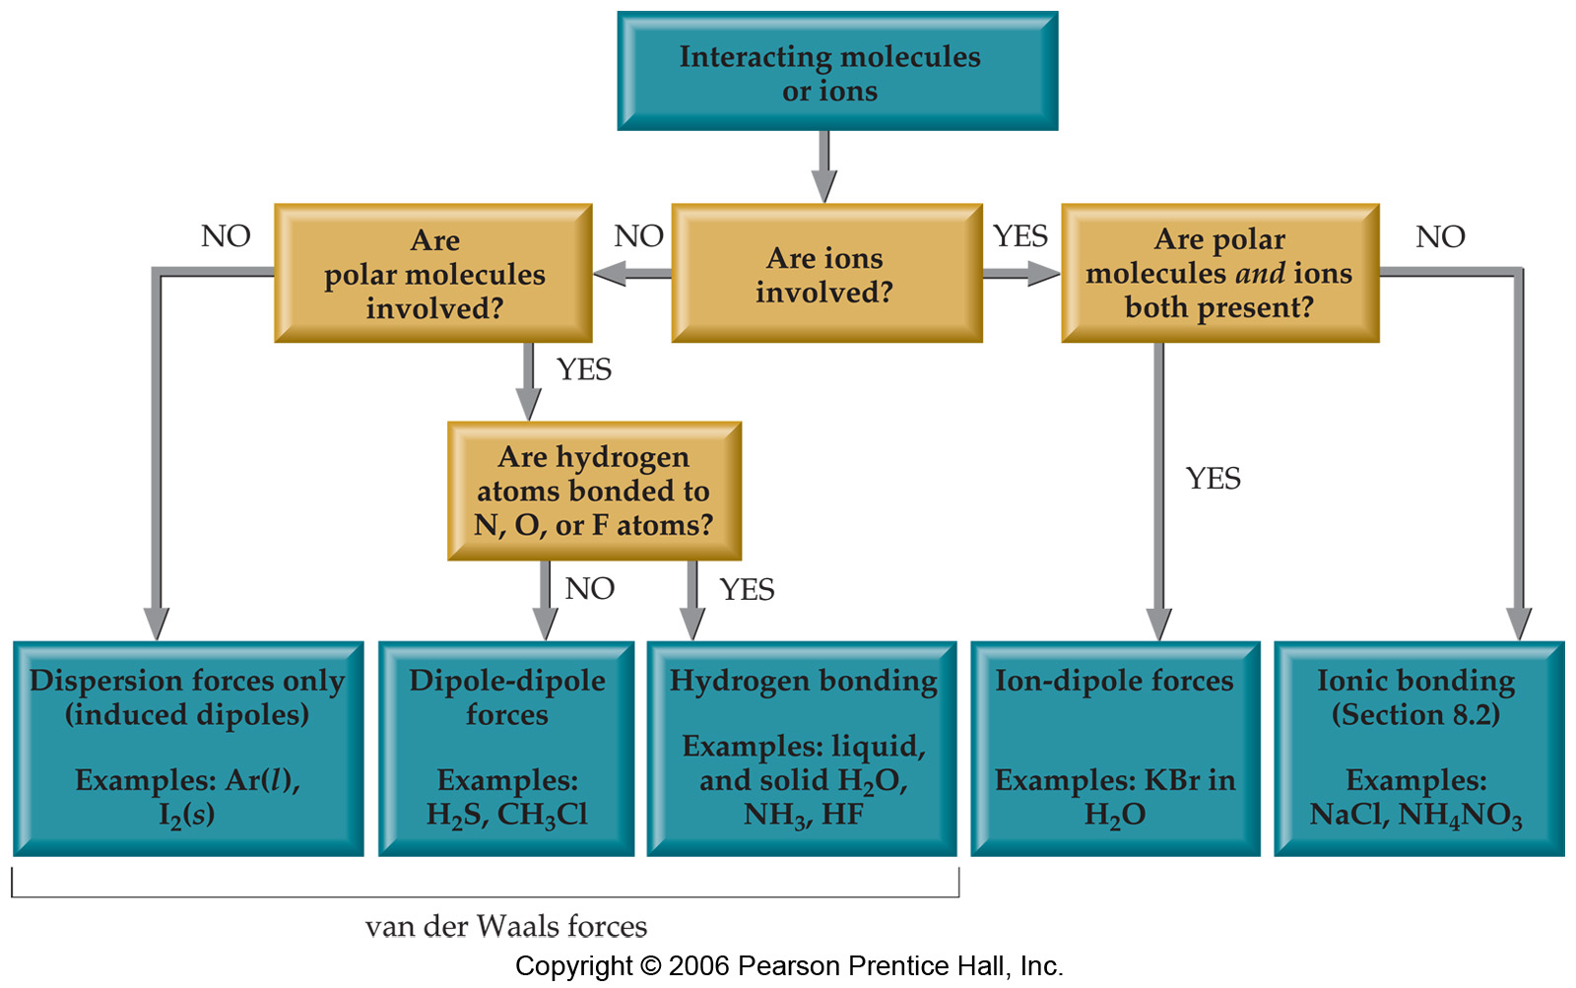

Slide 13
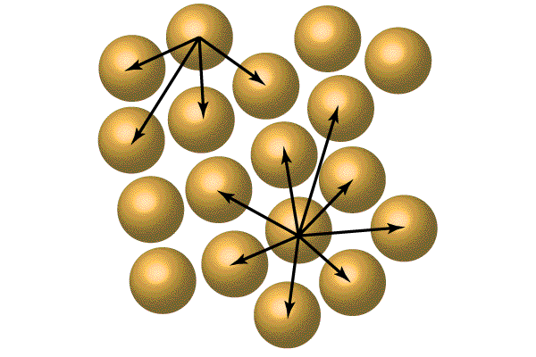

Slide 14
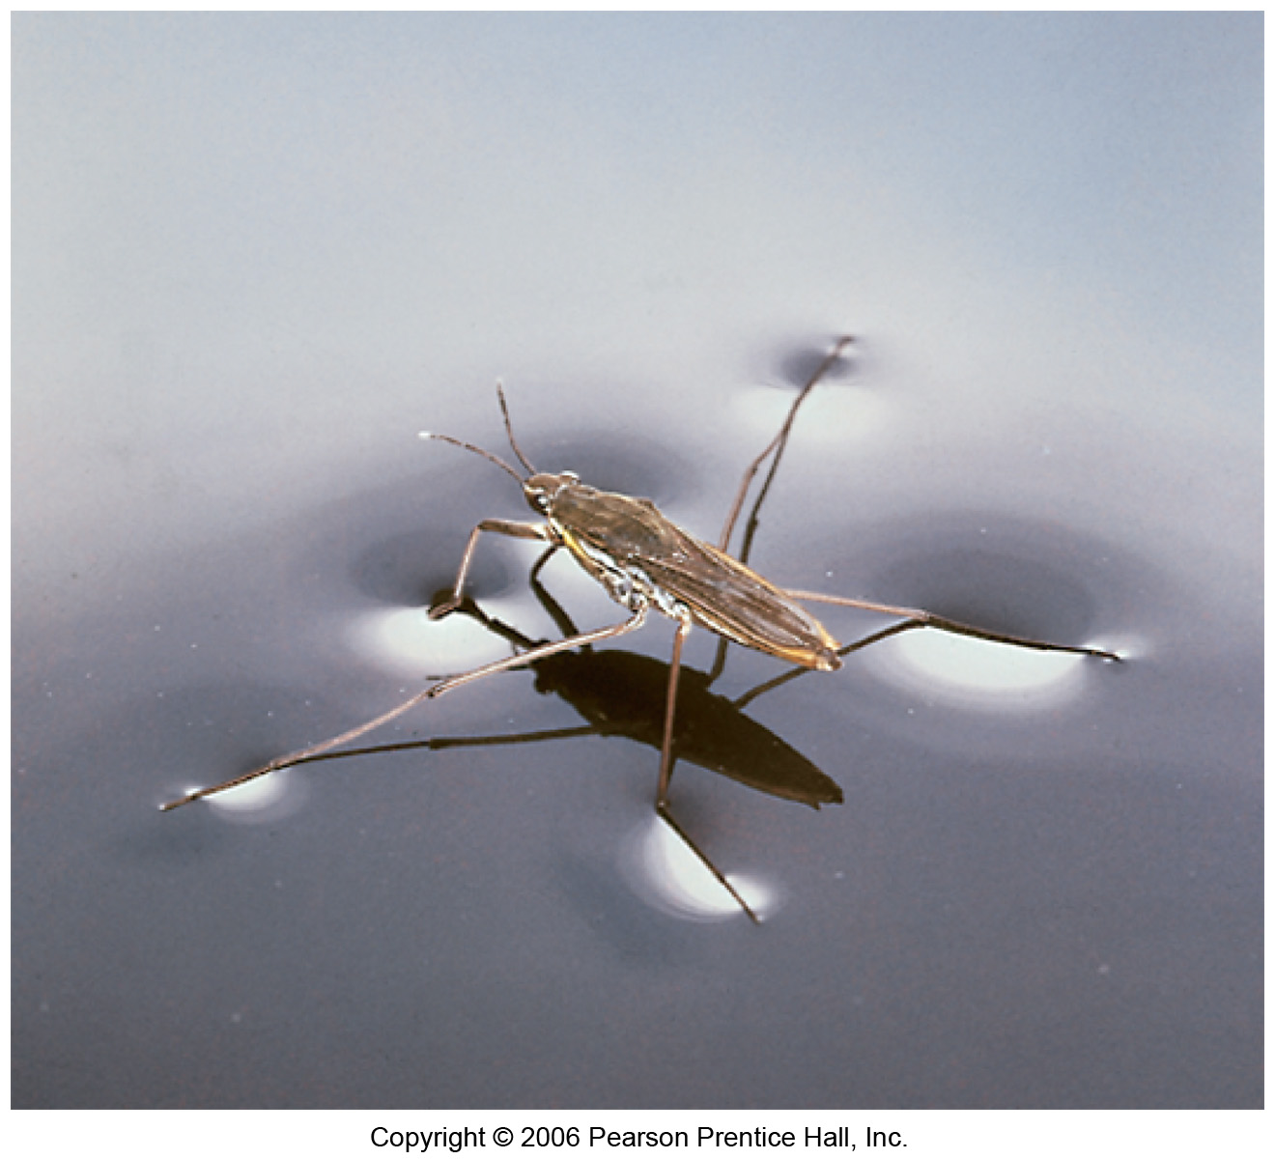

Slide 15
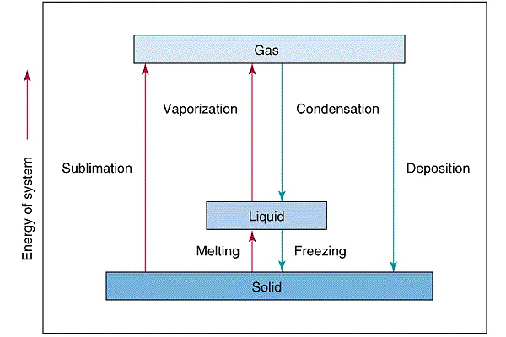

Slide 16
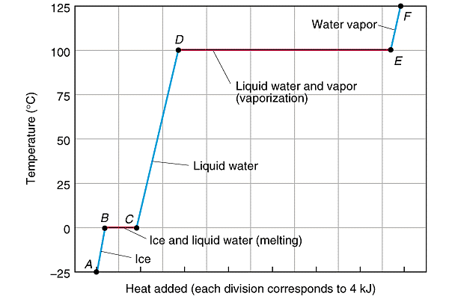

Slide 17
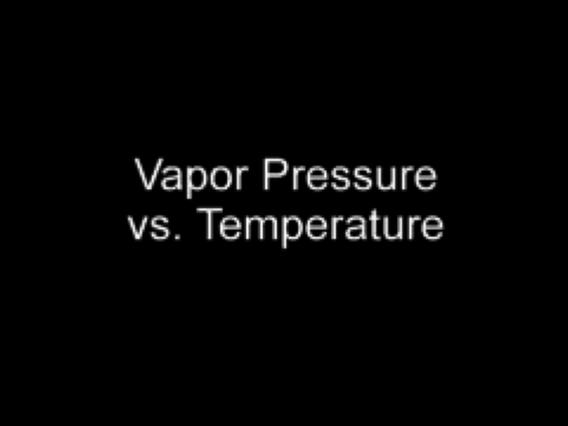
Vapor Pressure vs. Temperature
Play Video On YouTube
Notes:
AN26_034.mov

Slide 18
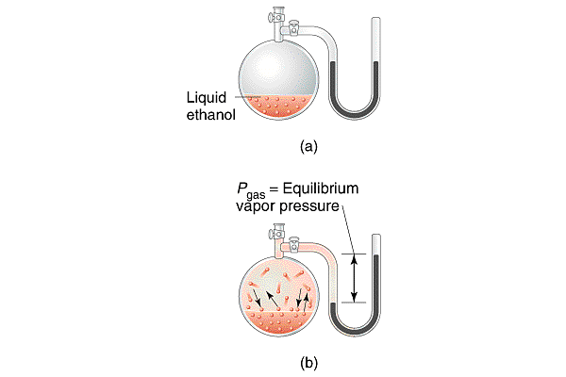

Slide 19
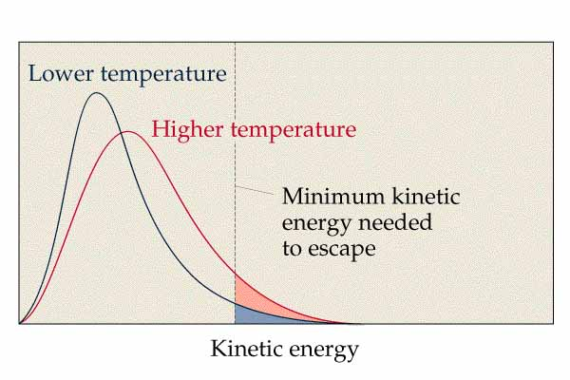

Slide 20
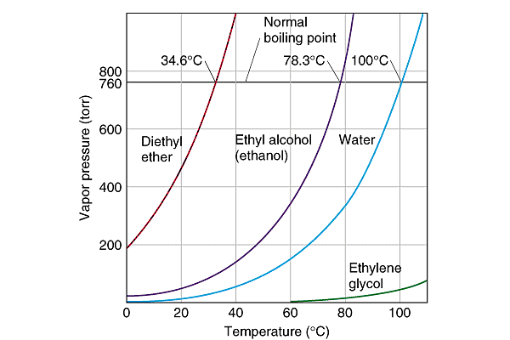

Slide 21
Bird Gas

Slide 22
Bird Gas at Condensation Point

Slide 23
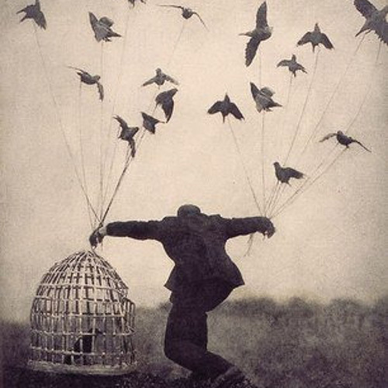
Bird Liquid

Slide 24
Bird Liquid at Melting Point

Slide 25
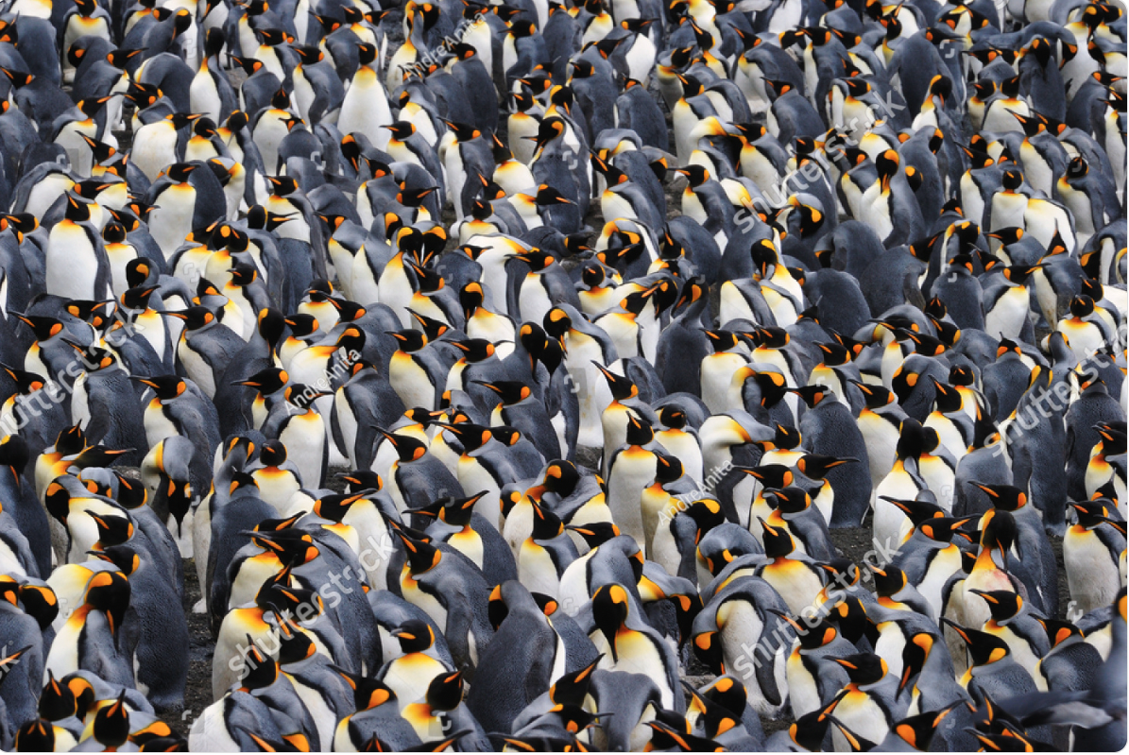
Bird Solid

Slide 26
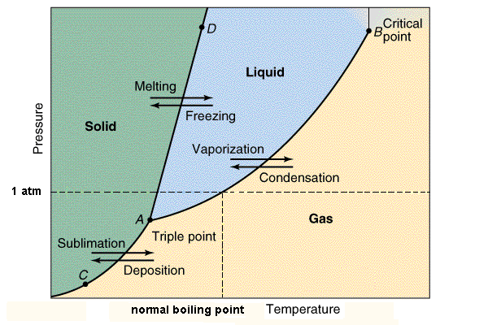

Slide 27
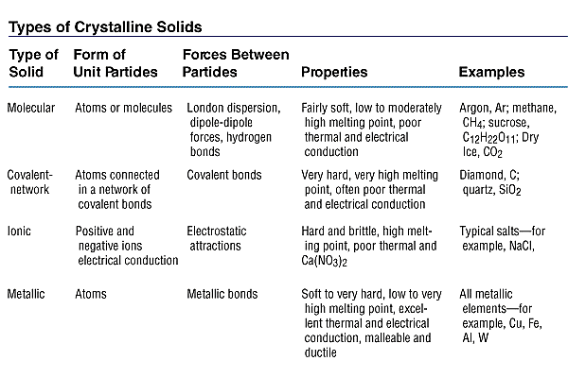

Slide 28
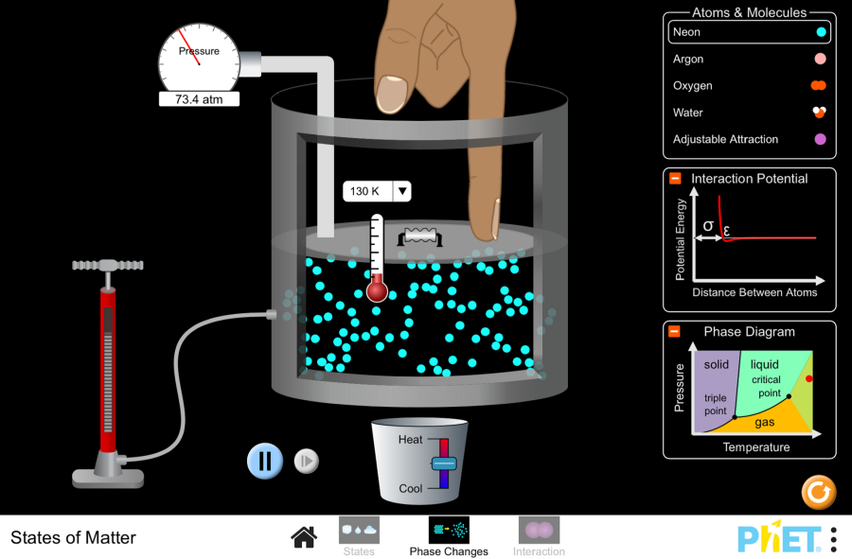
Play Phase Changes Animation

Slide 29
