Slide 1
Atoms, Molecules,
and Ions
Chapter 2

Slide 2
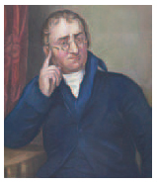
Atomic Theory of Matter
The theory that atoms are the fundamental building blocks of matter reemerged in the early 19th century, championed by John Dalton.
Notes:
Figure 2.1 John Dalton (1766-1844)

Slide 3
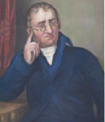
Dalton’s Postulates
All matter is composed of tiny particles called atoms.

Slide 4
Dalton’s Postulates
All atoms of a given element have identical chemical properties. Atoms of different elements have distinct properties.

Slide 5
Dalton’s Postulates
In chemical reactions, atoms of an element are not changed into different types of atoms; instead, a chemical reaction changes the way atoms are combined. Atoms are neither created nor destroyed.

Slide 6
Dalton’s Postulates
Atoms form chemical compounds by combining in whole-number ratios. All samples of a pure compound have the same combination of atoms.

Slide 7
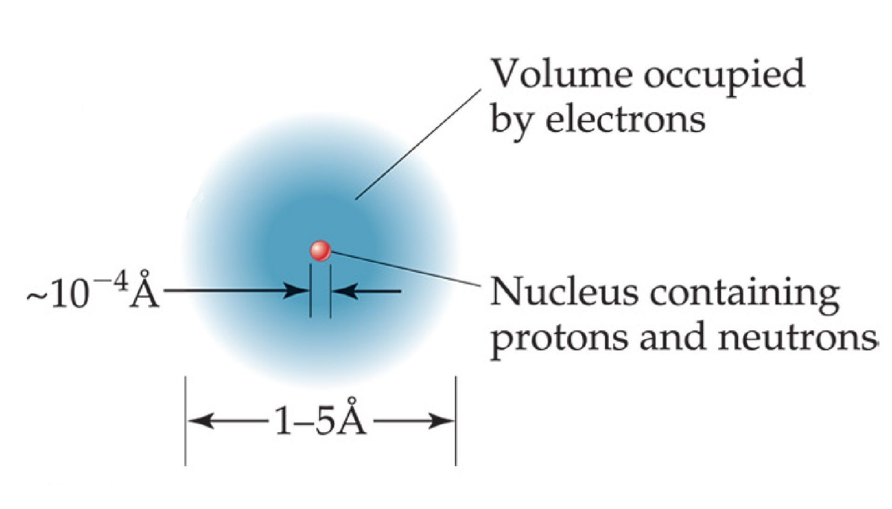
The Nuclear Atom
Notes:
Figure 2.12

Slide 8
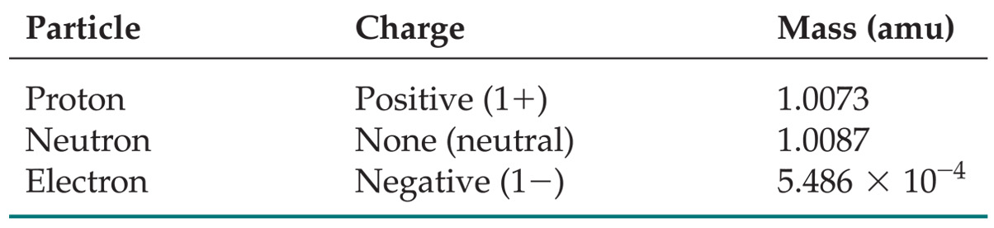
Subatomic Particles
Protons and electrons are the only particles that have a charge.
Protons and neutrons have essentially the same mass.
The mass of an electron is so small we sometimes ignore it.
Notes:
Table 2.1

Slide 9
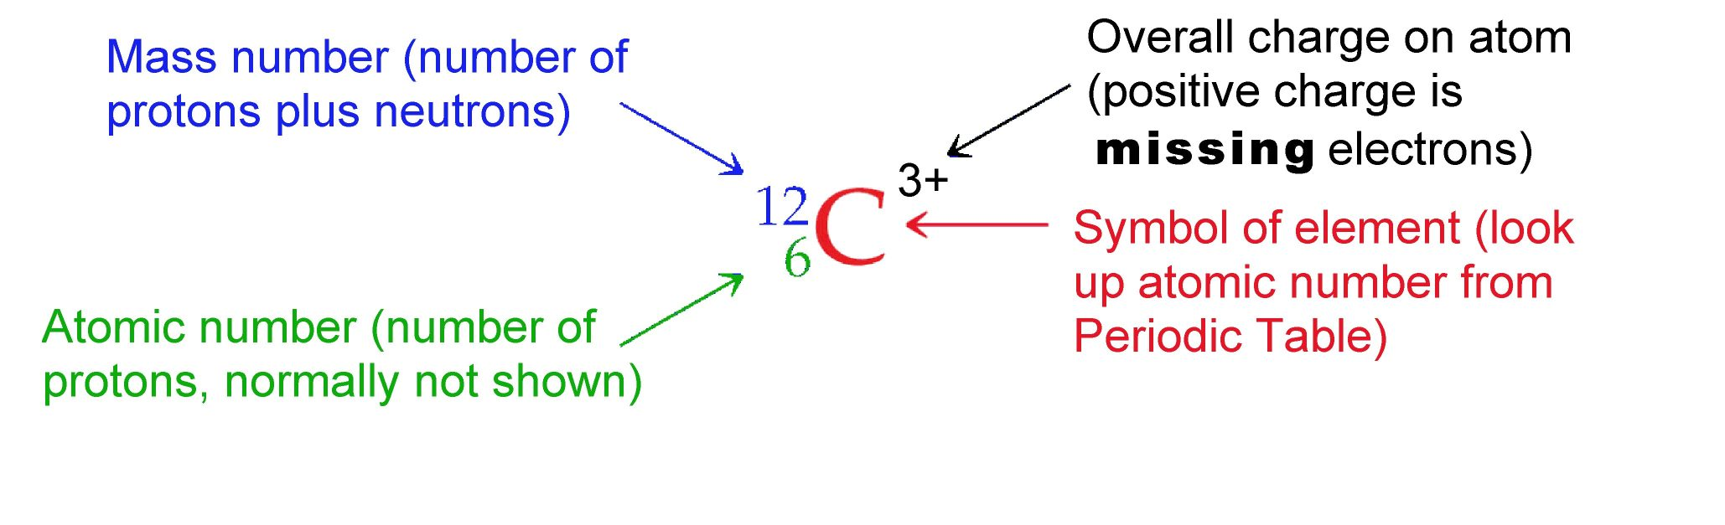
Isotope Designations
Elements are symbolized by one or two letters.
The atomic number is integer ABOVE Periodic Table symbol
Uncharged atoms have equal protons and electrons
Negative ions (anions) have EXTRA negative electrons
Positive ions (cations) are MISSING some negative electrons

Slide 10
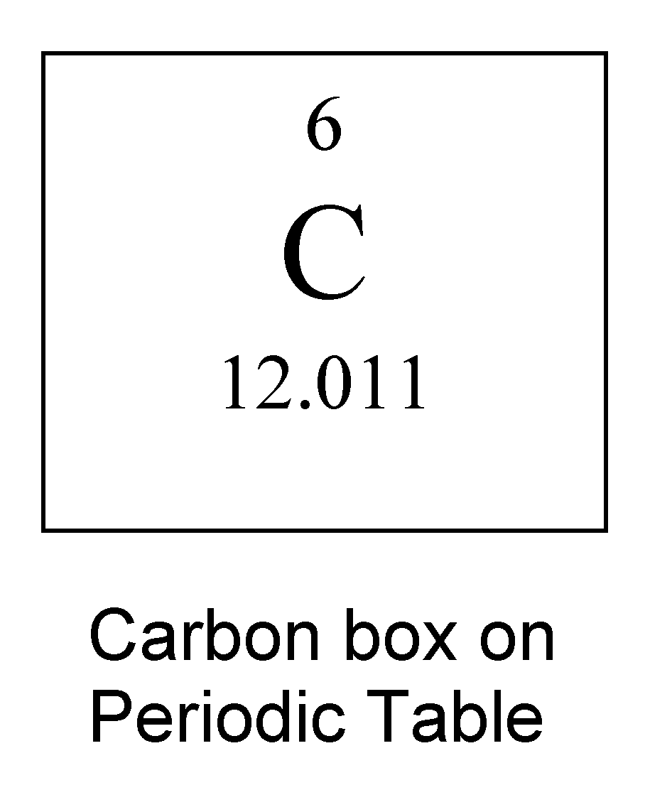
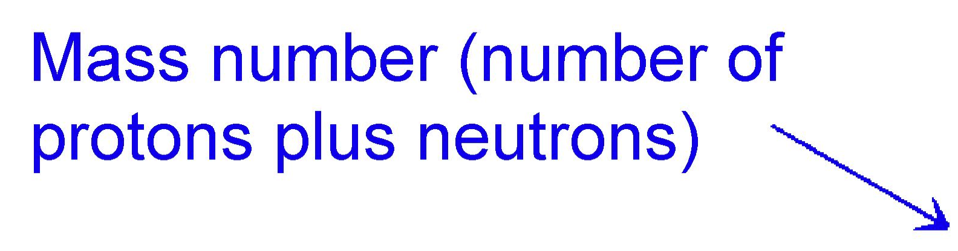
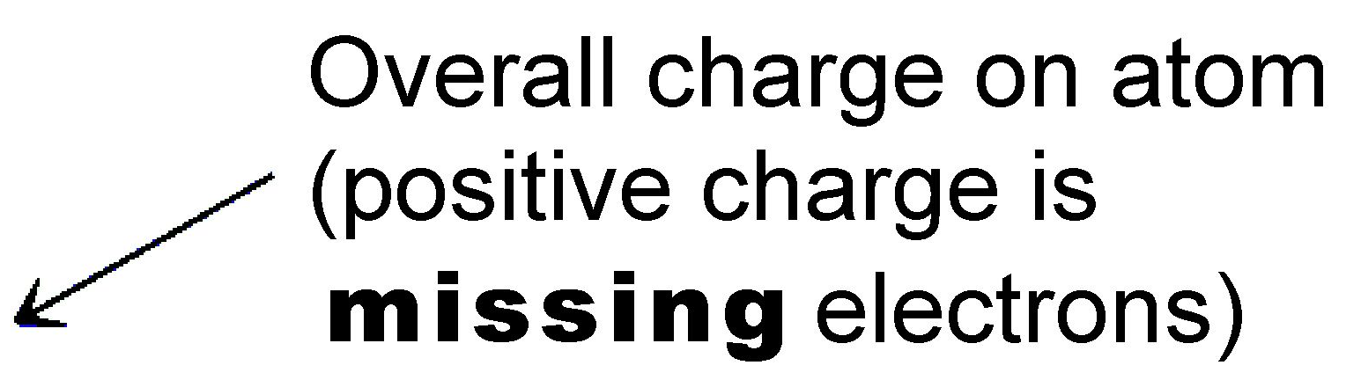
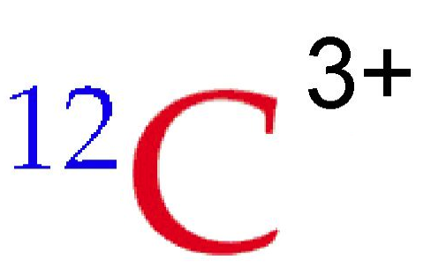
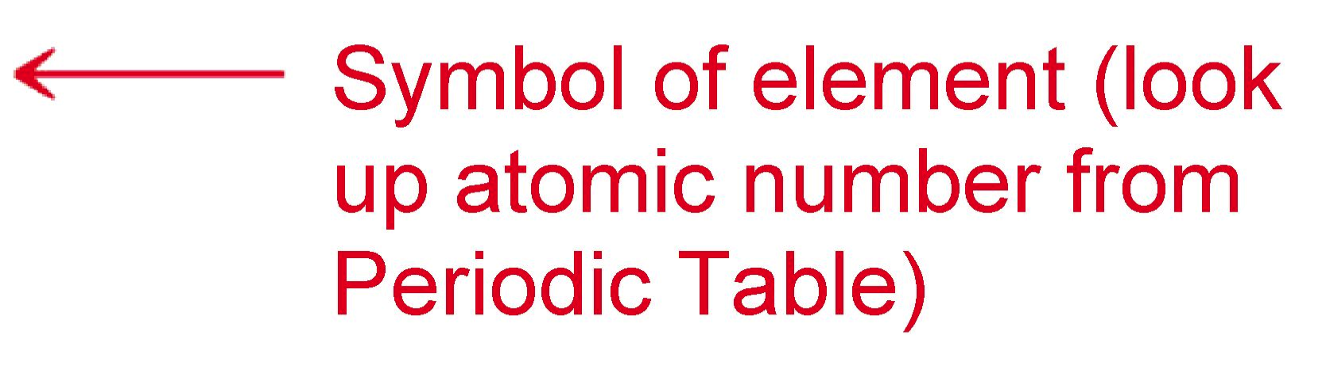
Isotope Designation
Atomic number is number of protons, found ABOVE atom symbol. ALL carbon atoms have 6 protons.
This atom is MISSING 3 NEGATIVE electrons (a double negative is positive). An atom with 6 protons which is missing three electrons has 3 electrons left.
This isotope of carbon has a total of 12 protons and neutrons. Since it has 6 protons it must have 12 - 6 = 6 neutrons

Slide 11
Isotopes:
Atoms of the same element with different masses.
Isotopes have different numbers of neutrons.
All atoms with the same symbol have same proton count
11
12
13
14
C
C
C
C

Slide 12
Fill In the Blanks
Hint: Do atomic number, protons, and symbol first!

Slide 13
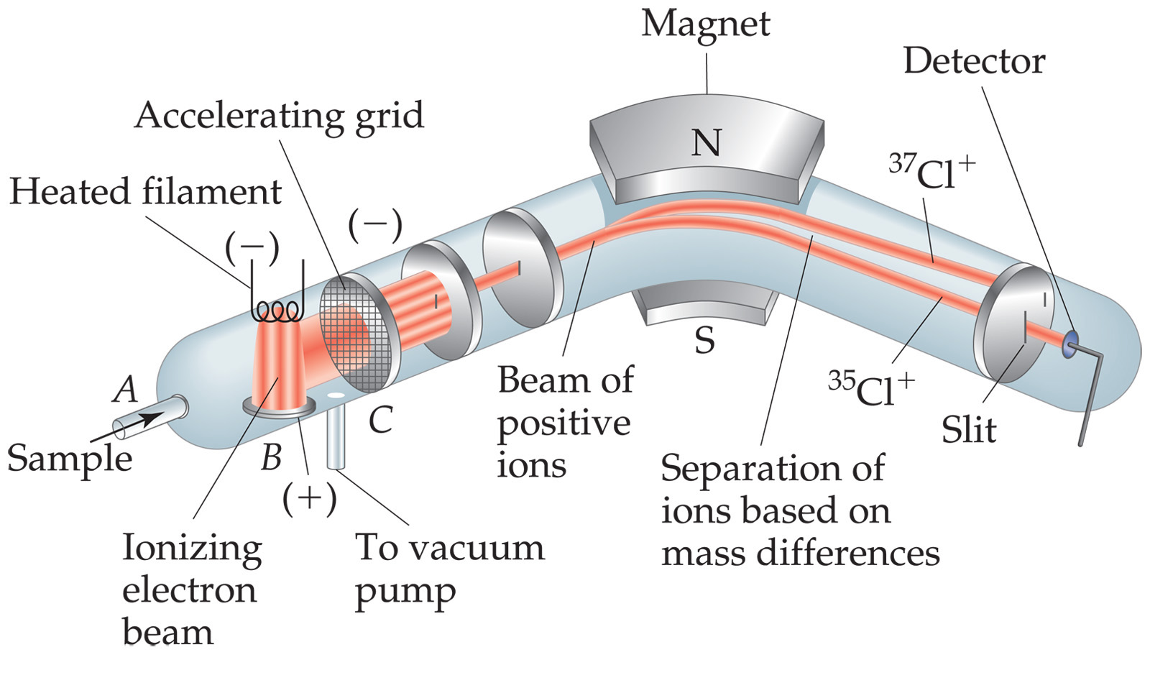
Atomic Mass
Atomic and molecular masses can be measured with great accuracy with a mass spectrometer.
First one electron is stripped off of each molecule or atom of sample (left side)
Next the positive ions (cations) are accelerated toward the magnet
Magnet’s strength is adjusted so that only ions with a certain mass hit detector
Heavier ions aren’t turned enough by the magnet; light ions turned too much
Notes:
Figure 2.13

Slide 14
Average Mass
Because in the real world we use large numbers of atoms and molecules, we use average masses in calculations.
Average mass is calculated from the isotopes of an element weighted by their relative abundances.
First a weighted mass is calculated for each isotope
Weighted mass is mass of isotope times fractional abundance of isotope (ie. 50% abundance = 0.5 fractional abundance)
Just add up the weighted masses for all of the isotopes to get the average mass of an atom of a particular element

Slide 15
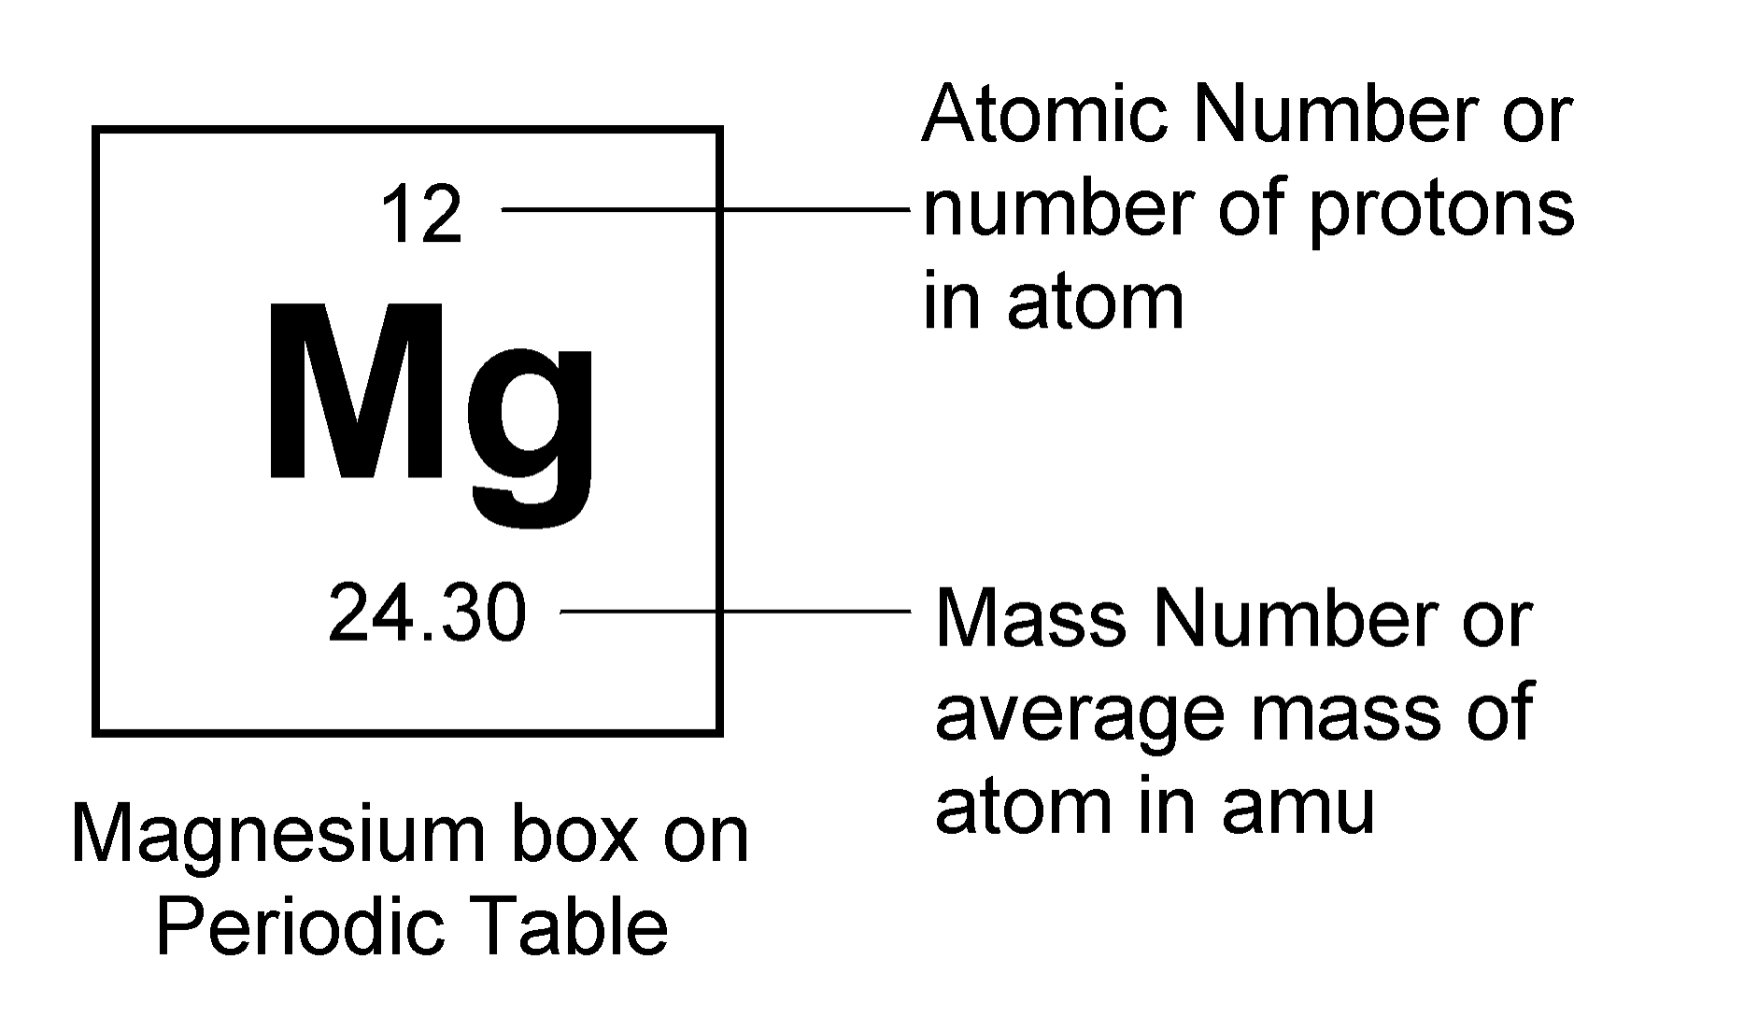
Weighted Average Mass
isotope | ²⁴Mg | ²⁵Mg | ²⁶Mg
mass | 23.985045 amu | 24.985839 amu | 25.982595 amu
abundance | 78.90% | 10.00% | 11.10%
abundance fraction | 0.7890 | 0.1000 | 0.1110
weighted mass | amu | amu | amu
18.92 amu + 2.499 amu + 2.884 amu = 24.30 amu average mass
²⁴Mg: (23.985045 mass) (0.7890 fraction) = 18.92 amu weighted mass
²⁵Mg: (24.985839 mass) (0.1000 fraction) = 2.499 amu weighted mass
²⁶Mg: (25.982595 mass) (0.1110 fraction) = 2.884 amu weighted mass

Slide 16
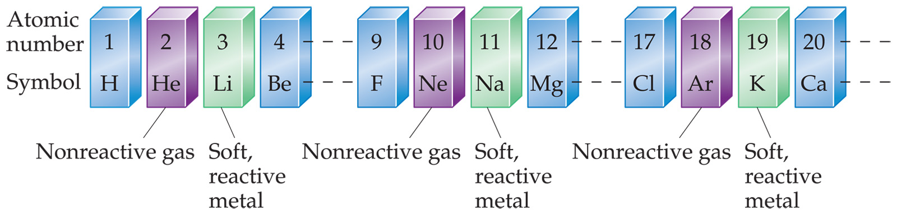
Periodicity
When you look at the chemical properties of elements, you see a repeating pattern as atoms of the elements get heavier (more protons, neutrons and electrons).

Slide 17
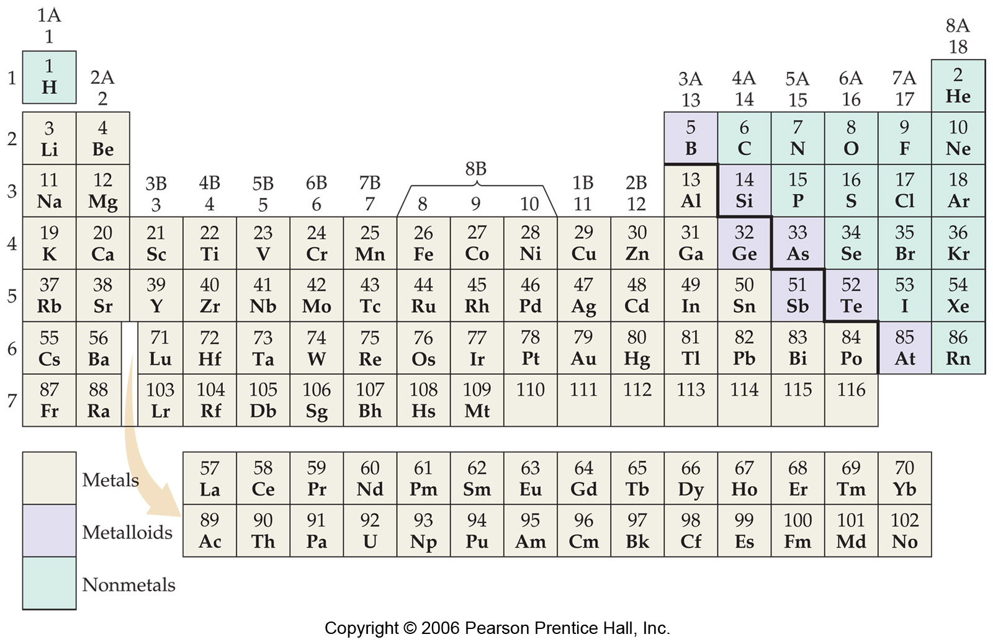
Periodic Table
The rows on the Periodic Table are periods.
Columns are groups.
Elements in the same group have similar chemical properties.

Slide 18
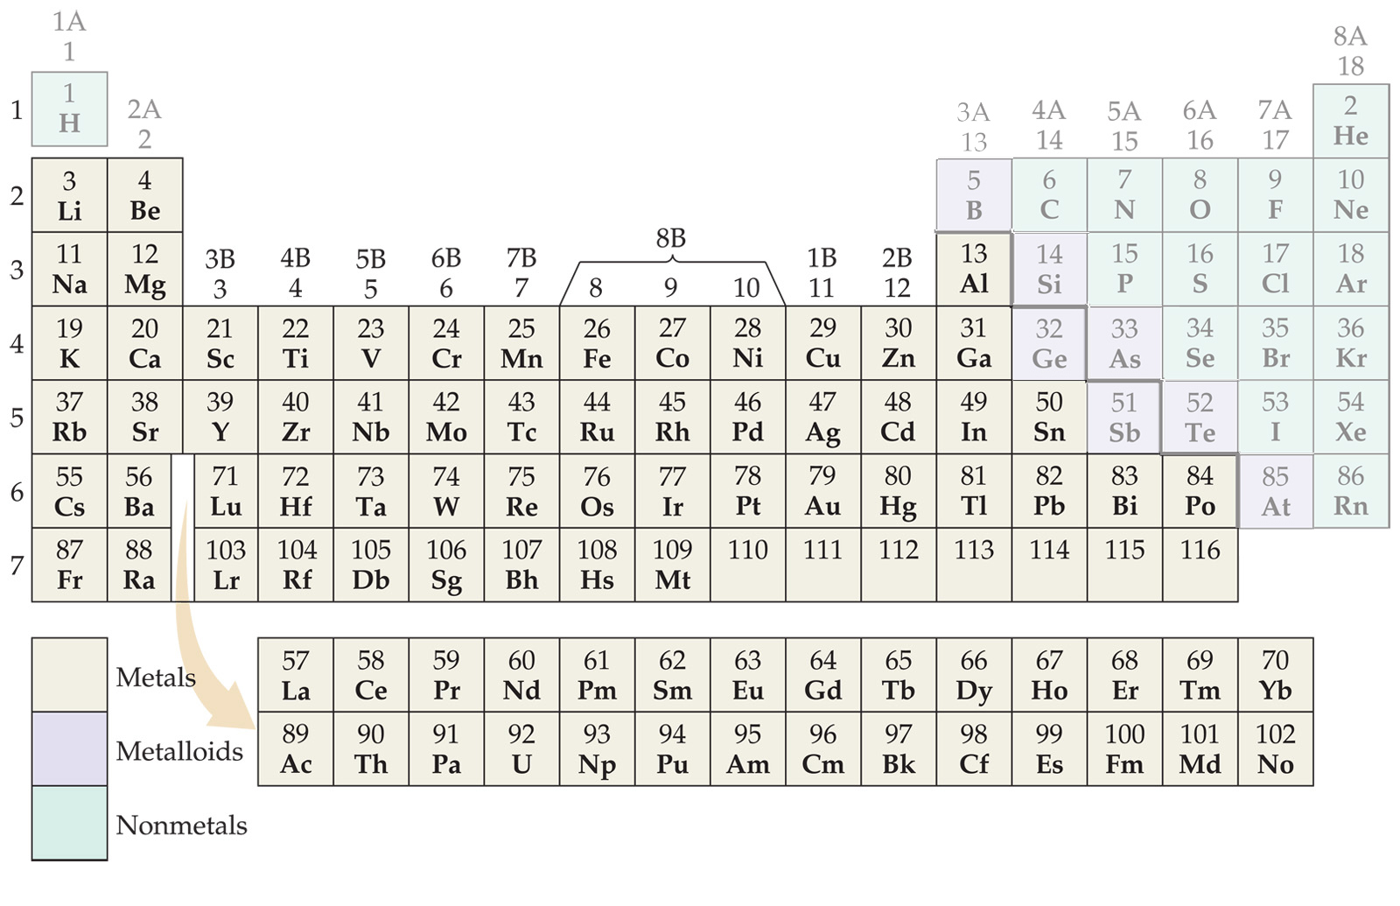
Periodic Table
Metals are on the left side of the table.

Slide 19
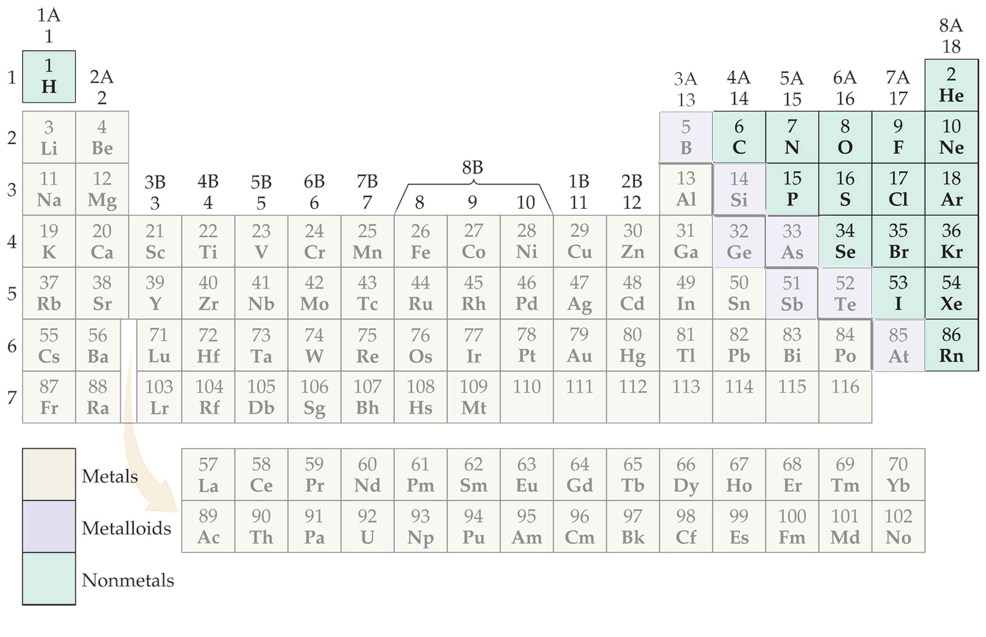
Periodic Table
Nonmetals are on the right side of the Periodic Table (with the exception of H).

Slide 20
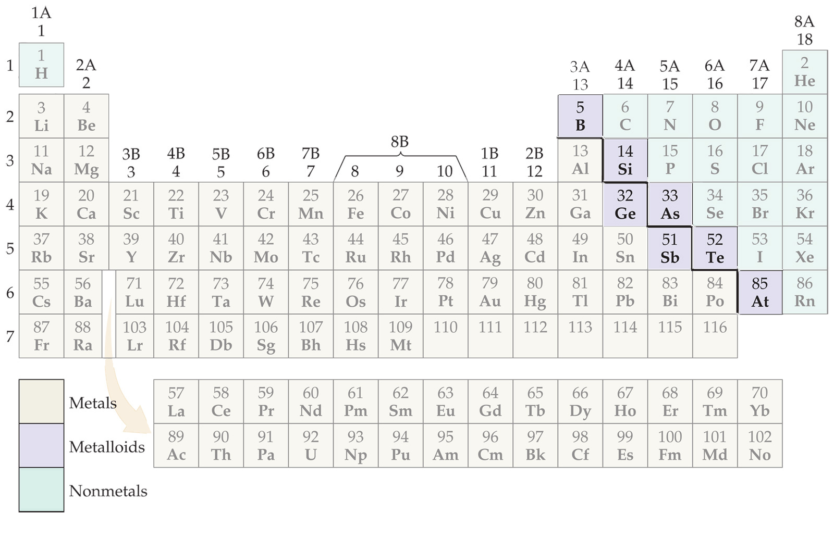
Periodic Table
Metalloids are on a diagonal line down and to the right from B and include Ge and Sb.
Learn the position of the “metal line” which contains the metalloids!

Slide 21
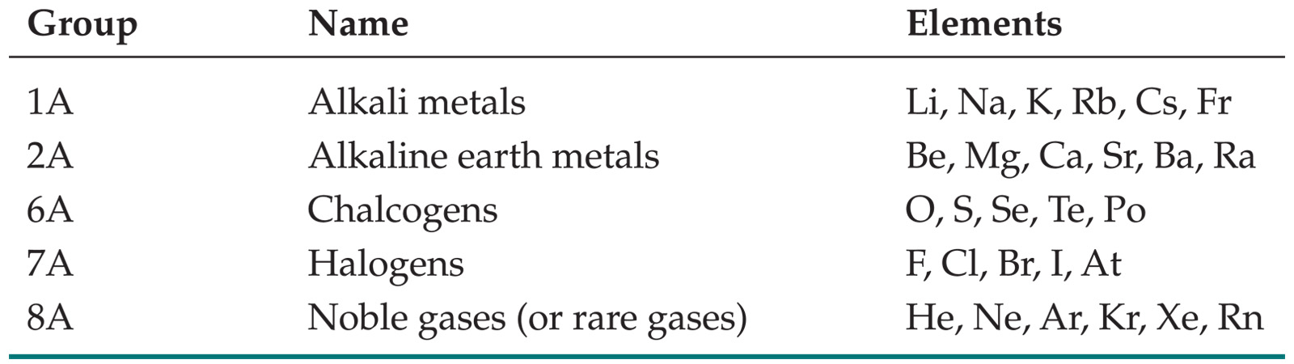
Groups
These five groups are known by their names.
Learn these!

Slide 22
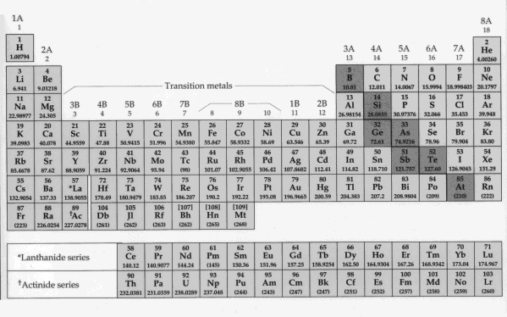
Periodic Table Summary
The Periodic Table is used to organize elements in a meaningful way.
There are periodic (cyclic) properties associated with the periodic table.
Columns in the periodic table are called groups and rows called periods.
Metals are located on the left-hand side (orange) and non-metals are located in the top right-hand side (green) of the Periodic Table and include hydrogen (top left).
Elements with properties between metals and non-metals called metalloids (dark blue) and are located on the “metal line” between the metals and non-metals.
Group 1A called alkalai metals (except H) - remember this and learn all names and symbols in 1A
Group 2A called alkaline earth metals - remember this and learn all names and symbols in 2A
Group 6A called chalcogens - remember this and learn all names and symbols in Group 6A
Group 7A called halogens - remember this and learn all symbols and names in this group
Group 8A called noble gases - remember this and learn names and symbols of all noble gases
Learn names and symbols of Pd, Pt, Groups 1B, 2B, 3A, 4A, 5A, and first row of transition metals

Slide 23
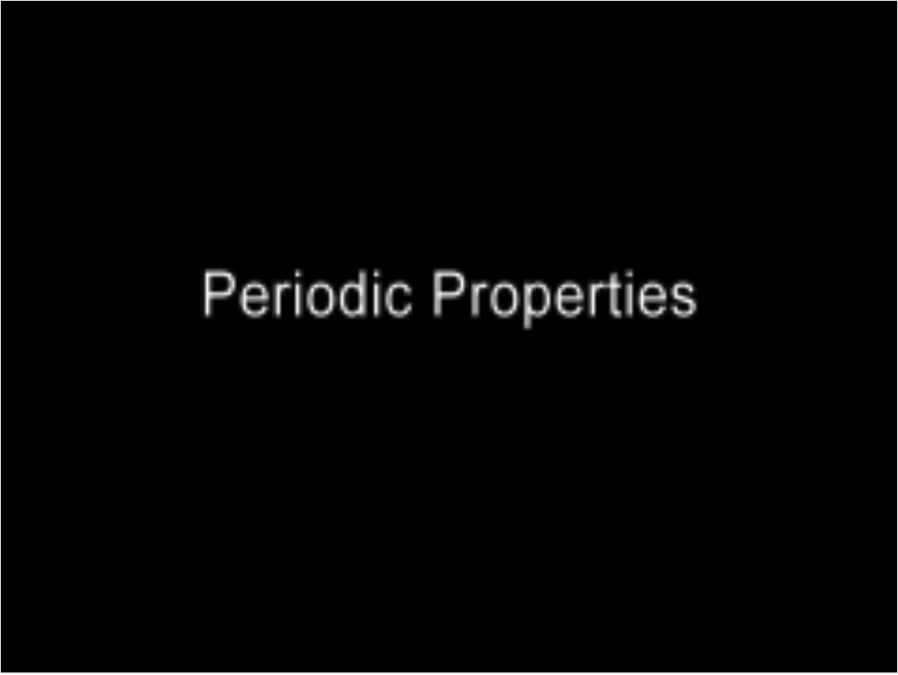
Periodic Table Video
Play Video

Slide 24
Ions and Molecules
Molecules are ultrasmall particles made from more than one atom where the particle has no charge (equal protons and electrons)
Molecules are made from H, metalloids and nonmetals ONLY - no metals!
Ions are ultrasmall particles made from one or more atoms where these particles have some charge (unequal protons and electrons)
Ions with POSITIVE charges are called CATIONS
Ions with NEGATIVE charges are called ANIONS
Ions can be made from any kind of atoms, metals, H, metalloids, and/or nonmetals

Slide 25
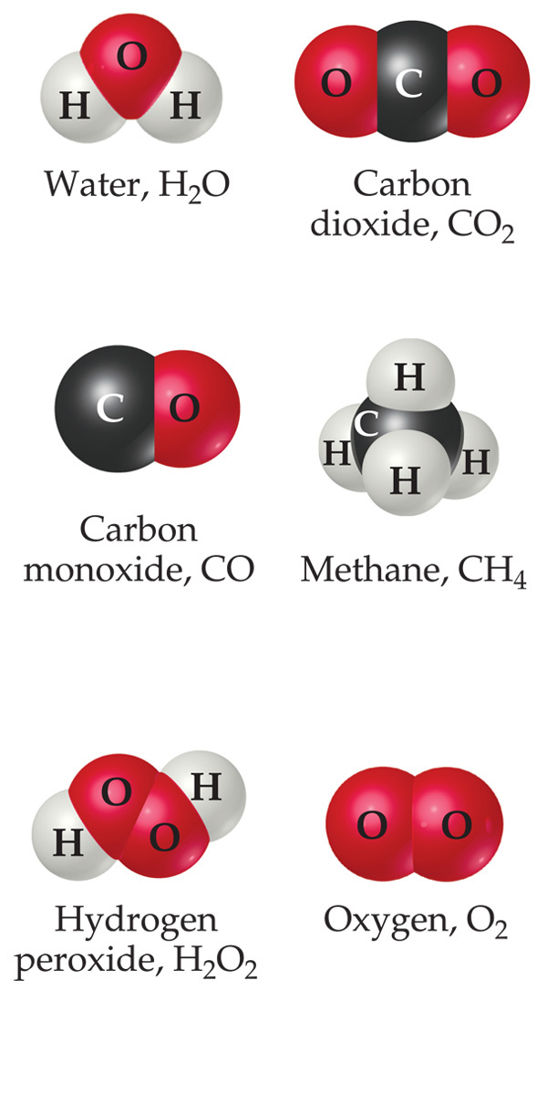
Molecular Chemical Formulas
Chemical formulas of MOLECULAR compounds tell you what kinds of atoms are bonded together to make a molecule of a compound.
The subscript to the right of the symbol of an element tells the number of atoms of that element in one molecule of the compound.
The chemical formula for water is H₂O because each water MOLECULE contains two hydrogen atoms and one oxygen atom.
If a chemical formula has NO METALS in it, NO CHARGE (positive or negative), and no NH₄ it is usually a MOLECULAR chemical formula (exceptions later in the course). LEARN THIS!

Slide 26
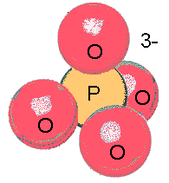
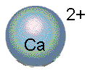
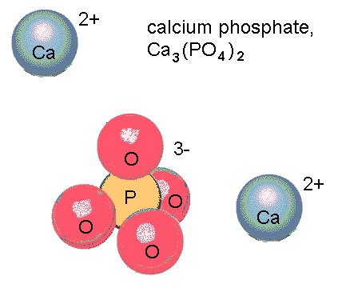
Ionic Chemical Formulas
Ionic formulas are a little trickier than molecular ones
The formula for an ION works like a molecular formula, except that a charge is included as a superscript to the right of the formula
The formula for calcium ion is Ca²⁺
The formula for phosphate ion is PO₄³⁻
Ionic COMPOUNDS have formulas which are NEUTRAL (no charges written) because the total amount of positive charge equals the total amount of negative charge in the formula
Calcium phosphate’s formula has 6 positive charges from the 3 calcium ions, and 6 negative charges from the 2 phosphate ions, so this formula is neutral overall (the positive and negative charges cancel)
In this course ionic compounds have formulas with metals AND nonmetals in them or they have ammonium (NH₄) in the beginning of the formula

Slide 27
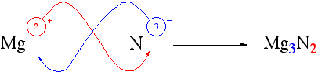
Writing Ionic Formulas
  The charge on the cation becomes the subscript on the anion.
  The charge on the anion becomes the subscript on the cation.
  If these subscripts are not in the lowest whole-number ratio, divide them by the greatest common factor (ie. Pb⁴⁺ + O²⁻ makes PbO₂ and NOT Pb₂O₄

Slide 28
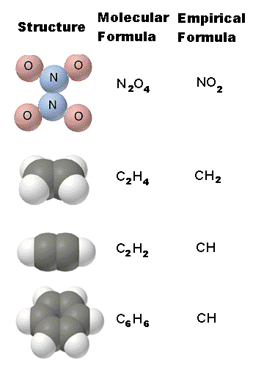
Empirical vs. Molecular Formulas
Empirical formulas give the lowest whole-number ratio of atoms of each element in a compound.
Molecular formulas give the exact number of atoms of each element in a molecule.
Molecular formulas can be turned into empirical formulas by dividing each subscript in the formula by the largest possible factor common to all of them.

Slide 29
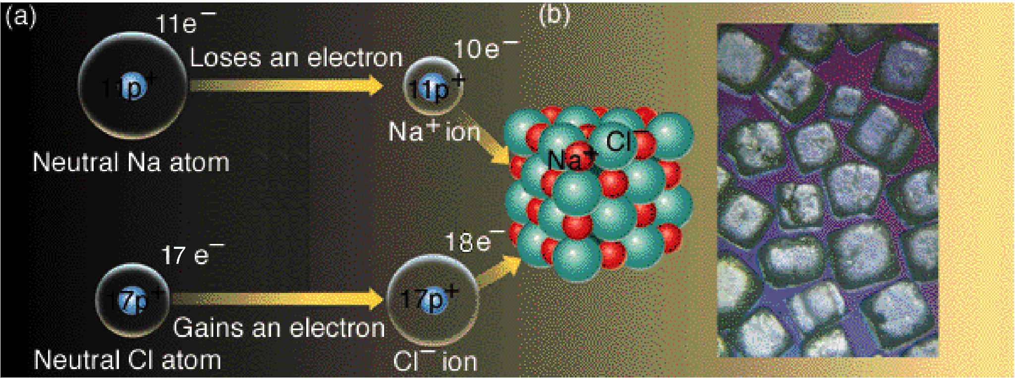
Ionic Bond Formation
When a metal atom meets a nonmetal atom the metal atom can give one or more electrons to the nonmetal atom
Nonmetal atoms like electrons more than metal atoms do.
The metal atom loses negative-charged electron(s) and becomes a (positive) cation
The nonmetal atom gains negative-charged electron(s) and becomes a (negative) anion
The anion and cation are now held together by opposite charge attraction, an IONIC BOND
Lots of atoms doing this leads to an IONIC LATTICE shown in picture above
Notice there are no distinct pairs of sodium and chloride ions - the formula NaCl doesn’t describe individual particles like molecules

Slide 30
Names/Formulas of Anions
Anions made of only ONE nonmetal atom are named by taking breaking off the end of the name of the nonmetal atom and replacing it with -ide
You break off only the last syllable of the element name unless the result ends in a vowel, in which case you break off another syllable
Exception: phosphorus becomes phosph rather than phosphor
The amount of negative charge on single-atom anions is determined by finding the atom on the Periodic Table and counting how many elements to the RIGHT you have to go to hit the nearest noble gas element.
Se is two elements away from the noble gas Kr
The name and formula for the anion made from Se is selenide, Se²⁻
I is 1 element away from the noble gas Xe
The anion made from I is iodide, I⁻

Slide 31
Oxyanions - Charges
The most common kind of anion which is made of more than atom is an OXYANION
An oxyanion is made of ONE metalloid or nonmetal atom OTHER THAN oxygen and anywhere from one to four oxygen atoms
Oxygen (O), fluorine (F), and the noble gases (He, Ne, Ar, Kr, Xe, and Rn) do NOT combine with oxygen to make oxyanions
The amount of negative charge on an oxyanion is determined by finding the metalloid or nonmetal atom (NOT oxygen) used to make the oxyanion on the Periodic Table and counting how many elements to the right you have to go to hit the first element which will NOT form an oxyanion
B is three elements away from O, which doesn’t make oxyanions. The oxyanion made out of B is borate, BO₃³⁻
Se is two elements away from Kr, which does not make oxyanions. Se makes two oxyanions, both with -2 charge, selenate, SeO₄²⁻, and selenite, SeO₃²⁻

Slide 32
Oxyanion Formulas (-ate)
The most common oxyanions are named by chopping off the end of an element name and adding -ate, ie. nitrate, NO₃⁻
Carbon does NOT chop off the end of the atom name to make carbonate, CO₃²⁻
The oxyanions with the -ATE ending have THREE oxygens if metalloid/nonmetal atom is on SECOND ROW of Periodic Table (B, C, N, but NOT O, F, or Ne), OR if metalloid/nonmetal is in COLUMN 7A (Cl, Br, I, At, but NOT F).
Examples: chlorate, ClO₃⁻ and borate, BO₃³⁻ and iodate, IO₃⁻
The oxyanions with the -ate ending have FOUR oxygens otherwise
Examples: silicate, SiO₄⁴⁻ and arsenate, AsO₄³⁻ and sulfate, SO₄²⁻

Slide 33
Other Oxyanion Formulas
Oxyanions with one less oxygen than -ate oxyanions have the -ite ending
Examples: nitrite, NO₂⁻, and arsenite, AsO₃³⁻, and bromite, BrO₂⁻
B, C, Si, and Ge DO NOT have -ite oxyanions
The halogens in COLUMN 7A ONLY (except F) have hypo_ite and per_ate oxyanions as well as -ate and -ite oxyanions
The hypo_ite oxyanions have only one oxygen
Examples: hypochlorite, ClO⁻, and hypobromite, BrO⁻, and hypoiodite, IO⁻
The per_ate oxyanions have four oxygens
Examples: perchlorate, ClO₄⁻, and perbromate, BrO₄⁻, and periodate, IO₄⁻

Slide 34
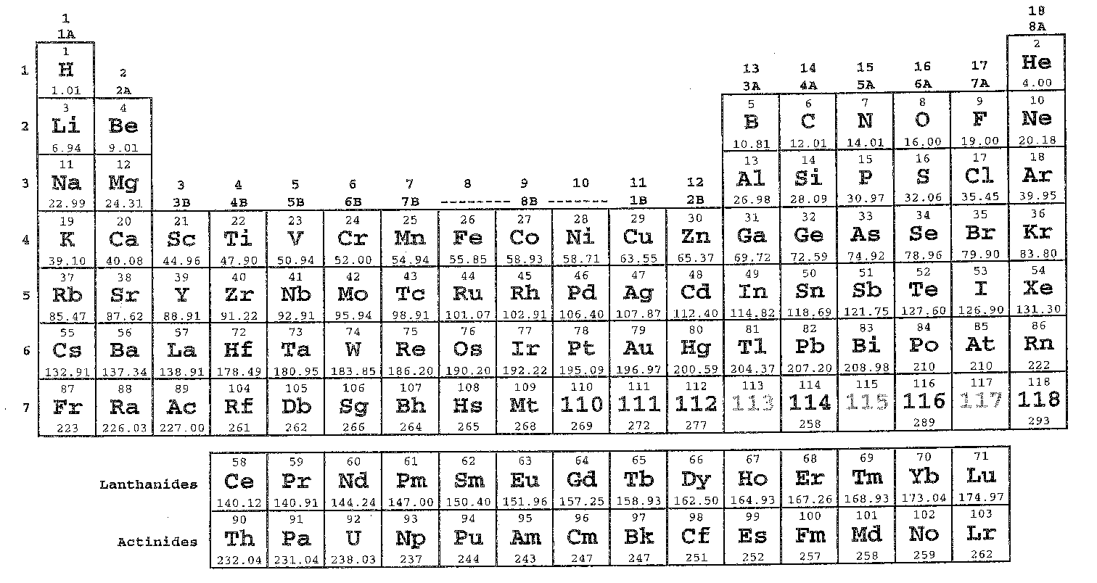
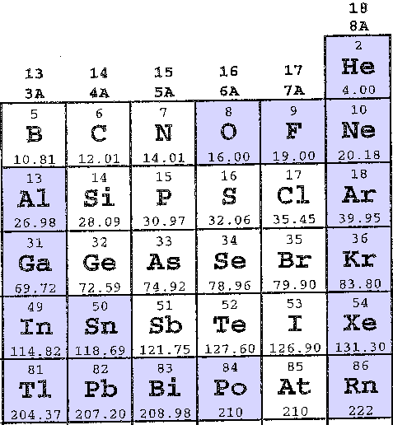
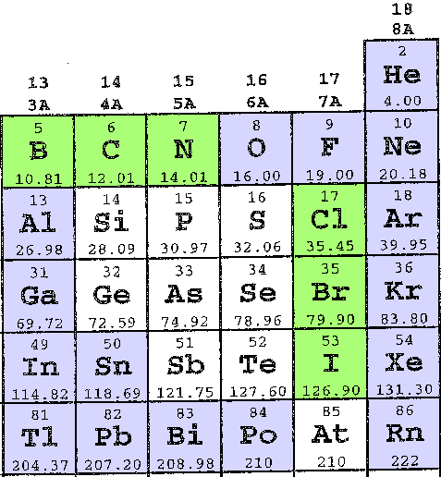
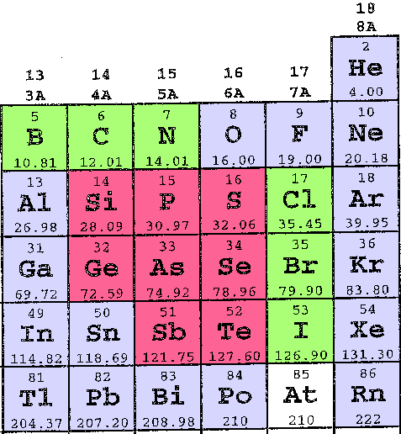
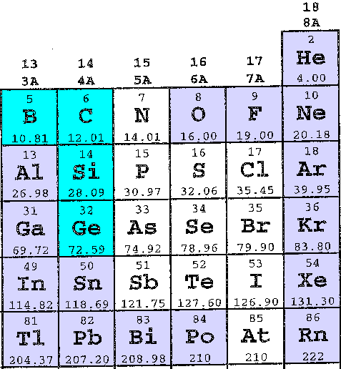
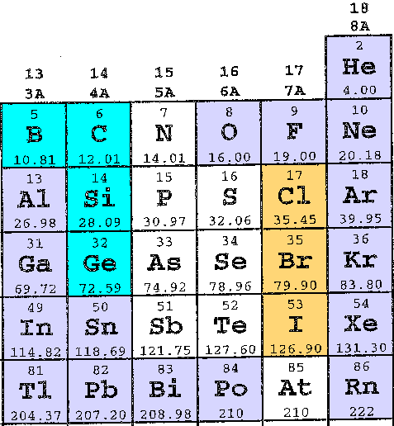
Oxyanion Summary
O, F, and noble gases DON’T DO oxyanions; don’t worry about metals on left side
B, C, N, Cl, Br, and I use THREE oxygens to make -ATE oxyanions
The inner elements use FOUR oxygens to make -ATE oxyanions
-ITE oxyanions have one less oxygen than -ATE oxyanions; B, C, Si and Ge DON’T DO -ITE oxyanions
Cl, Br, and I do PER_ATE (4 oxygen) and HYPO_ITE (1 oxygen) oxyanions

Slide 35
Hydrogenated Oxyanions
Adding one hydrogen atom in front of the formula for an oxyanion reduces the amount of negative charge on the ion by one unit
Example: phosphite, PO₃³⁻ becomes hydrogen phosphite, HPO₃²⁻
Adding two hydrogens in front of the formula for an oxyanion reduces the amount of negative charge by 2 units
Example: arsenate, AsO₄³⁻ becomes dihydrogen arsenate, H₂AsO₄⁻
You have to add LESS hydrogens to an oxyanion than the amount of negative charge originally on the oxyanion, otherwise you get rid of all of the negative charge on the anion and you no longer have an anion!
Example: selenate, SeO₄²⁻ + 2 H+ makes selenic acid H₂SeO₄, NOT AN ANION

Slide 36
Other Anions
Learn the names and formulas INCLUDING CHARGES of the following anions (make flashcards for each one with the name on one side and the formula and charge on the other side):
  Hydride, H⁻
  Hydrosulfide, HS⁻
  Hydroxide, OH⁻
  Cyanide, CN⁻
  Peroxide, O₂²⁻
  Acetate, C₂H₃O₂⁻ or CH₃COO⁻
  Permanganate, MnO₄⁻
  Chromate, CrO₄²⁻
  Dichromate, Cr₂O₇²⁻

Slide 37
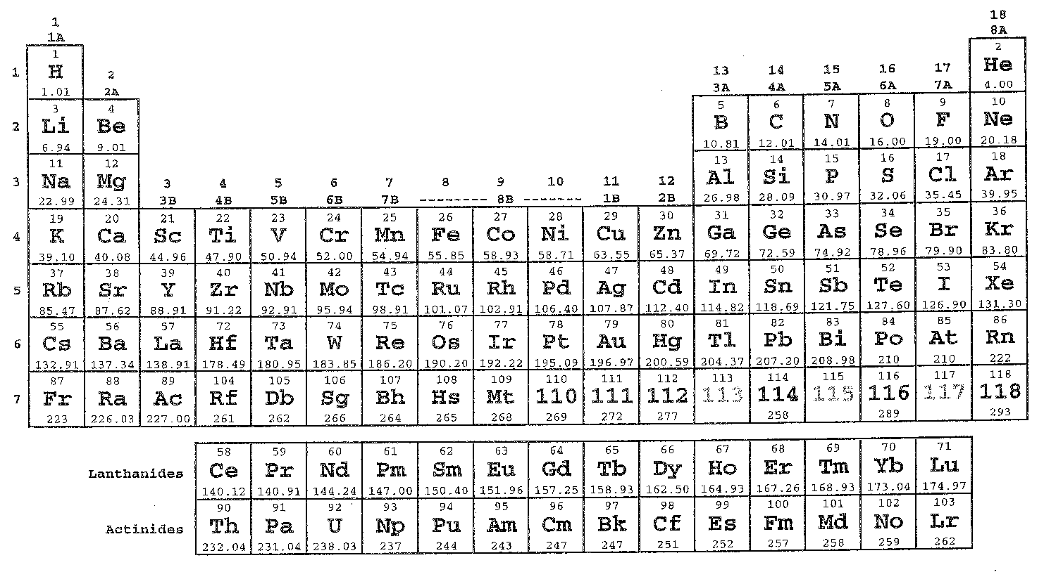
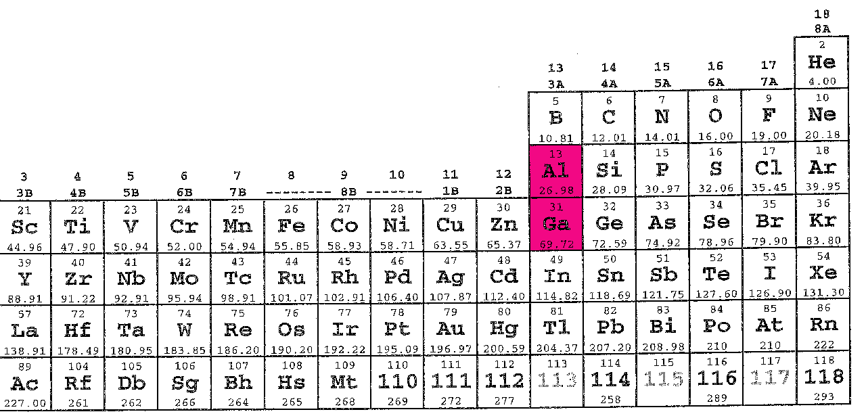
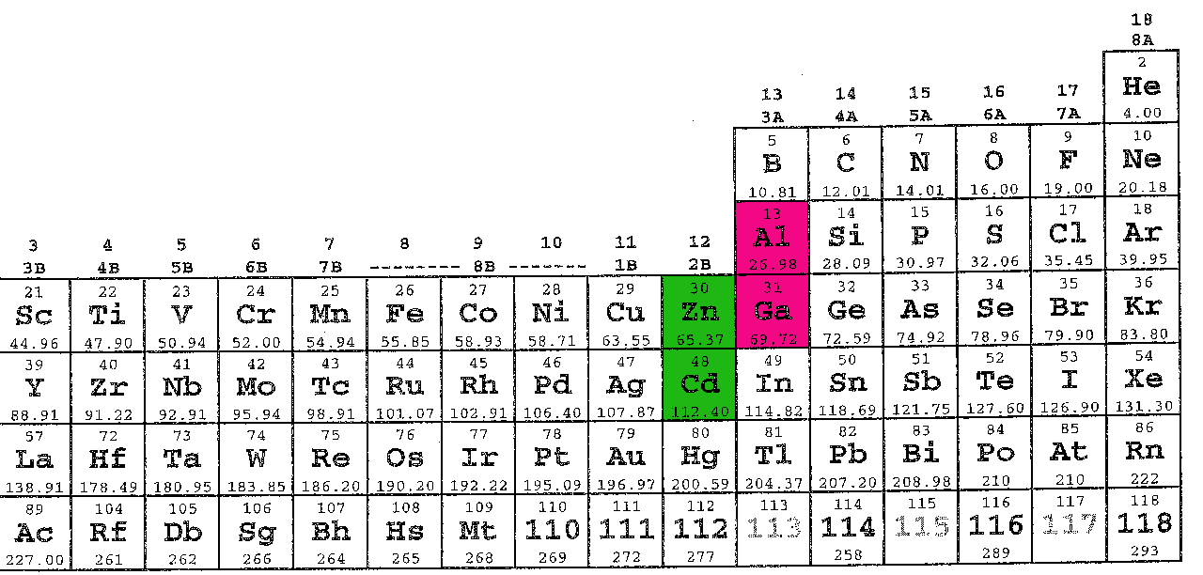
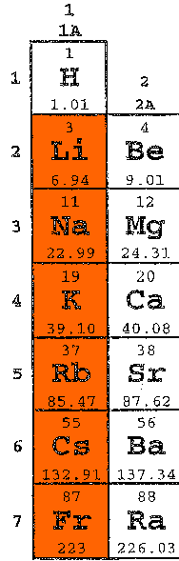
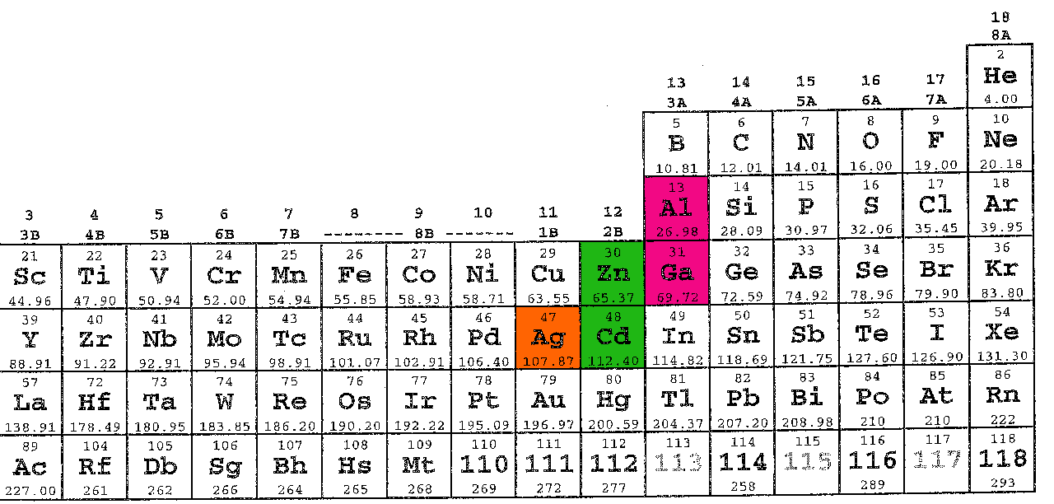
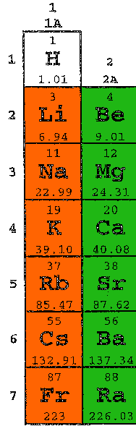
Cations
Cations are easier to name than anions
The METAL cations from column 1A (not H), the cations from column 2A, Al, Ga, Zn, Cd, and Ag have the same names as the neutral atoms they are made from
Ex: Ca²⁺ is calcium ion
The METAL cations in column 1A always have +1 charge, ie. potassium ion, K⁺
The cations in column 2A always have +2 charge, ie. Barium ion, Ba²⁺
The cations made from Al and Ga always have +3 charge, Al³⁺ and Ga³⁺
The cations made from Zn and Cd always have +2 charge, ie. Zn²⁺ and Cd²⁺
Silver ion always has +1 charge, ie. Ag⁺

Slide 38
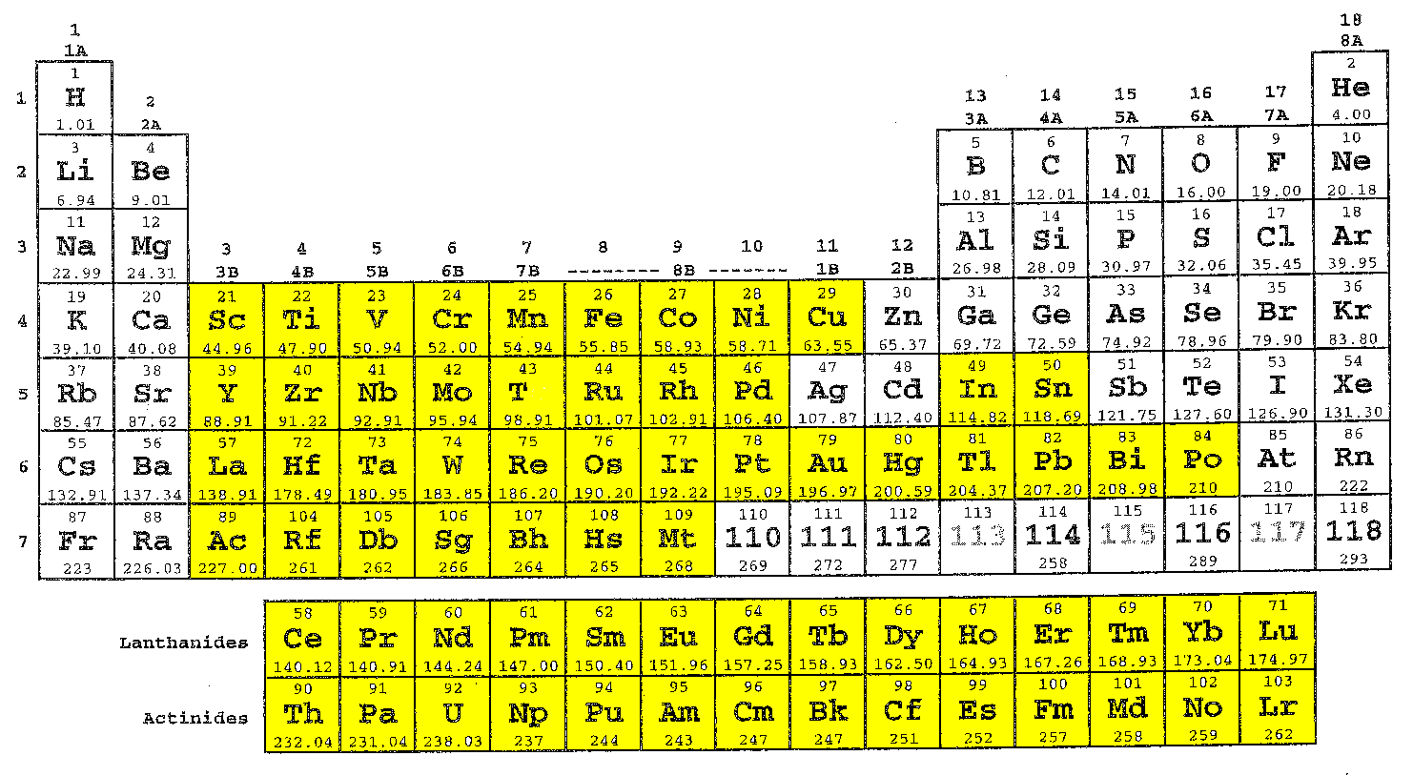
Cations
Most of the metallic elements on the Periodic Table can form at least two DIFFERENT cations which have different charges (yellow highlighted elements)
For example manganese can form manganese(II), Mn²⁺ or manganese(IV), Mn⁴⁺ or manganese(VII), Mn⁷⁺
To name cations where there is more than one possible charge for the ion you need to use Roman numerals and parentheses like in the manganese case above
If a cation is made from an alkalai metal, an alkaline earth metal, or aluminum you are NOT ALLOWED to use Roman numerals in parentheses.

Slide 39
Other Cations
Hydronium, H₃O⁺
Ammonium, NH₄⁺
Mercury(I), Hg₂²⁺ (two mercury ions each with +1 charge get together and form a covalent bond - mercury(I) ions always occur as bonded pairs, Hg⁺-Hg⁺)

Slide 40
Naming Ionic Compounds
To name an ionic compound first make sure the compound is NOT A MOLECULAR COMPOUND!
Molecular compounds are made from nonmetals (including H) and metalloids ONLY (no metals)
Ionic compounds have to have metals AND nonmetals in the formula or ammonium, NH₄, with other nonmetal elements elsewhere in the formula
If you are sure you have an ionic compound name the metal (or ammonium) first and then name the anion in a separate word
Example: the ionic compound made from Fe³⁺ and SO₄²⁻ is iron(III) sulfate, Fe₂(SO₄)₃
On the other hand the ionic compound made from Al³⁺ and SO₄²⁻ is aluminum sulfate, Al₂(SO₄)₃, NOT aluminum(III) sulfate!!

Slide 41
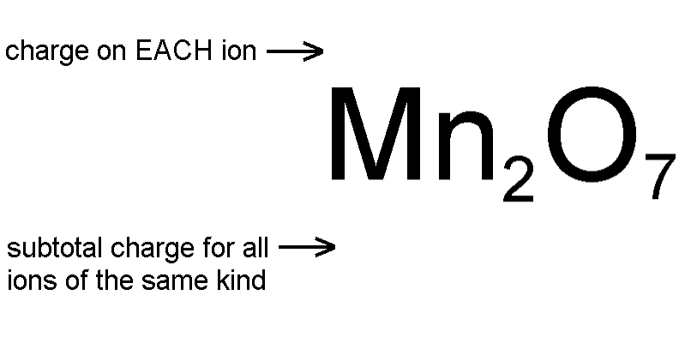







Figuring Out Cation Charges
Each oxide ion has a charge of -2
7 oxide ions have a subtotal charge of -2 x 7 = -14
Since the formula has to be uncharged the 2 manganese ions have to have a +14 subtotal
The +14 subtotal divided evenly over 2 manganese ions gives each manganese +14 / 2 = +7
This compound is manganese(VII) oxide

Slide 42
Naming Acids
An acid has a molecular formula which starts with H, ie. HNO₃, but doesn’t include water, H₂O
If the anion in the acid ends in -ide, change the ending to -ic acid and add the prefix hydro- :
  HCl: hydrochloric acid
  HBr: hydrobromic acid
If the anion in the acid ends in -ite, change the ending to -ous acid:
  HClO: hypochlorous acid
  HClO₂: chlorous acid
If the anion in the acid ends in -ate, change the ending to -ic acid:
  HClO₃: chloric acid
  HClO₄: perchloric acid
If possible the atom prefix is EXTENDED so that it includes or ends in the letter “r” before adding the ending
  H₂SO₄: sulfuric acid (NOT sulfic acid)
  H₃PO₃: phosphorous acid (NOT phosphous acid)
  H₂S: hydrosulfuric acid

Slide 43
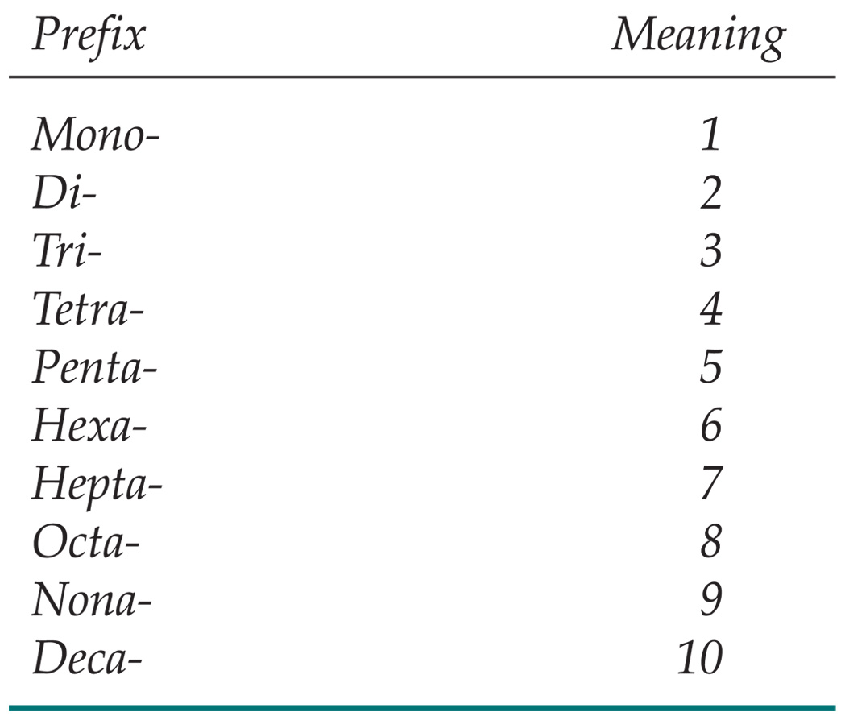
Naming Binary Molecular Compounds
First make sure the compound is NOT IONIC and NOT AN ACID
The element furthest away from F on the Periodic Table is usually listed first.
A prefix is used to denote the number of atoms of each element in the compound (mono- is not used on the first element listed, however.)
The ending on the element closest to F is changed to -ide.
  CO₂: carbon dioxide
  CCl₄: carbon tetrachloride
If the prefix ends with a or o and the name of the element begins with a vowel, the a or o at the end of the prefix is dropped:
  N₂O₅: dinitrogen pentoxide

