Slide 1
Chapter 3

Slide 2
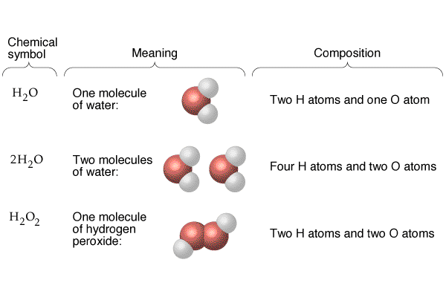

Slide 3
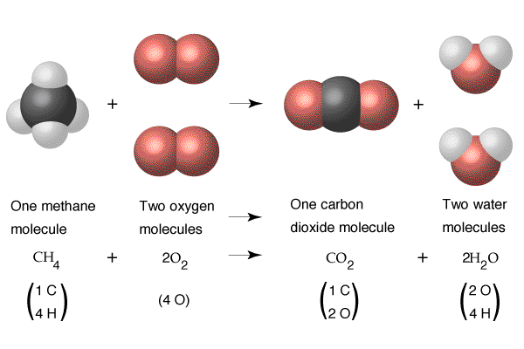

Slide 6
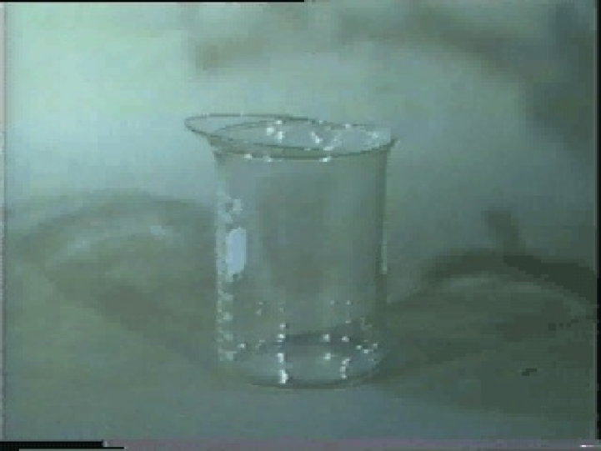
Oxygen Combustion Reactions
Play Video On YouTube
Notes:
DM27_015.mov

Slide 7
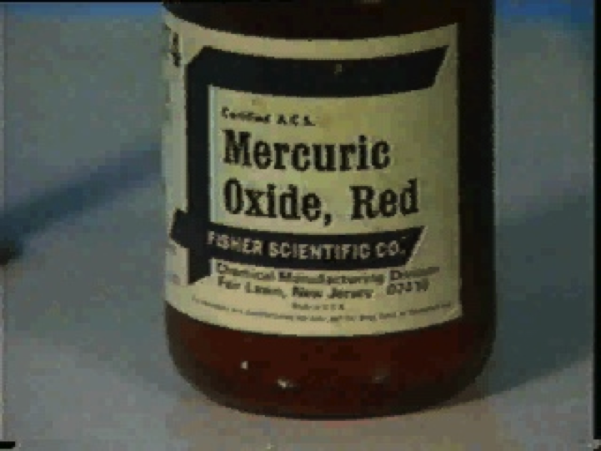
Decomposition Reaction
Play Video On YouTube
Notes:
DM27_013.mov

Slide 9
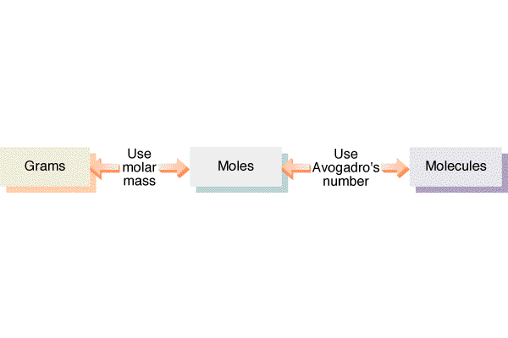

Slide 10
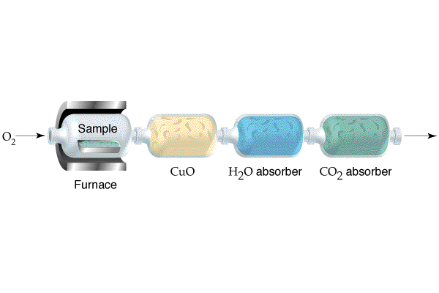

Slide 11
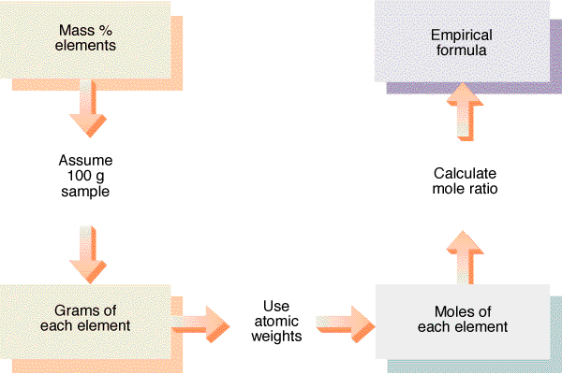

Slide 12
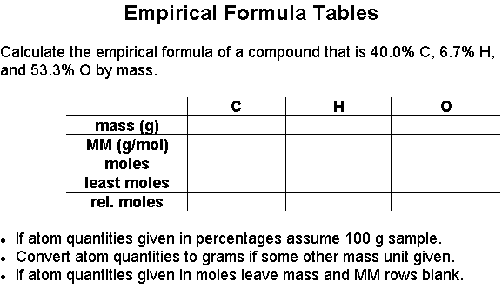
0

Slide 13
Limiting Reagent
Play Video On YouTube
Notes:
AN26_001.mov

Slide 14
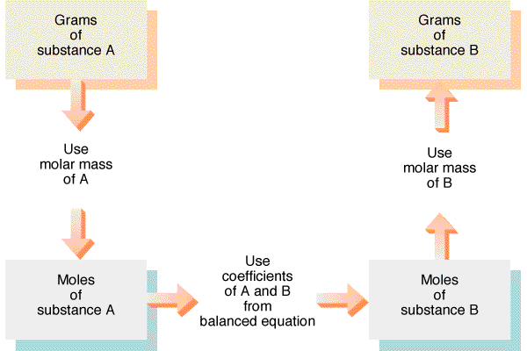

Slide 15
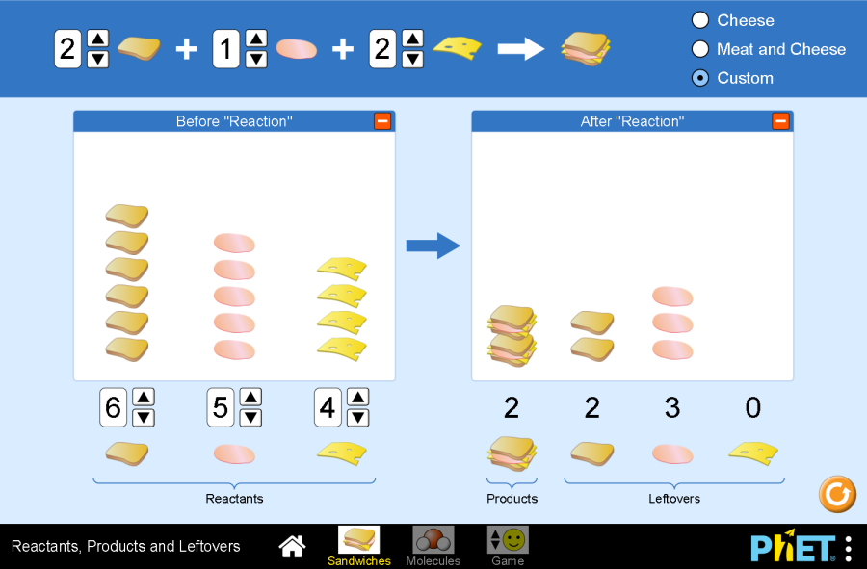
Play Stoichiometry Animation

Slide 16
