Slide 1
Chapter 4

Slide 2
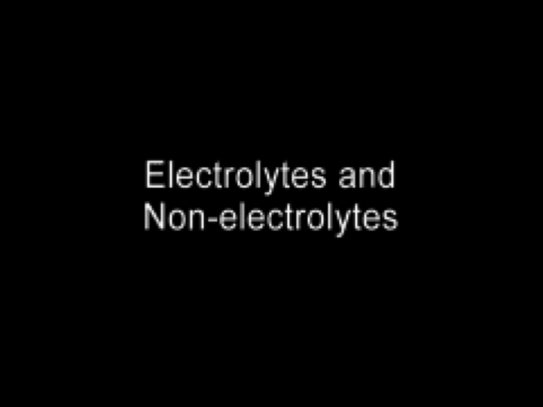
Electrolytes and Nonelectrolytes
Play Video On YouTube
Notes:
AN26_036.mov

Slide 3
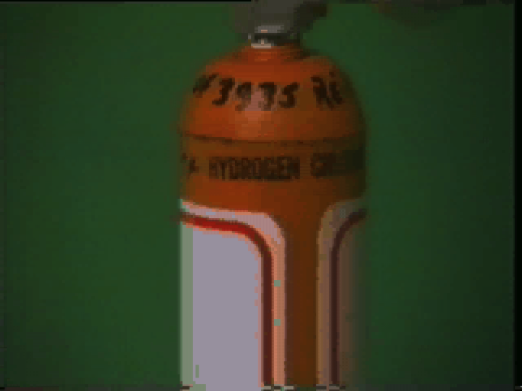
Electrolytes
Play Video On YouTube
Notes:
DM27_005.mov

Slide 4
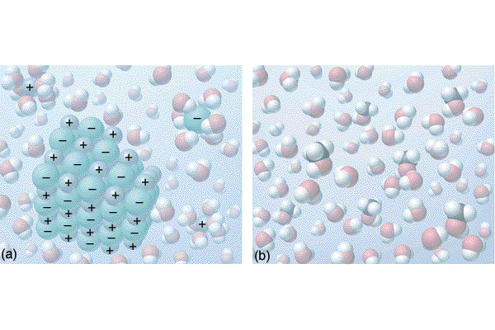

Slide 5
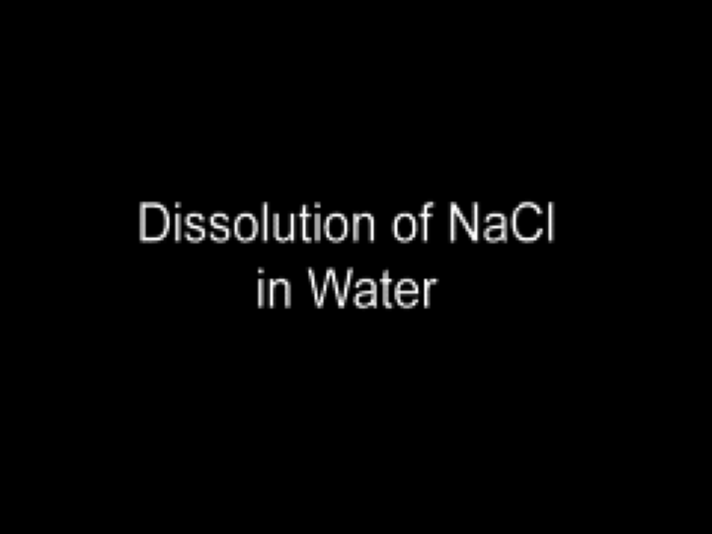
Dissolution of NaCl in Water
Play Video On YouTube
Notes:
AN26_004

Slide 6
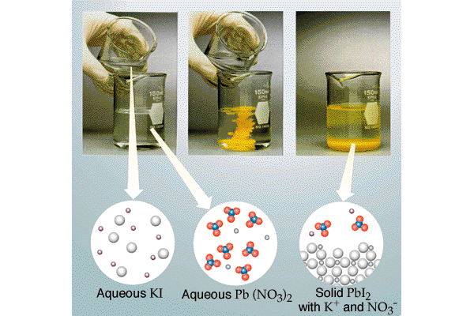

Slide 7
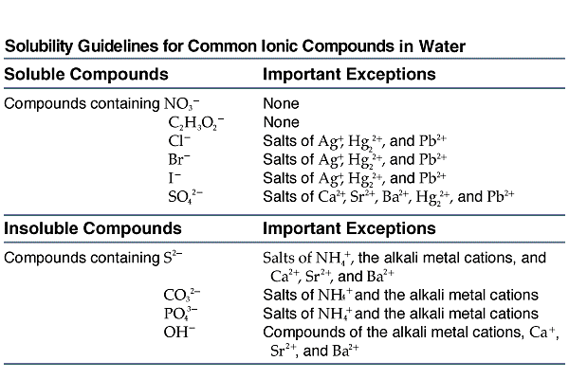

Slide 8
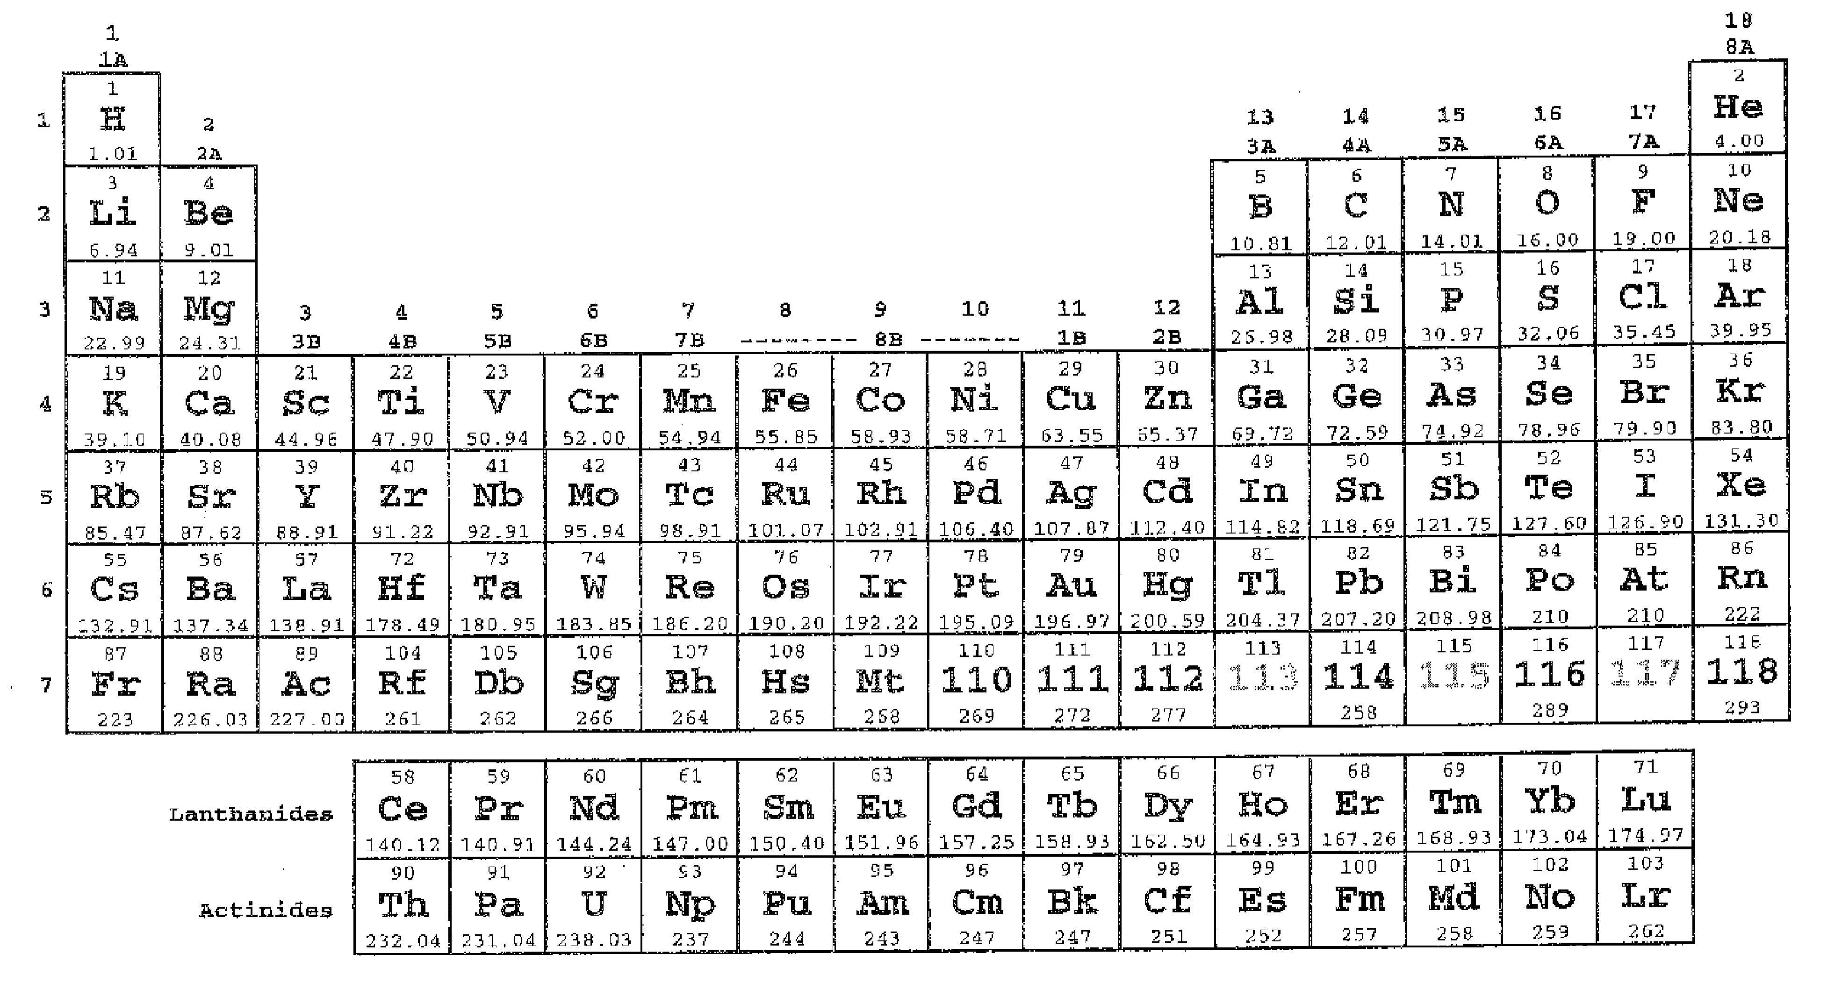
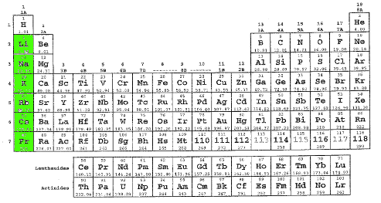
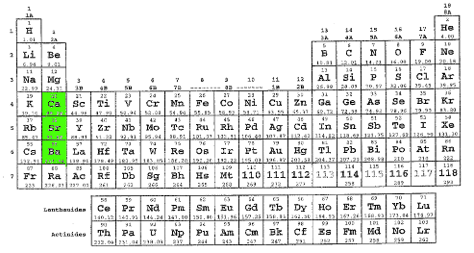
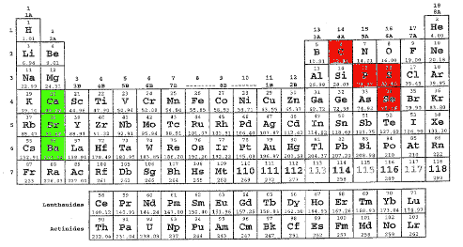
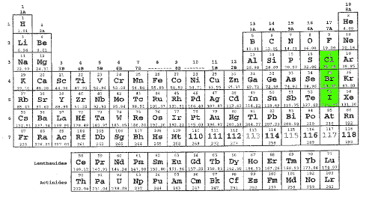
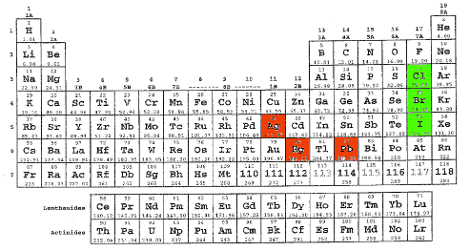
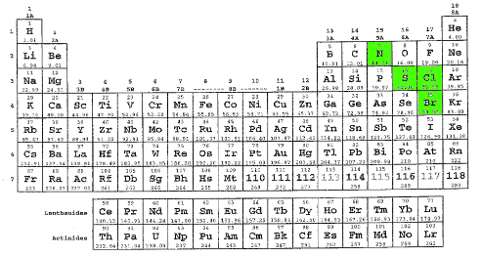
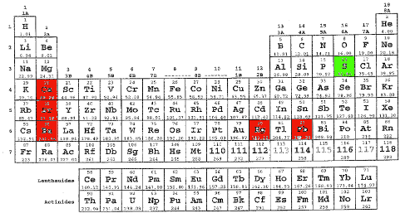
Spectator Ions
If spectator ion(s) are in its formula an ionic compound is water soluble
If spectator ion(s) are present an ionic compound is a strong electrolyte
Spectator ions are NOT acidic OR basic
Cations in Group 2A under Mg are usually spectators
Exceptions are carbonate, phosphate, selenate, and sulfate
Oxyanions with ate or per_ate names made from N, S, Br, and Cl usually spectators
Sulfate has the only exceptions: Group 2A cations and Hg₂²⁺, and Pb²⁺ in alchemy block
Anions in Group 7A under F are usually spectators
Exceptions are Ag⁺, Hg₂²⁺, and Pb²⁺, but NOT Hg²⁺ or Pb⁴⁺
Cations in Group 1A under H are always spectator ions
There are no exceptions

Slide 9
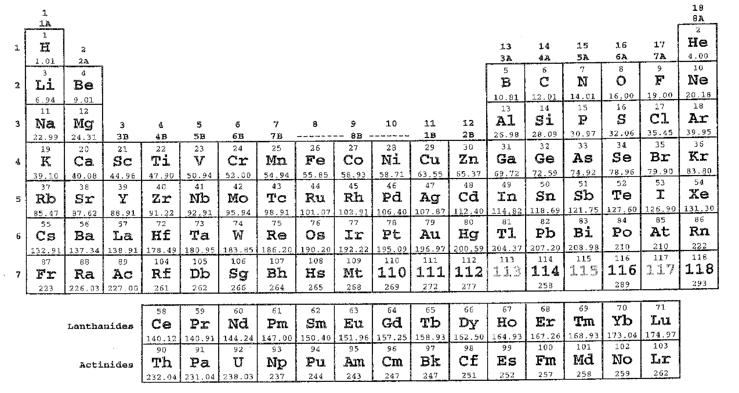
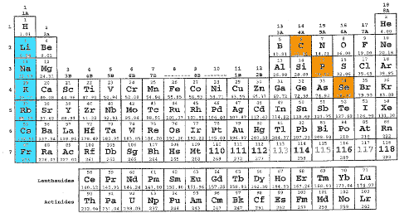
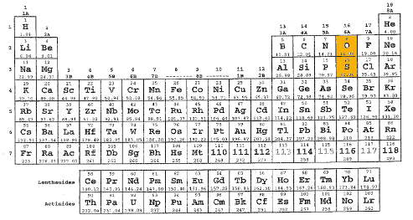
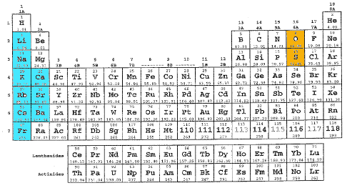
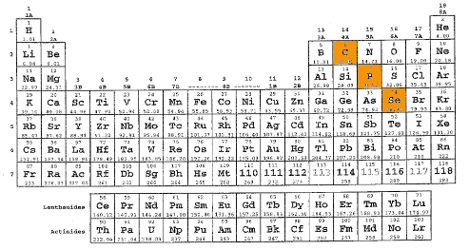
Insoluble Ions
Always look for spectator ions in a formula before looking for insoluble ions.
If spectator ion(s) are present an ionic compound a is water-soluble strong electrolyte.
If spectator ions NOT present and insoluble ions ARE ionic cpd is insoluble weak electrolyte.
Carbonate, phosphate, and selenate are usually insoluble.
Oxide, sulfide, hydroxide, and hydrosulfide are usually insoluble.
Exceptions: Column 1A ions under H, Column 2A ions under Mg, and NH₄⁺
Exceptions are Column 1A ions under H and NH₄⁺

Slide 11
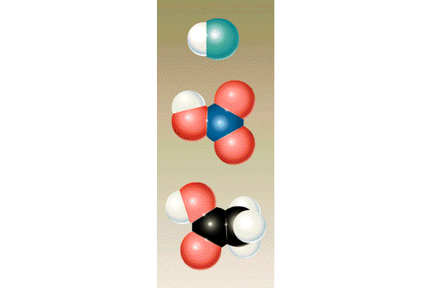

Slide 12
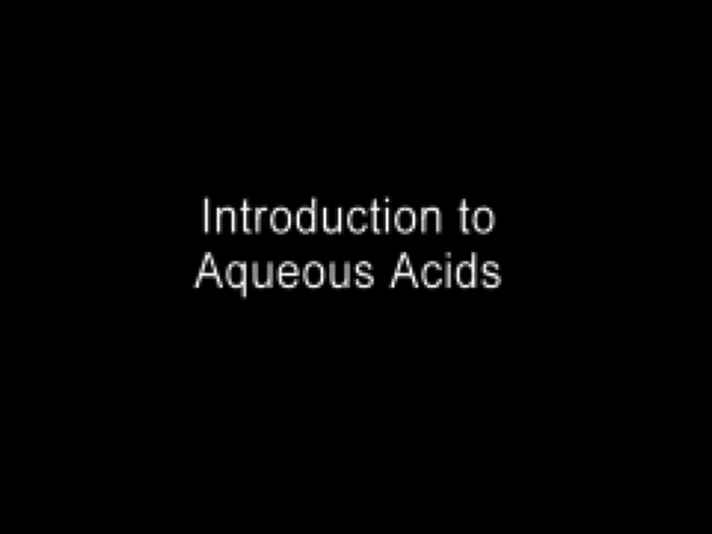
Introduction to Aqueous Acids
Play Video On YouTube
Notes:
AN26_037.mov

Slide 13
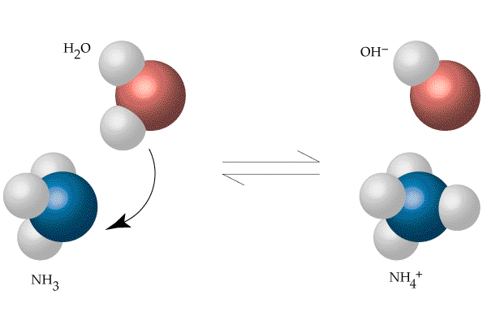

Slide 14
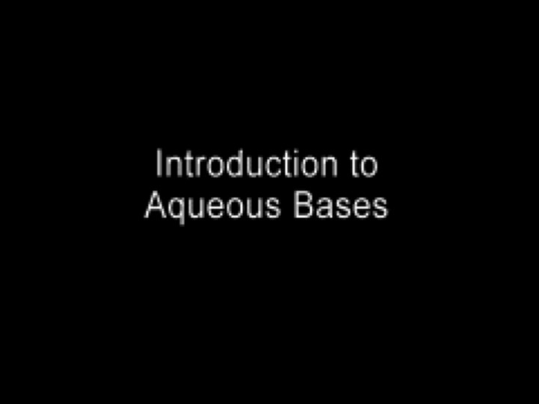
Introduction to Aqueous Bases
Play Video On YouTube
Notes:
AN26_038.mov

Slide 15
Formulas of Acids and Bases
Ammonium (NH₄⁺) and acetate (C₂H₃O₂⁻) are water-soluble ions (no exceptions), but are NOT spectators because they react with water.
Ammonium is a weak acid.
Acetate is a weak base.
Cations are weak acids except H⁺ (strong acid) and spectators (not acidic).
Anions are weak bases except OH⁻ (strong base) and spectators (not basic).
Always break formulas into left and right halves and analyze acid/base character of each half.
Example: HC₂H₃O₂ is combination of strong acid (H⁺) and weak base (C₂H₃O₂⁻); combination results in overall weak acid.

Slide 16
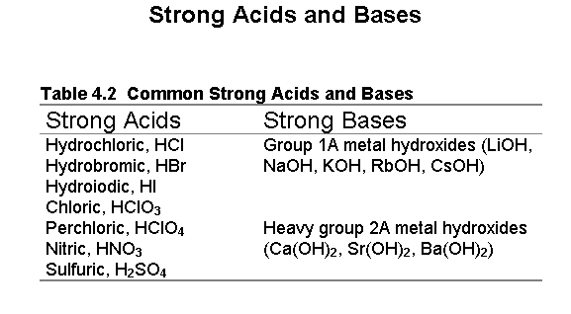

Slide 18
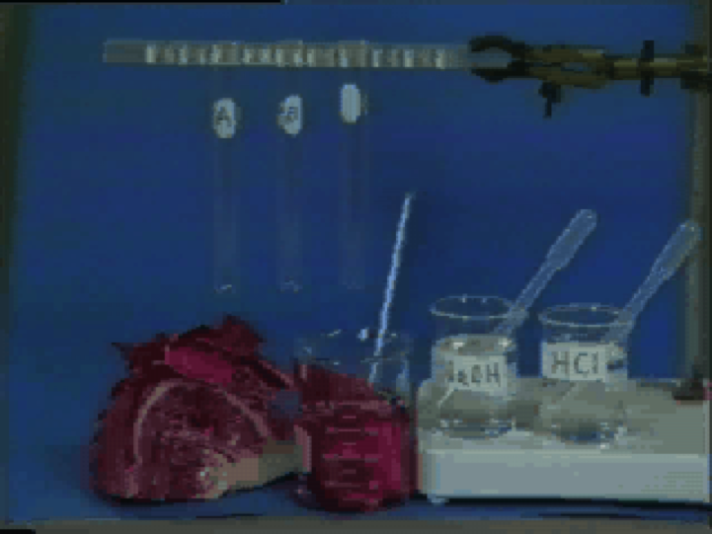
Natural pH Indicators
Play Video On YouTube
Notes:
DM27_010.mov

Slide 19
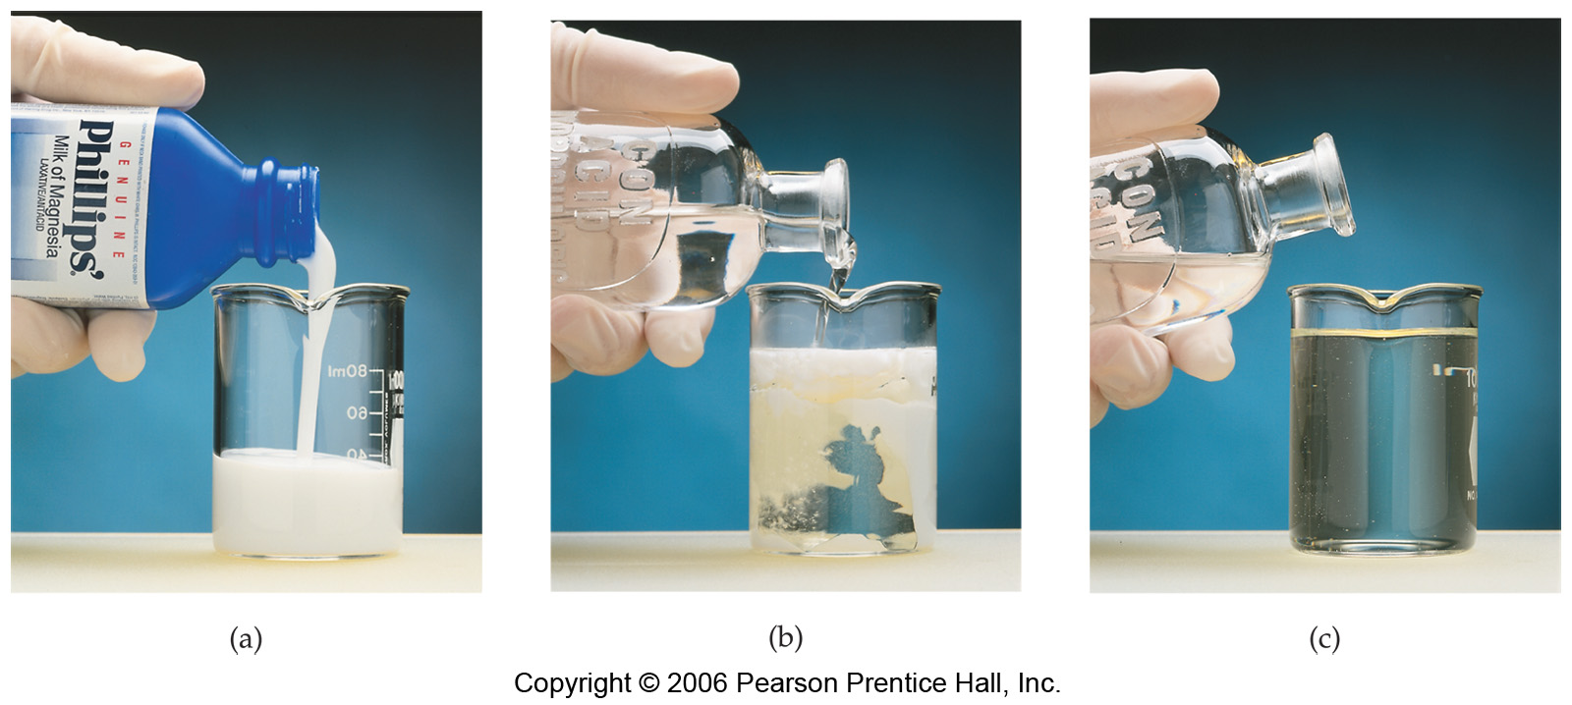

Slide 20
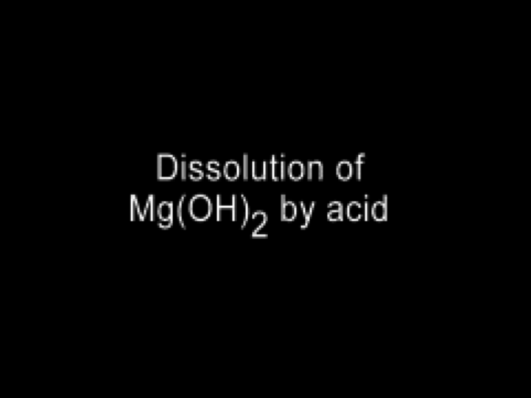
Dissolution of Mg(OH)₂ by Acid
Play Video On YouTube
Notes:
AN26_041.mov

Slide 21
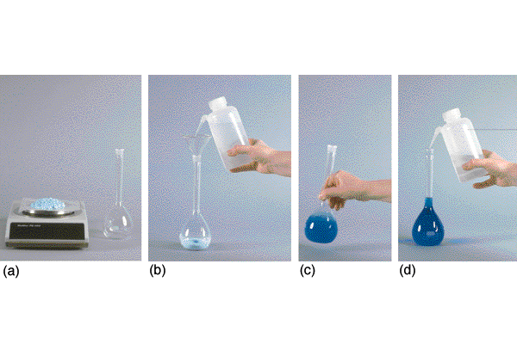

Slide 22
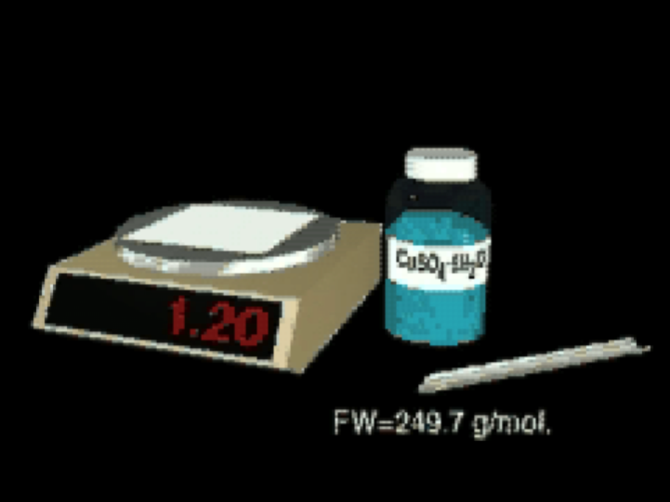
Solution Formation From Solid
Play Video On YouTube
Notes:
AN26_012

Slide 23
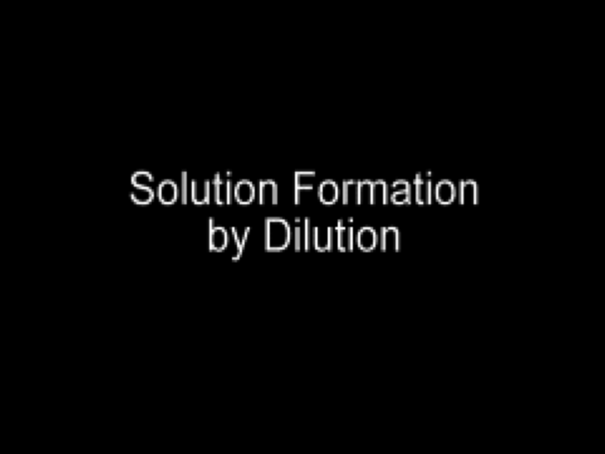
Solution Formation by Dilution
Play Video On YouTube
Notes:
AN26_011.mov

Slide 24
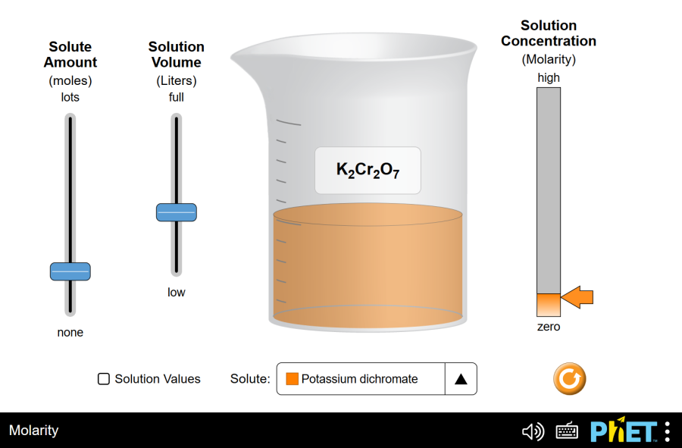
Run Molarity Simulation

Slide 26
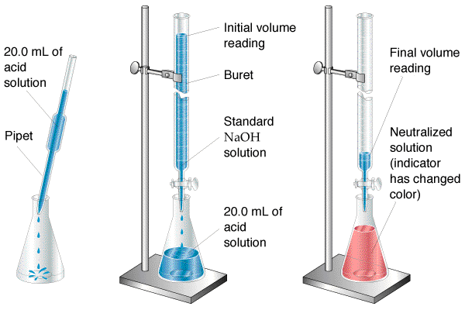

Slide 27

Titration Video
Play Video On YouTube
Notes:
AN26_042.mov

