Slide 1
Chapter 14

Slide 2
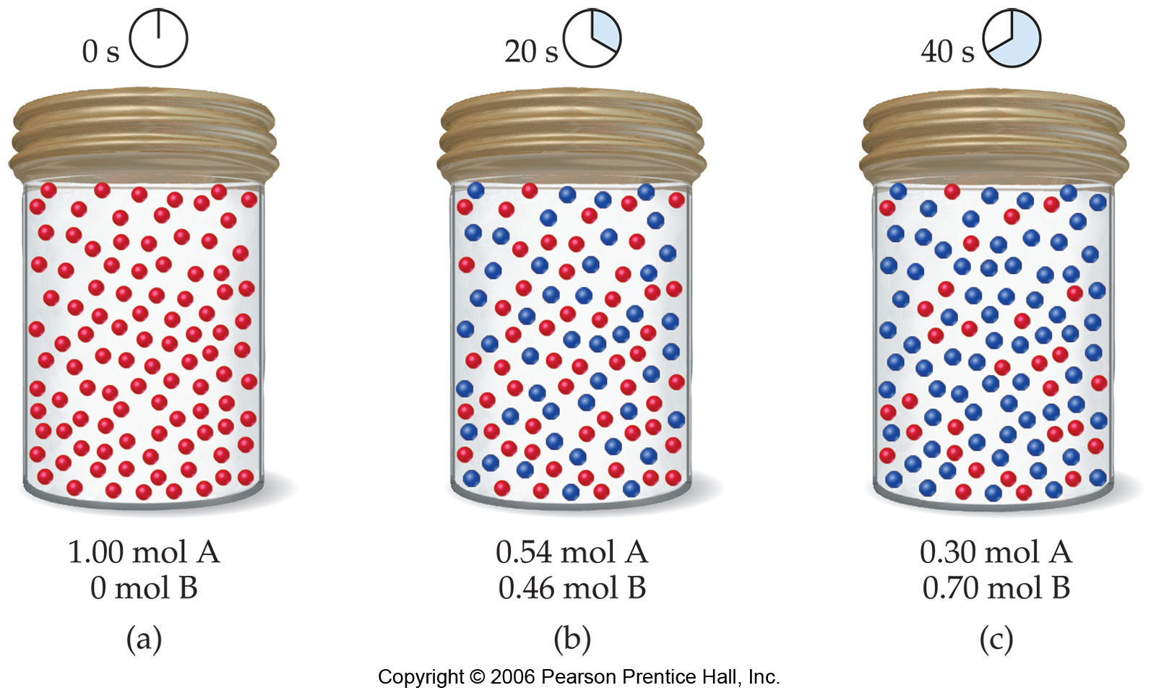

Slide 3
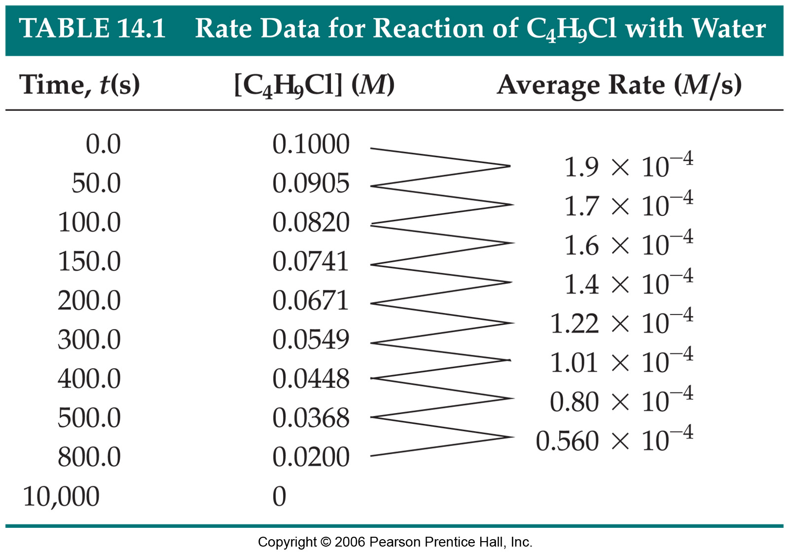

Slide 4
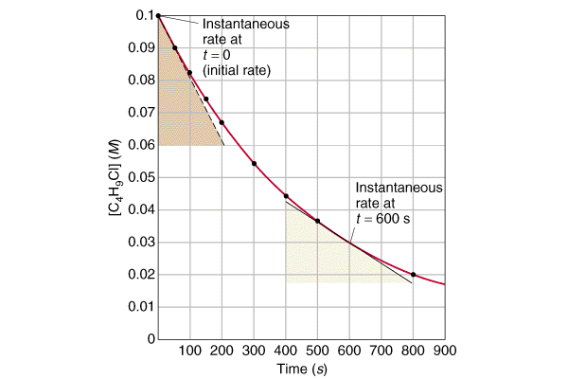

Slide 6
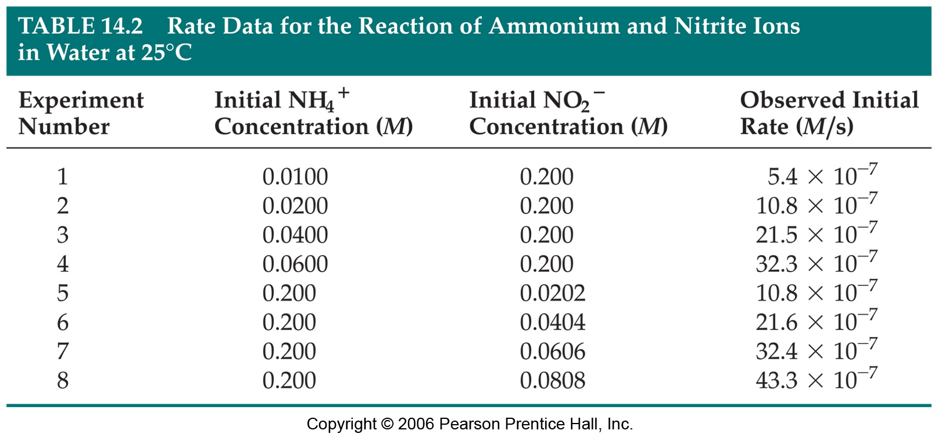

Slide 7
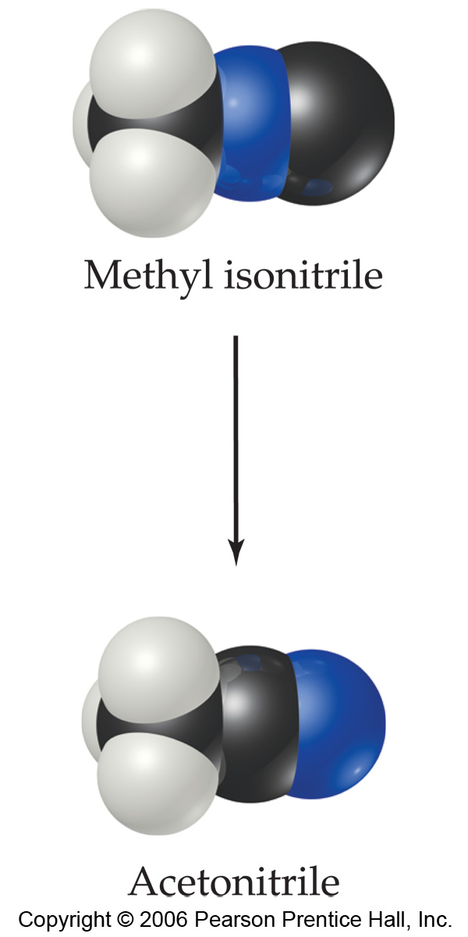

Slide 8
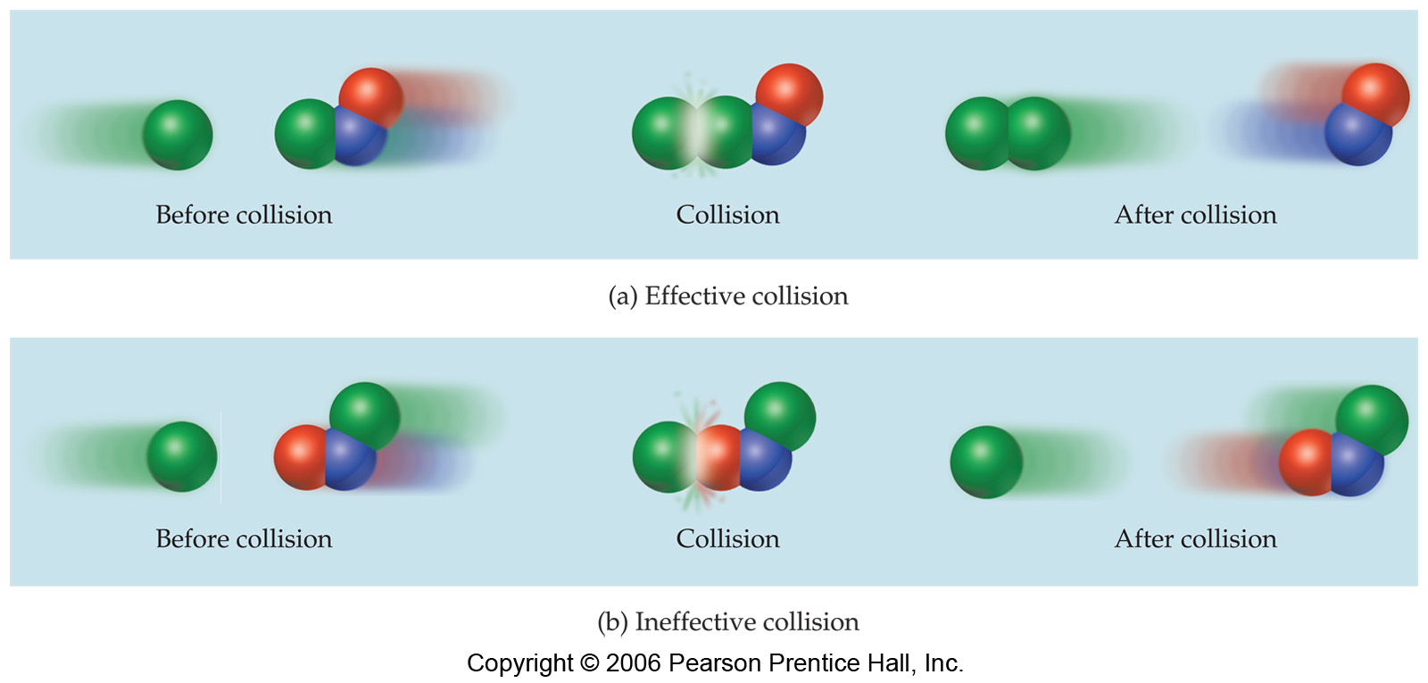

Slide 9
Integrated Rate Laws
First-Order: ln(c_{t}/c₀) = -kt
Second-Order: (1/c_{t}) - (1/c₀) = +kt

Slide 11


Slide 12
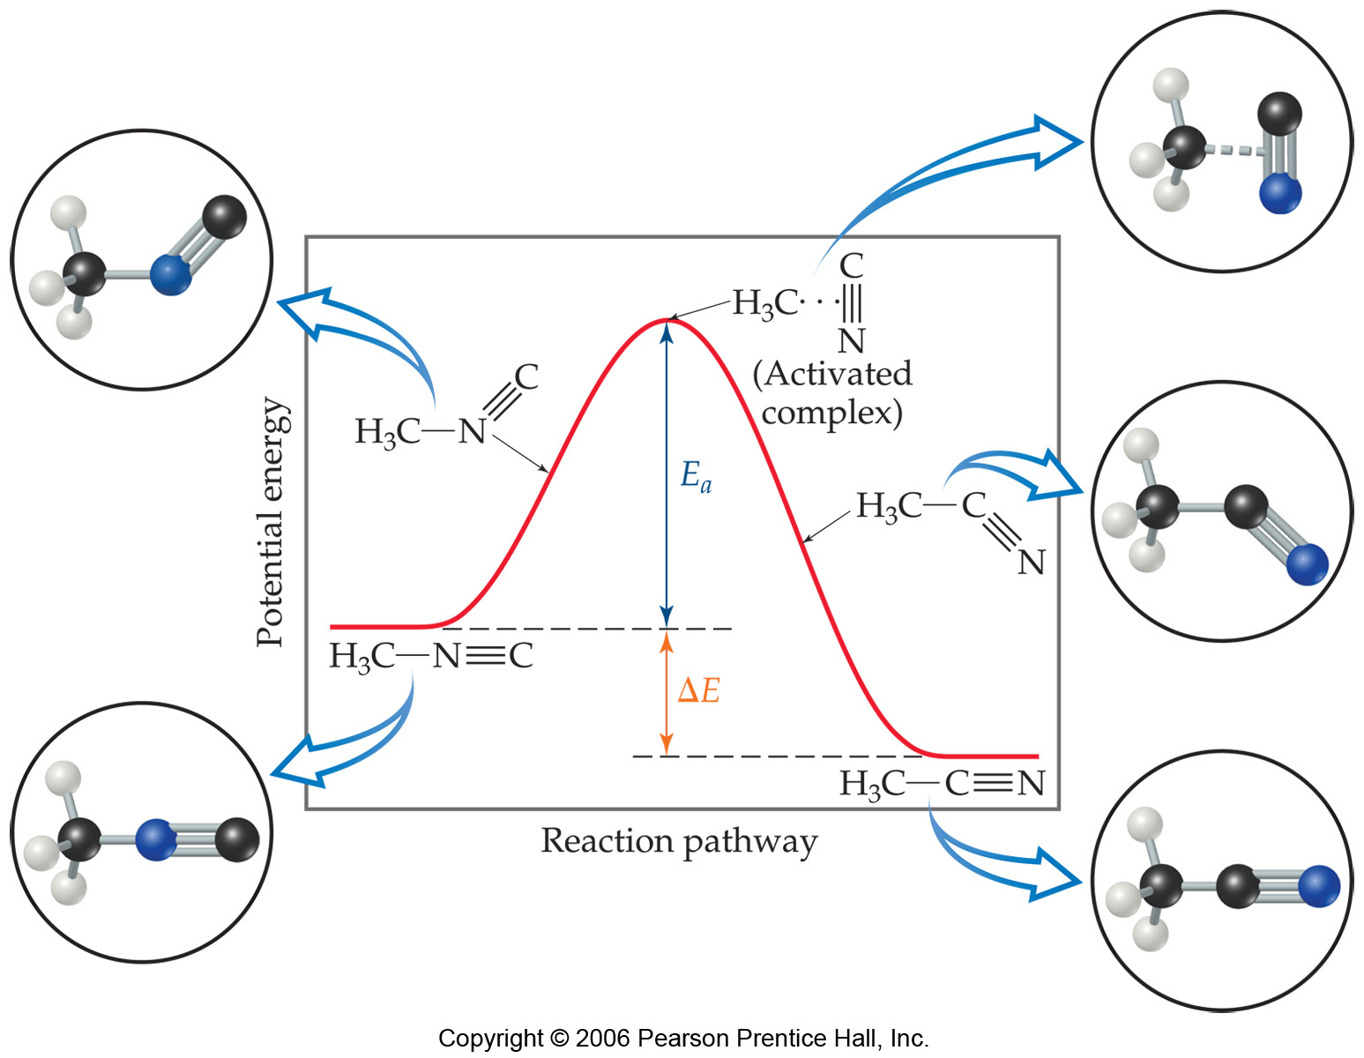

Slide 13
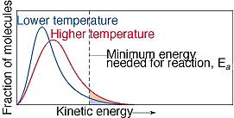

Slide 14
Arrhenius Equation
Activation energy measured by comparing rates at different temperatures
k = Ae^{-Ea/RT}
k₂/k₁ = (Ae^{-Ea/RT2})/(Ae^{-Ea/RT1}) = e^{-Ea/RT2-(-Ea/RT1)}
k₂/k₁ = e^{-(Ea/R)(1/T2 - 1/T1)}
ln(k₂/k₁) = -(Ea/R)(1/T₂ - 1/T₁)

Slide 15
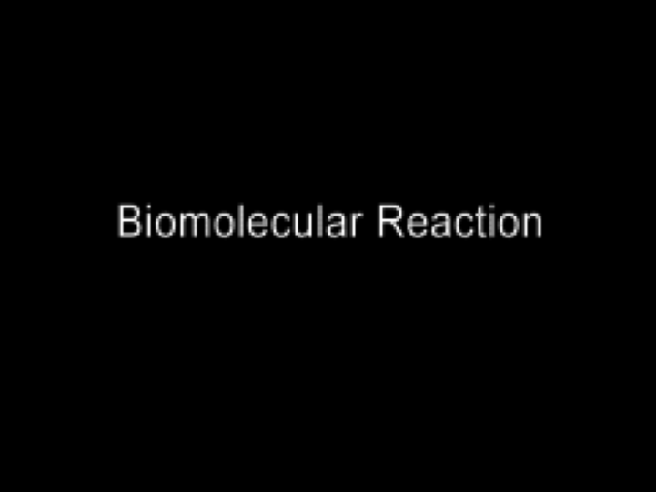
Bimolecular Reaction Mechanism
Play Video On YouTube
Notes:
AN26_046.nov

Slide 16
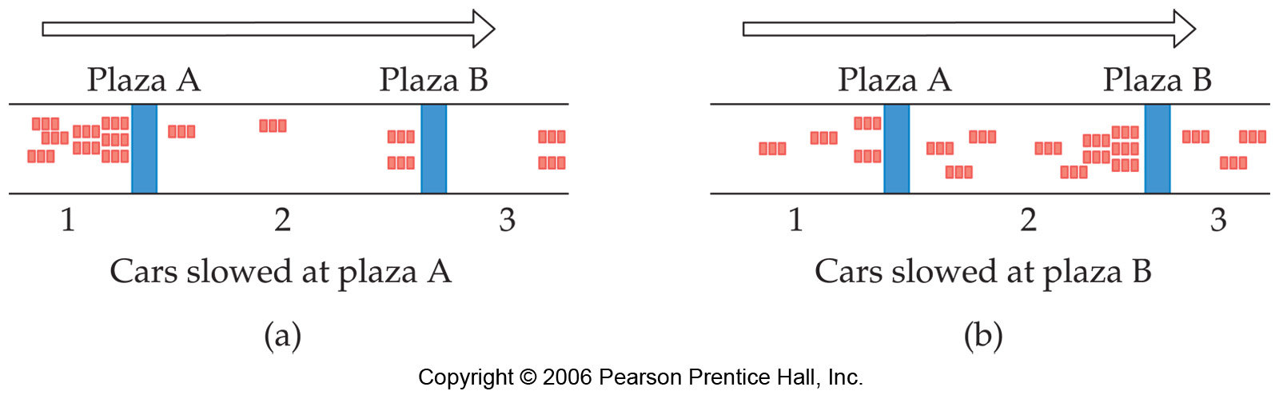

Slide 18
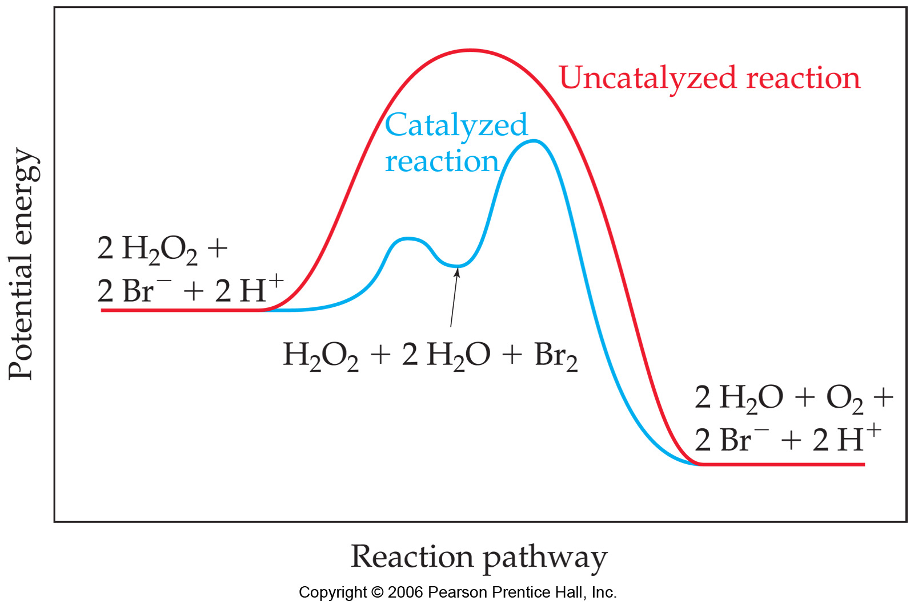

Slide 19
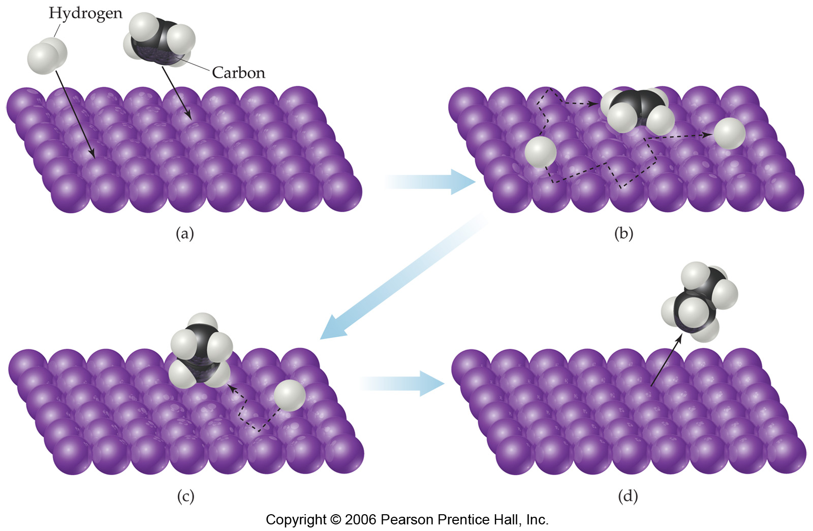

Slide 20
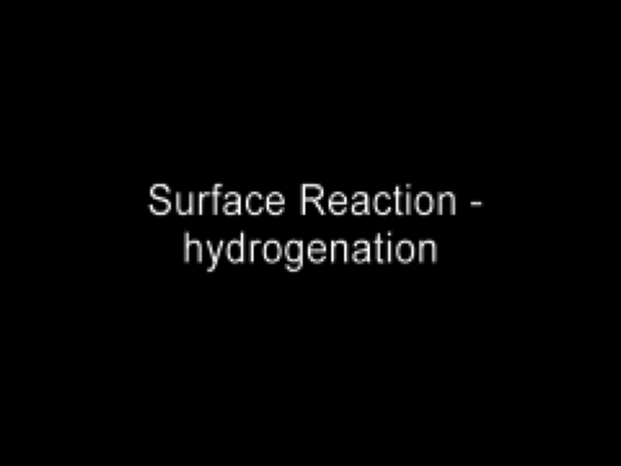
Surface Hydrogenation Mechanism
Play Video On YouTube
Notes:
AN26_050.mov

Slide 21
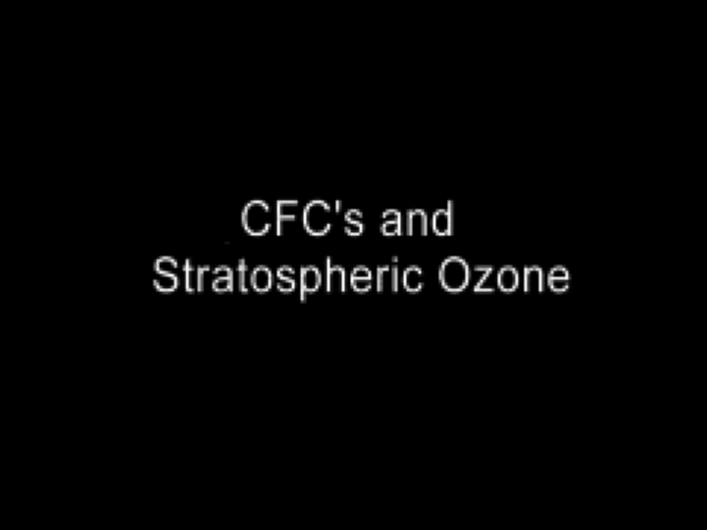
CFC’s and Stratospheric Ozone
Play Video On YouTube
Notes:
AN26_049.mov

Slide 22
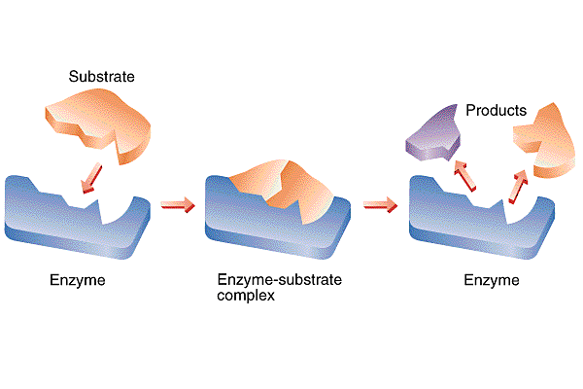

Slide 23
