Slide 1
Chapter 16

Slide 2
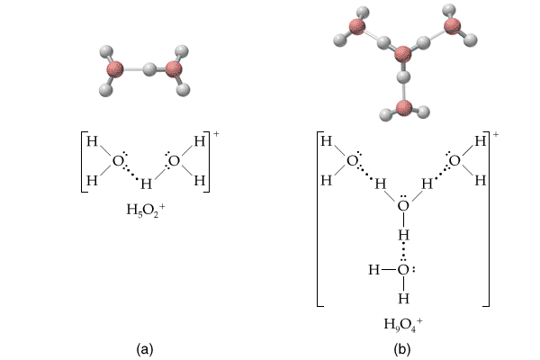

Slide 3
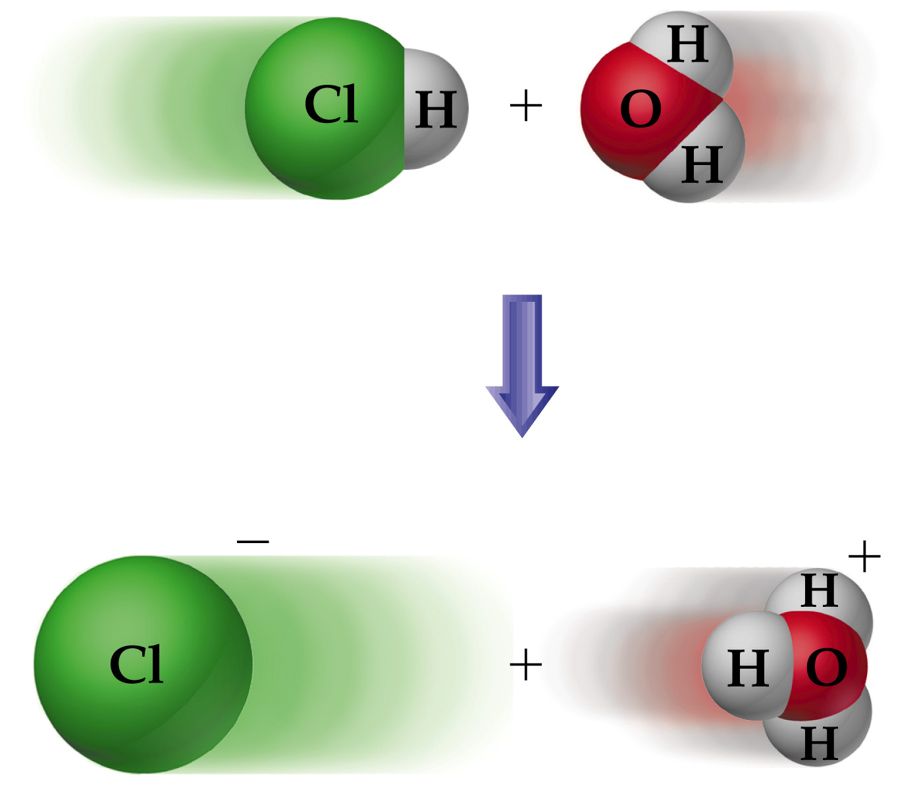

Slide 5
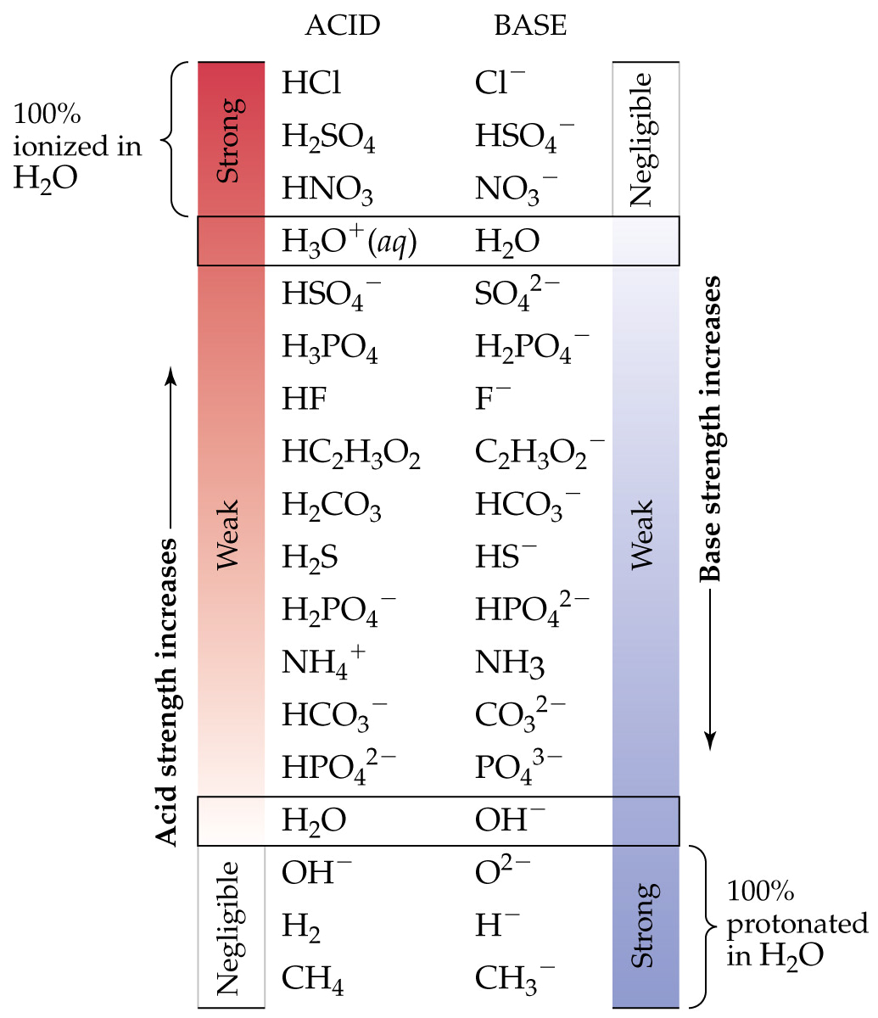

Slide 6
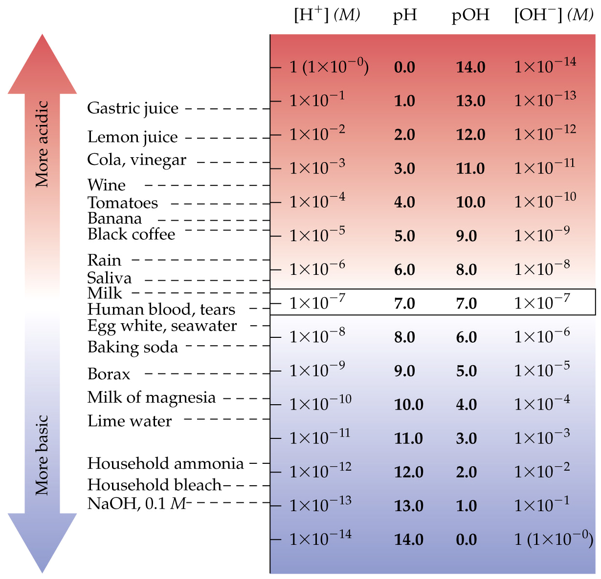

Slide 7
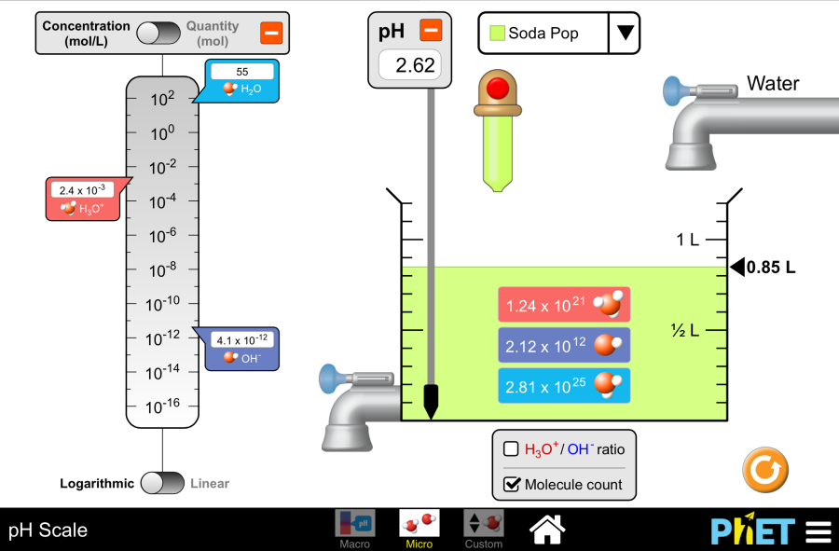
Run Simulation

Slide 8
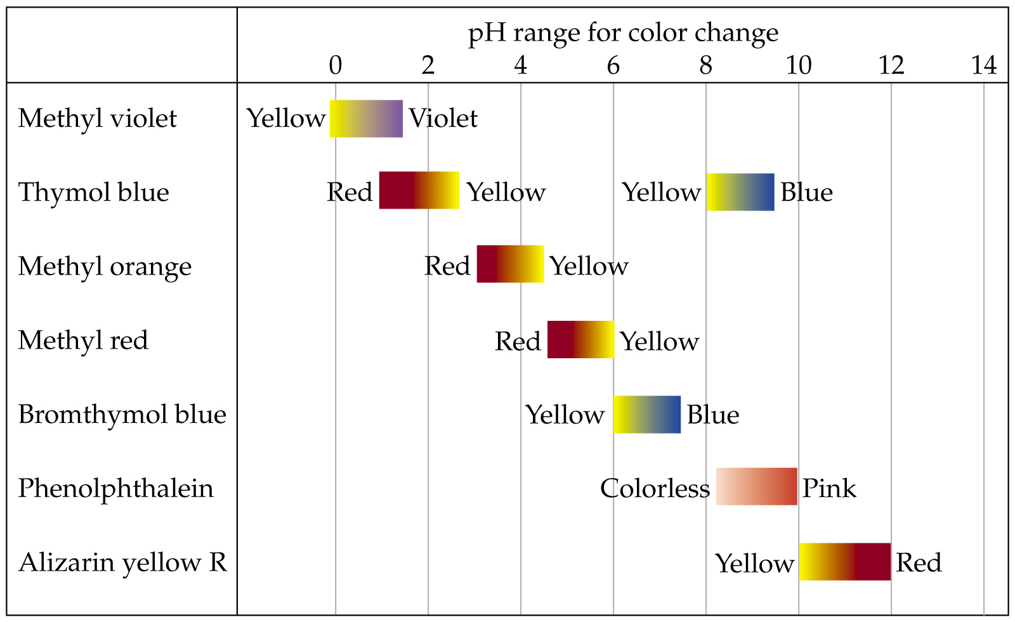

Slide 9
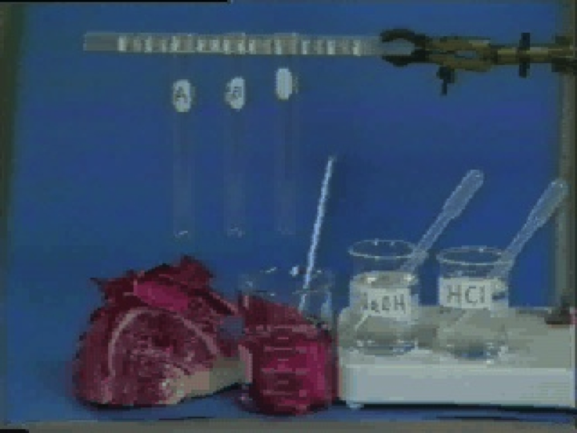
Natural pH Indicators
Play Video On YouTube
Notes:
DM27_010.mov

Slide 10
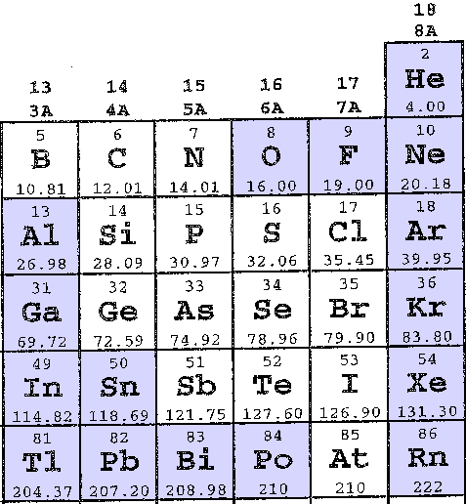
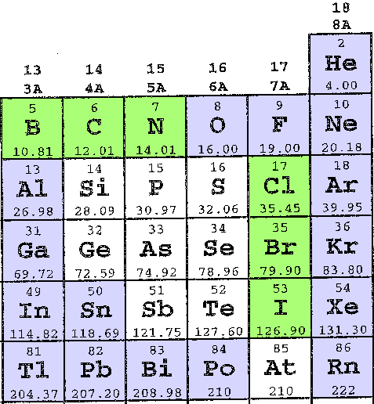
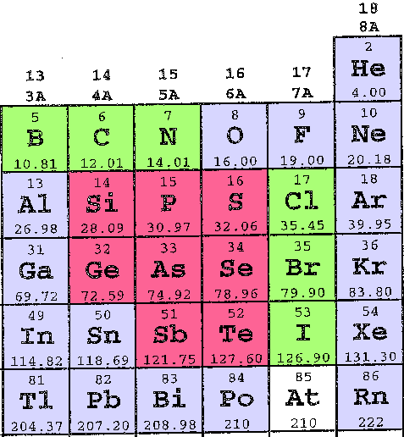
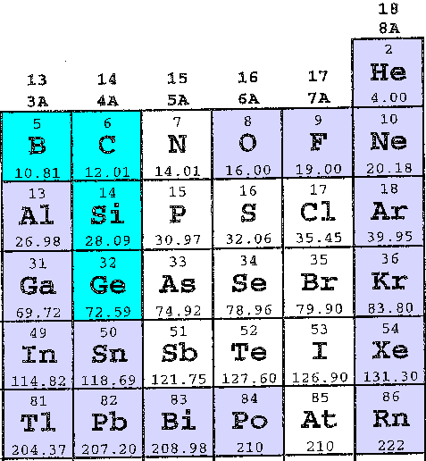
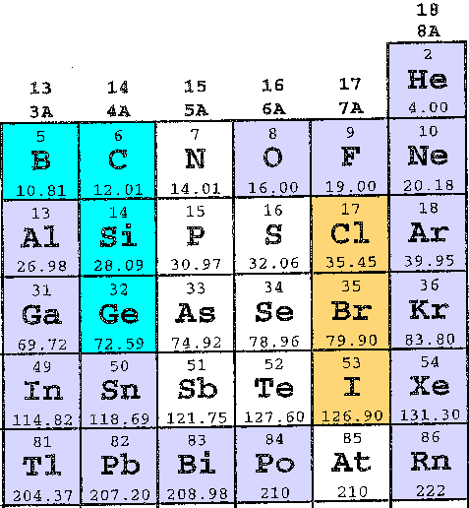
Oxyanion Summary
O, F, and noble gases DON’T DO oxyanions; don’t worry about metals on left side
B, C, N, Cl, Br, and I use THREE oxygens to make -ATE oxyanions
The inner elements use FOUR oxygens to make -ATE oxyanions
-ITE oxyanions have one less oxygen than -ATE oxyanions; B, C, Si and Ge DON’T DO -ITE oxyanions
Cl, Br, and I do PER_ATE (4 oxygen) and HYPO_ITE (1 oxygen) oxyanions

Slide 11
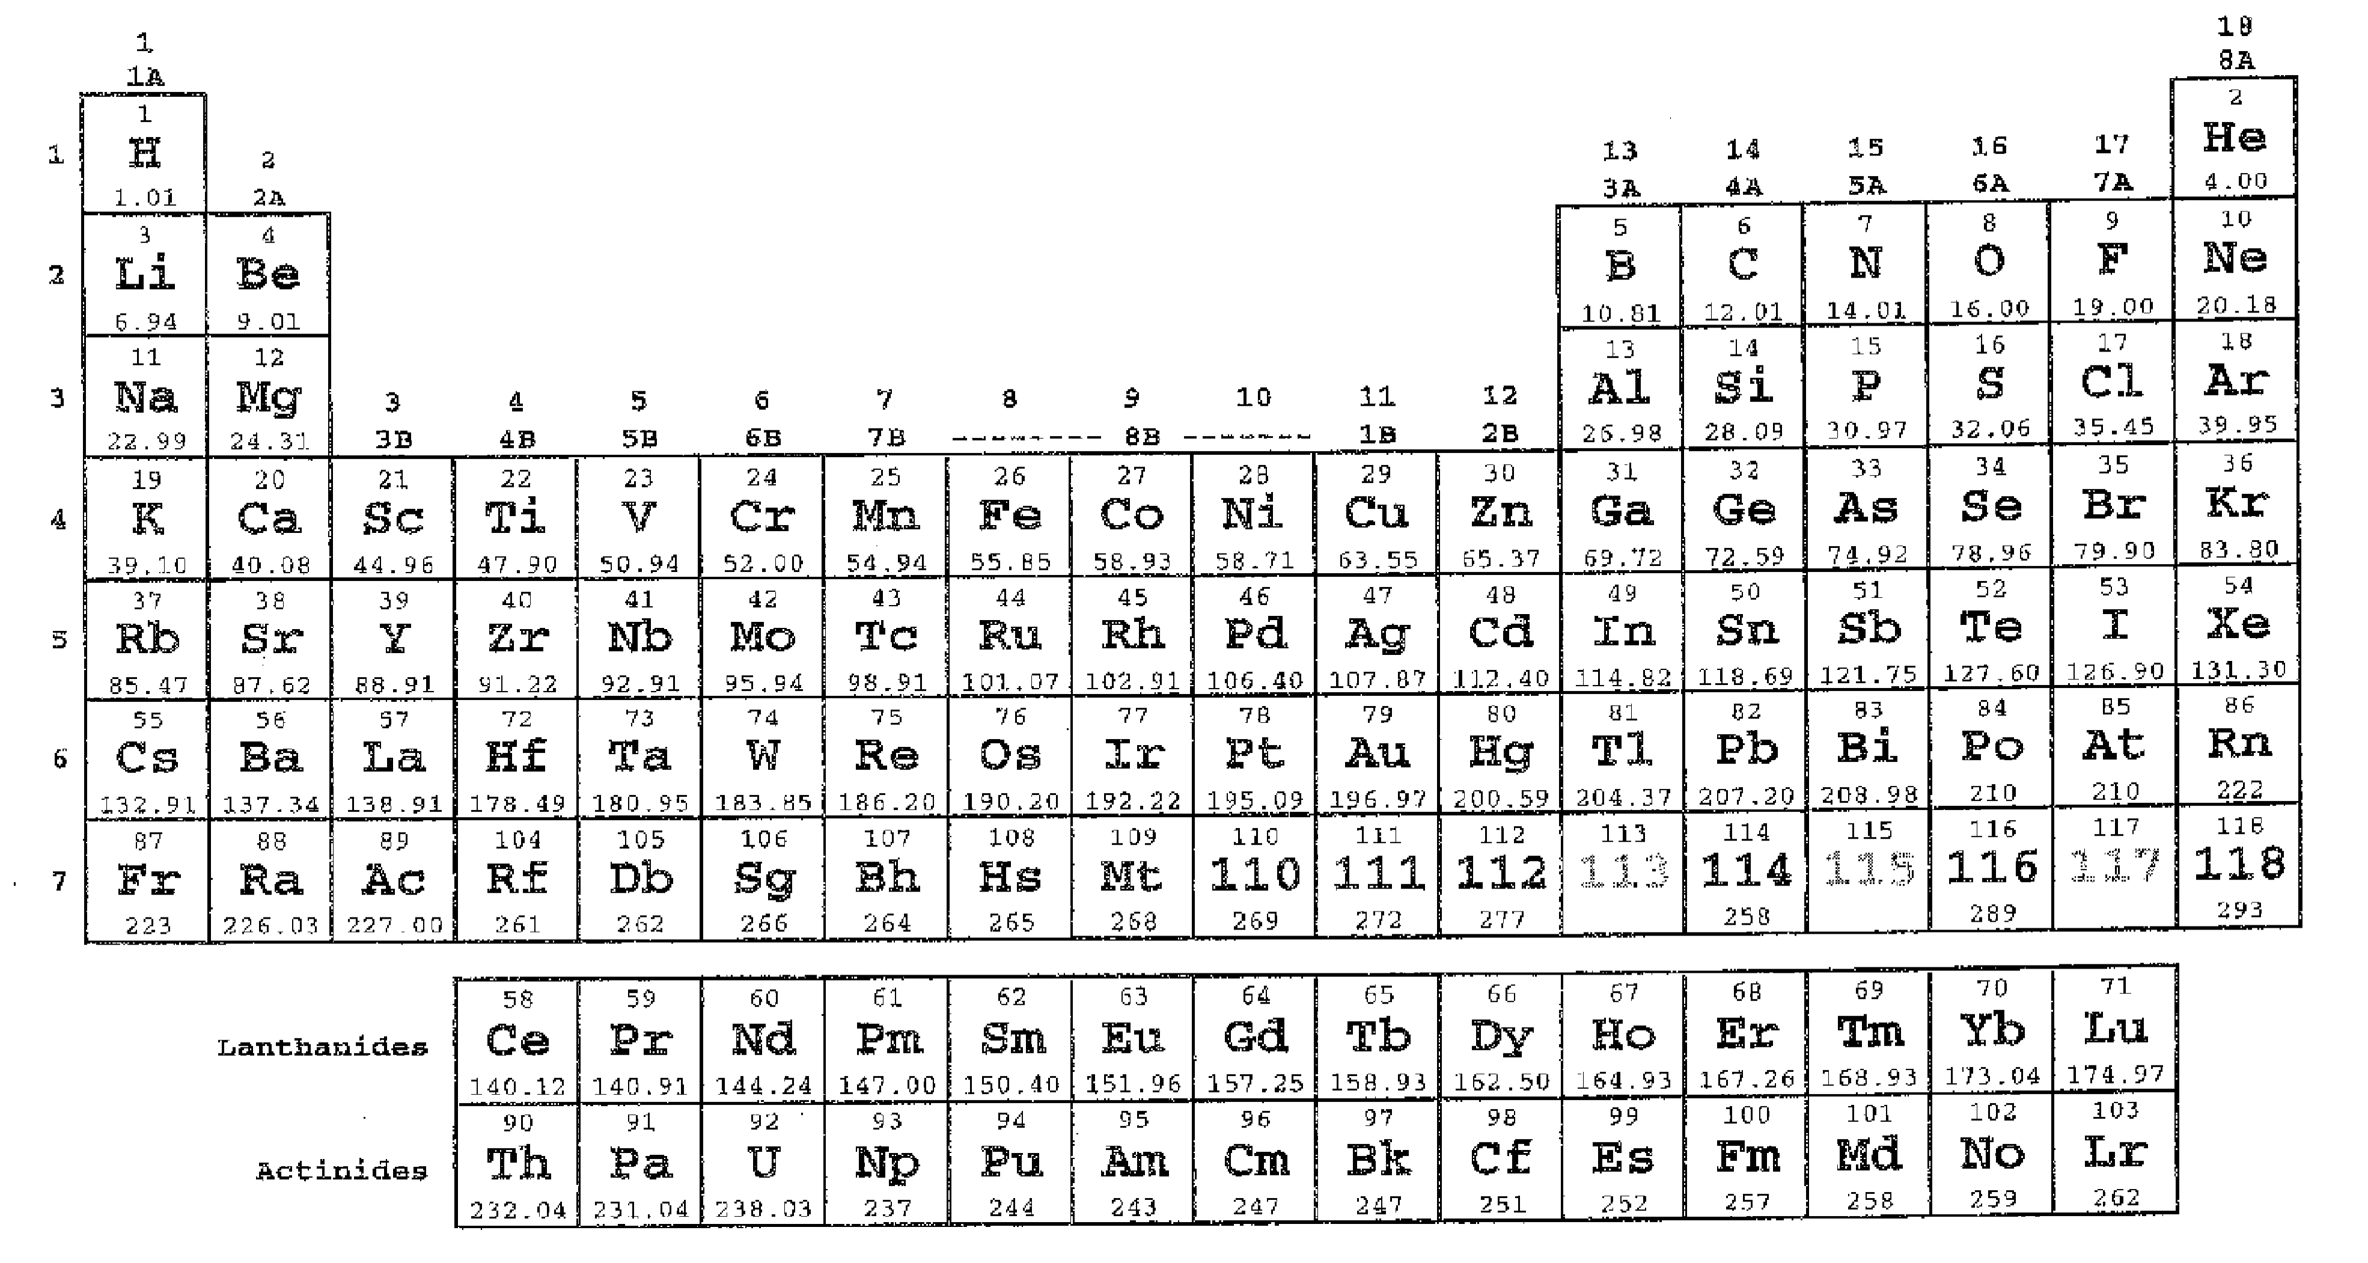
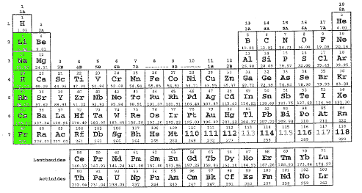
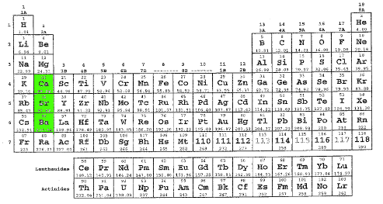
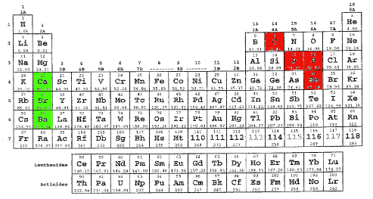
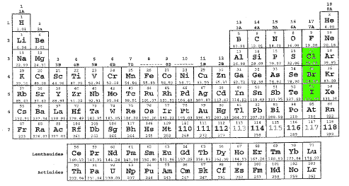
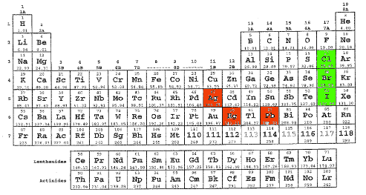
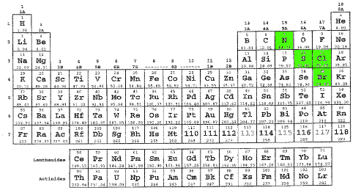
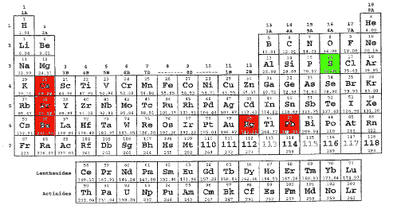
Spectator Ions
If spectator ion(s) are in its formula an ionic compound is water soluble
If spectator ion(s) are present an ionic compound is a strong electrolyte
Spectator ions are NOT acidic OR basic
Cations in Group 2A under Mg are usually spectators
Exceptions are carbonate, phosphate, selenate, and sulfate
Oxyanions with ate or per_ate names made from N, S, Br, and Cl usually spectators
Sulfate has the only exceptions: Group 2A cations and Hg₂²⁺, and Pb²⁺ in alchemy block
Anions in Group 7A under F are usually spectators
Exceptions are Ag⁺, Hg₂²⁺, and Pb²⁺, but NOT Hg²⁺ or Pb⁴⁺
Cations in Group 1A under H are always spectator ions
There are no exceptions

Slide 12
Formulas of Acids and Bases
Ammonium (NH₄⁺) and acetate (C₂H₃O₂⁻) are water-soluble ions (no exceptions), but are NOT spectators because they react with water.
Ammonium is a weak acid.
Acetate is a weak base.
Cations are weak acids except H⁺ (strong acid) and spectators (not acidic).
Anions are weak bases except OH⁻ (strong base) and spectators (not basic).
Always break formulas into left and right halves and analyze acid/base character of each half.
Example: HC₂H₃O₂ is combination of strong acid (H⁺) and weak base (C₂H₃O₂⁻); combination results in overall weak acid.

Slide 14
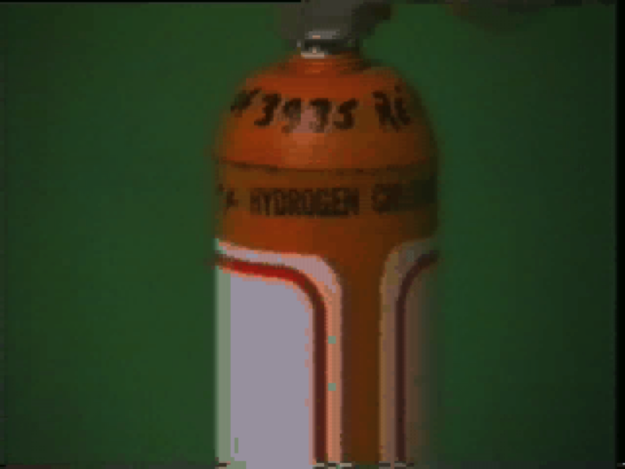
Strong and Weak Acids
Play Video In YouTube
Notes:
DM27_005.mov

Slide 15
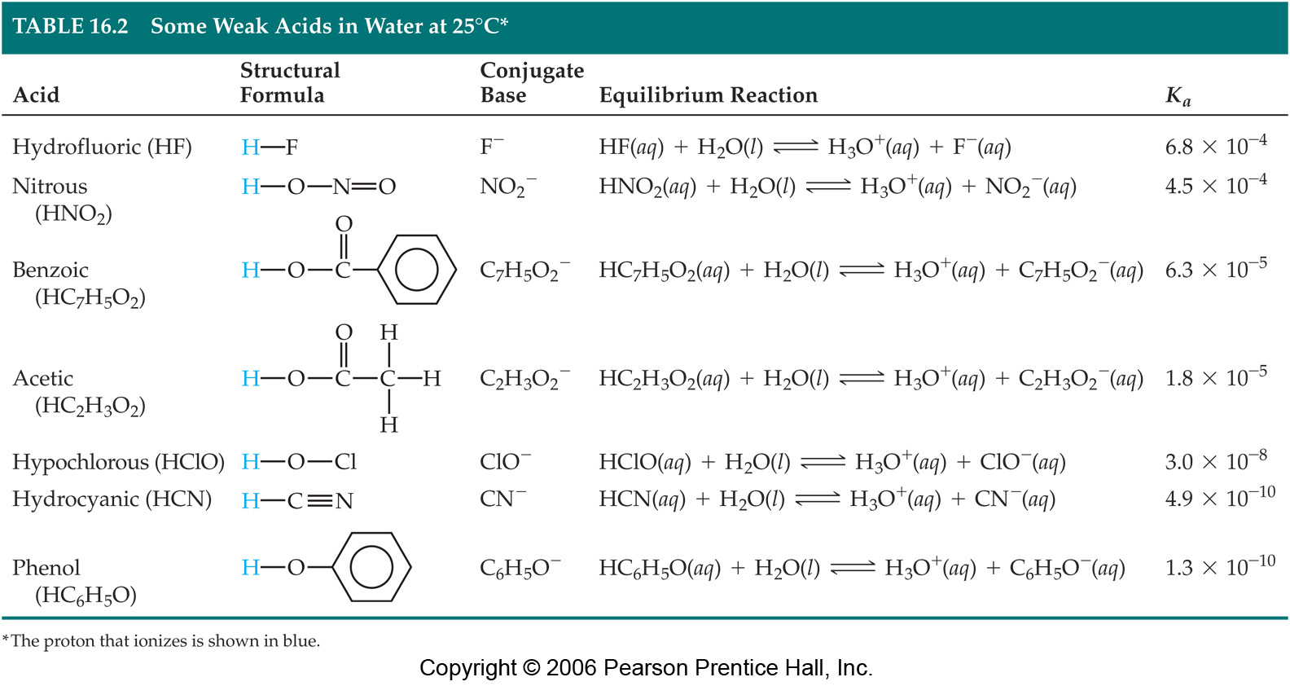

Slide 16
Introduction to Aqueous Acids
Play Video In YouTube
Notes:
AN26_037.mov

Slide 17
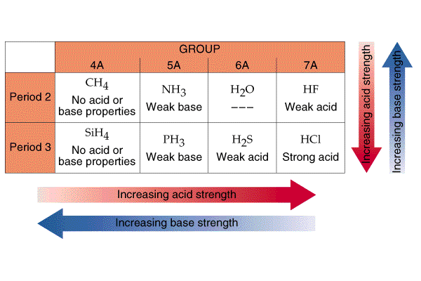

Slide 18
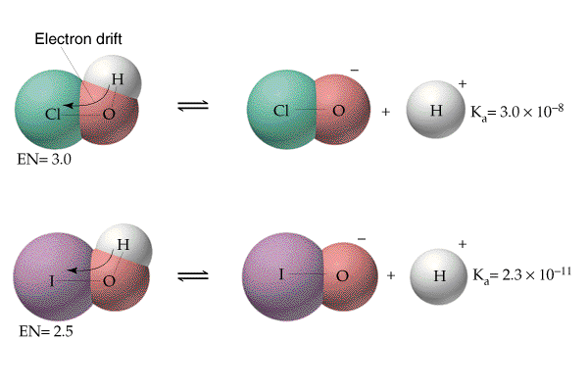

Slide 19
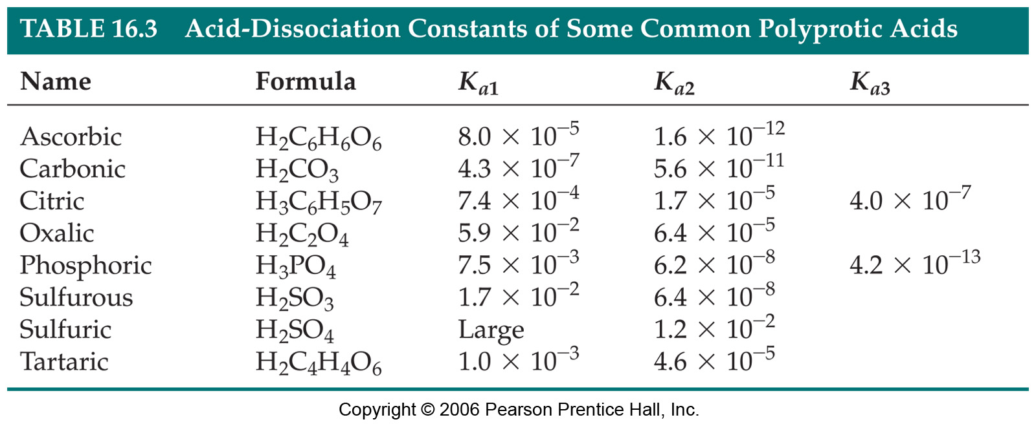

Slide 21
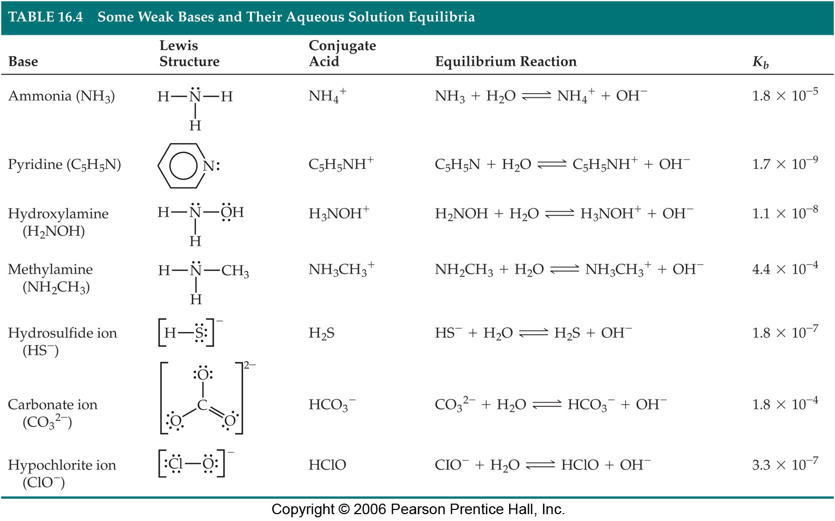

Slide 22
Introduction to Aqueous Bases
Play Video On YouTube
Notes:
AN26_038.mov

Slide 27
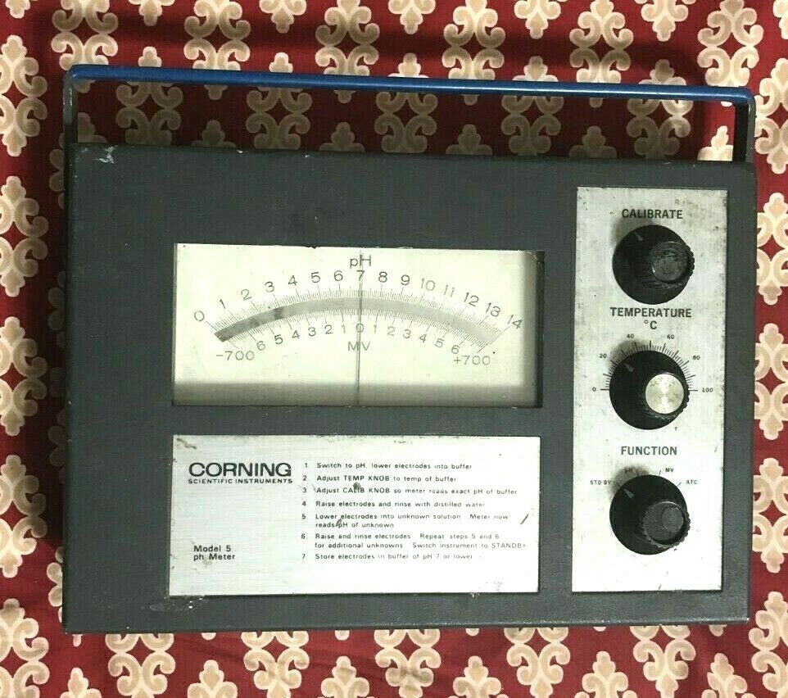

Slide 28
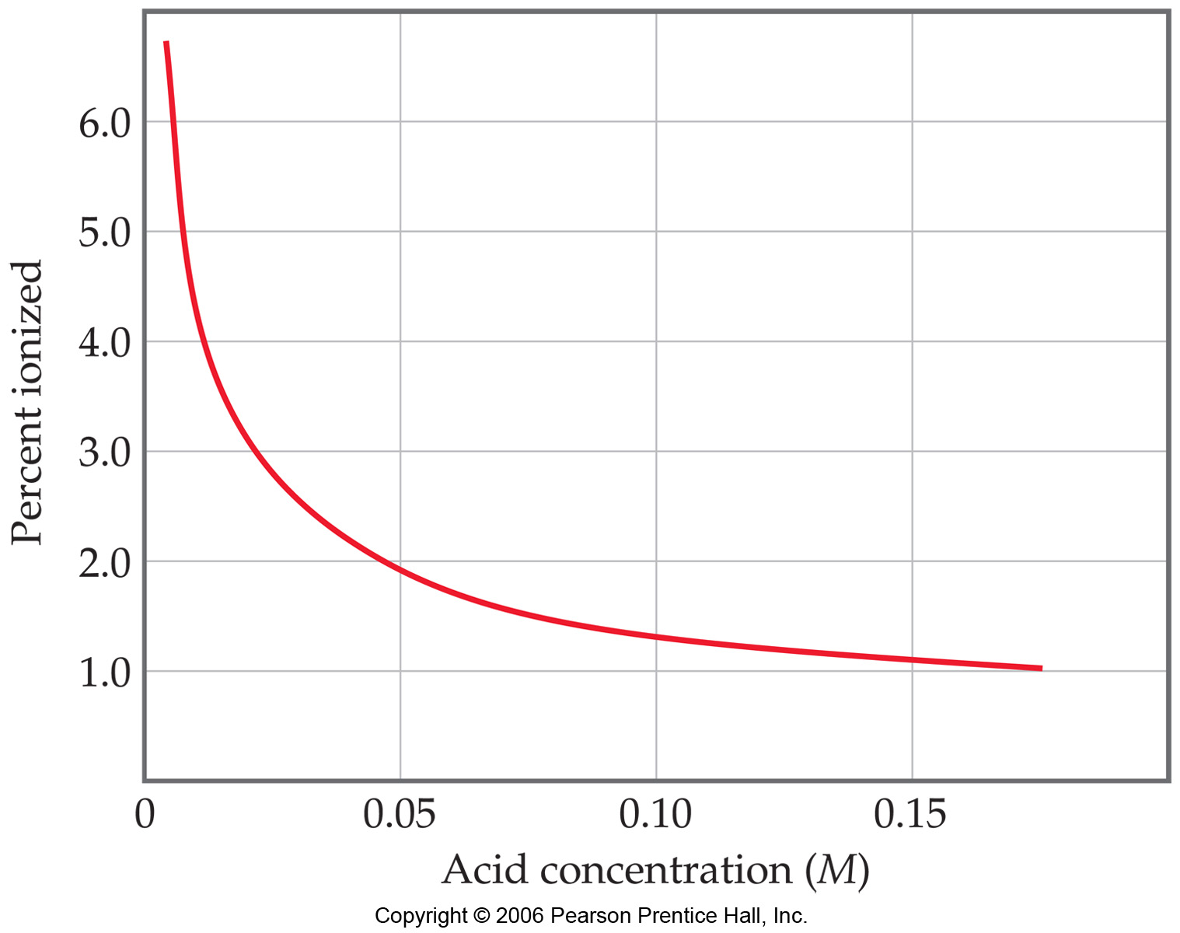

Slide 30
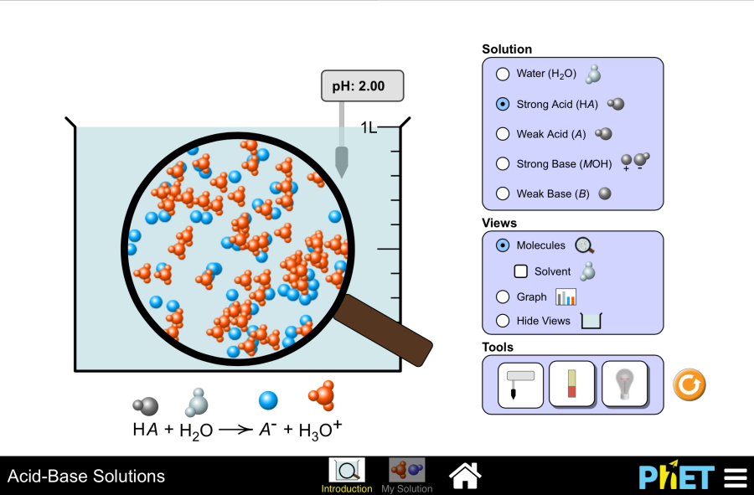
Run Simulation

