Slide 1
Chapter 17

Slide 3
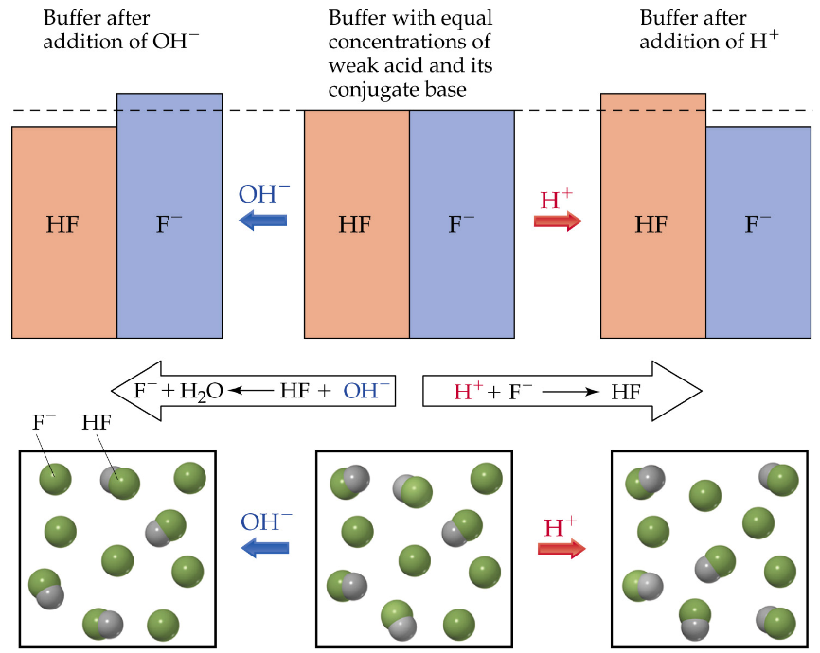

Slide 7
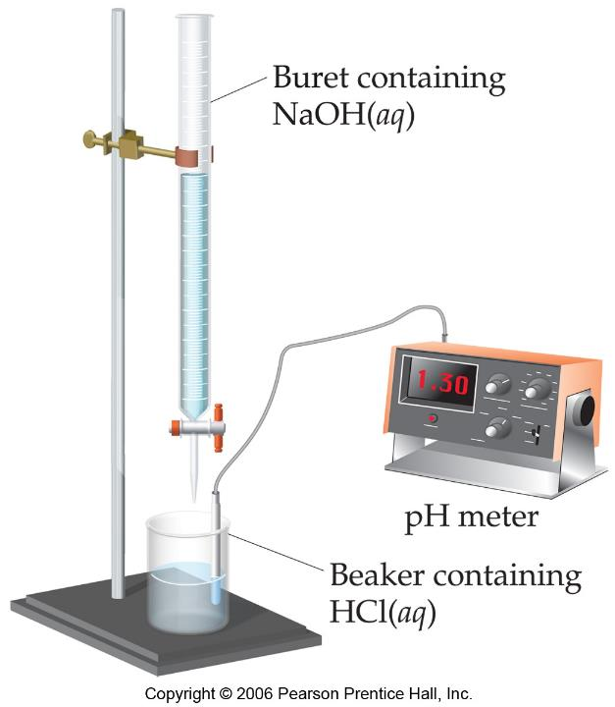

Slide 8
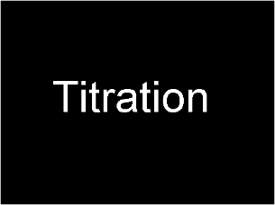
Titration
Play Video In YouTube
Notes:
AN26_042.mov

Slide 9
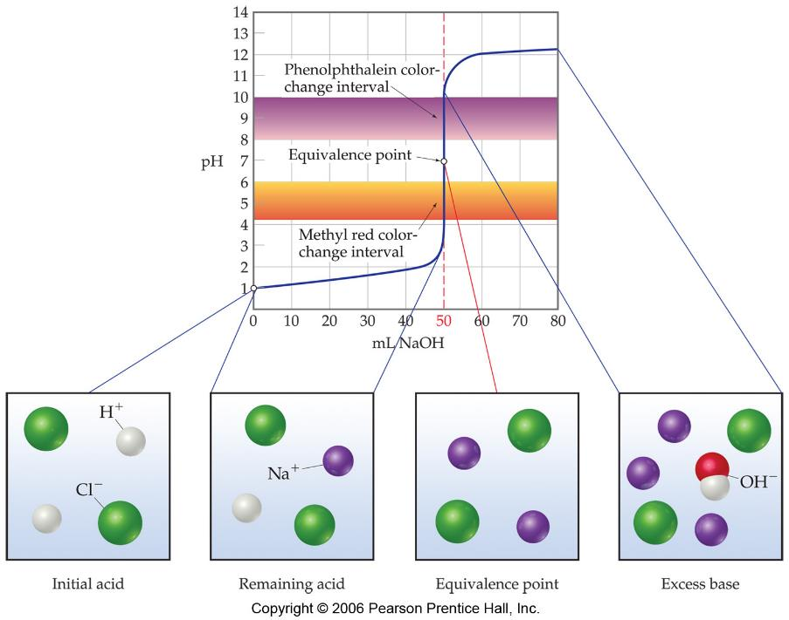

Slide 10
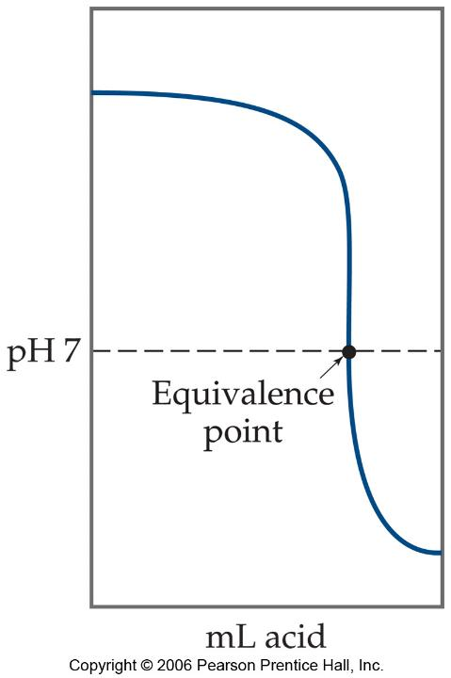

Slide 11
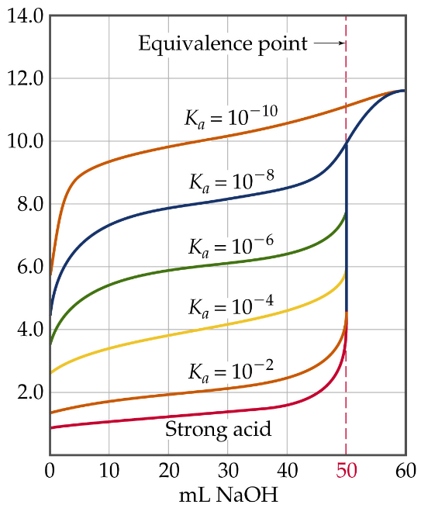

Slide 12
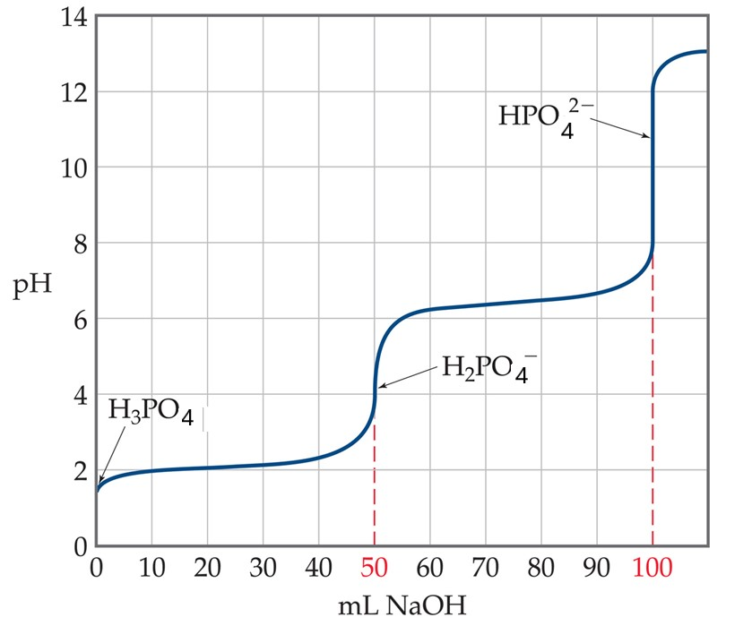

Slide 13
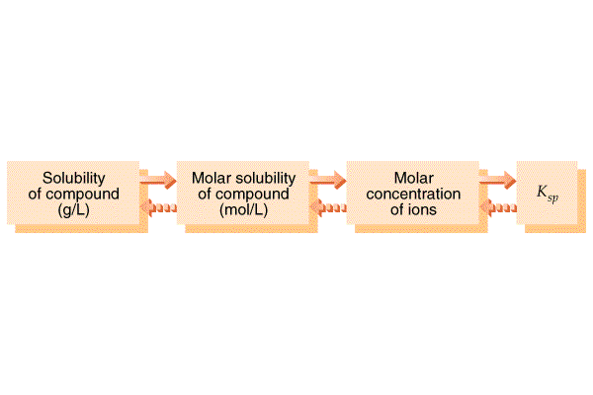

Slide 16
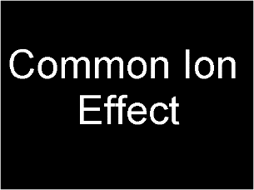
Common Ion Effect
Play Video On YouTube
Notes:
AN26_043.mov

Slide 17
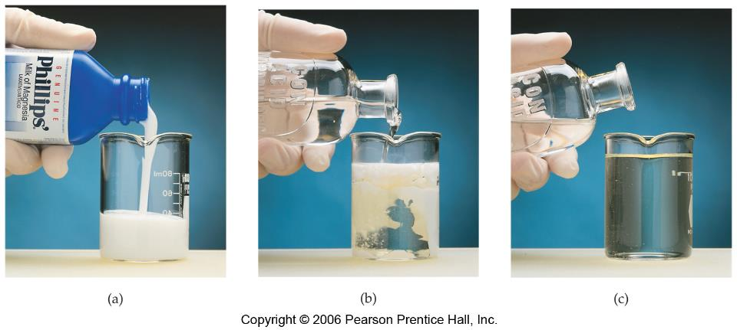

Slide 18
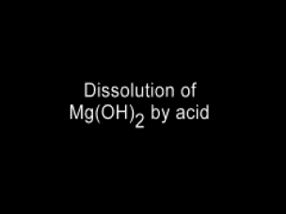
Dissolution of Mg(OH)₂ by Acid
Play Video In YouTube
Notes:
AN26_041.mov

Slide 19
