Slide 1
Chapter 20

Slide 2
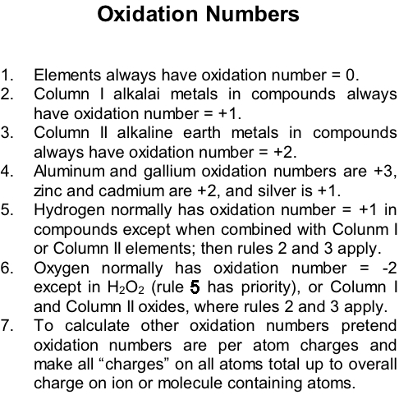

Slide 3
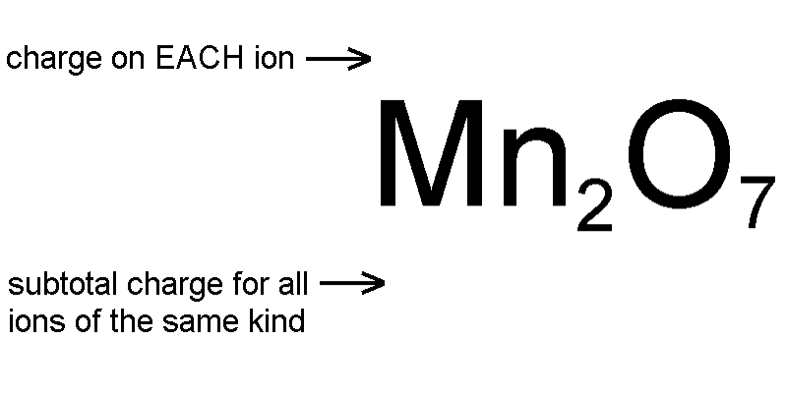







Calculating Oxidation Numbers
Each oxide ion has a charge of -2
7 oxide ions have a subtotal charge of -2 x 7 = -14
Since the formula has to be uncharged the 2 manganese ions have to have a +14 subtotal
The +14 subtotal divided evenly over 2 manganese ions gives each manganese +14 / 2 = +7
This compound is manganese(VII) oxide
Work oxidation numbers of Cr and S in Cr₂(SO₄)₃ (Hint: treat SO₄²⁻ as a single particle)

Slide 5
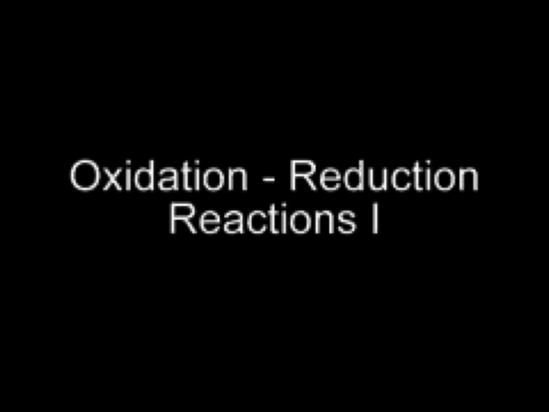
Oxidation -Reduction Reactions I
Play Video On YouTube
Notes:
AN26_007.mov

Slide 6
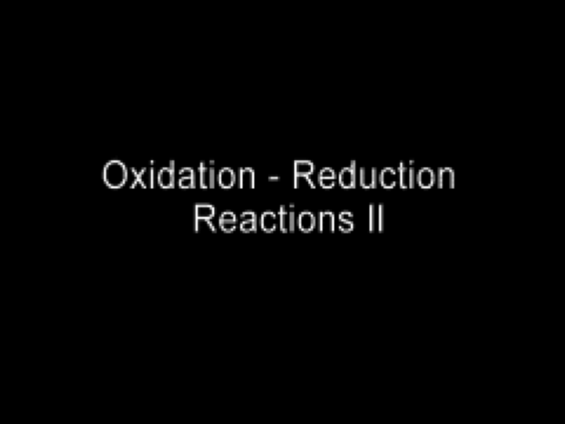
Oxidation - Reduction Reactions II
Play Video On YouTube
Notes:
AN26_008.mov

Slide 7
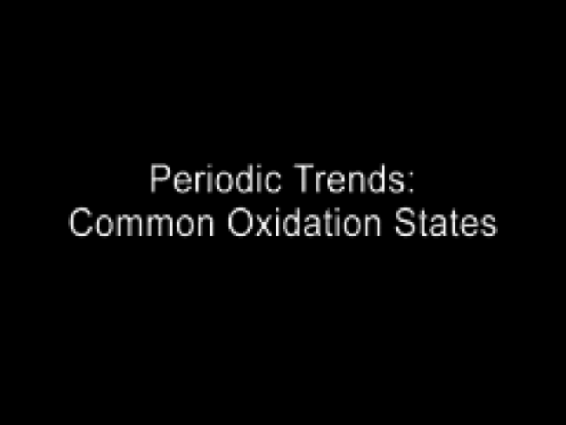
Common Oxidation States
Play Video On YouTube
Notes:
AN26_025.mov

Slide 9
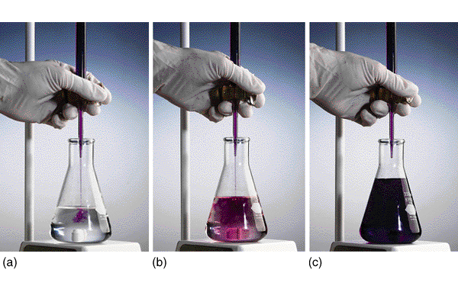

Slide 10
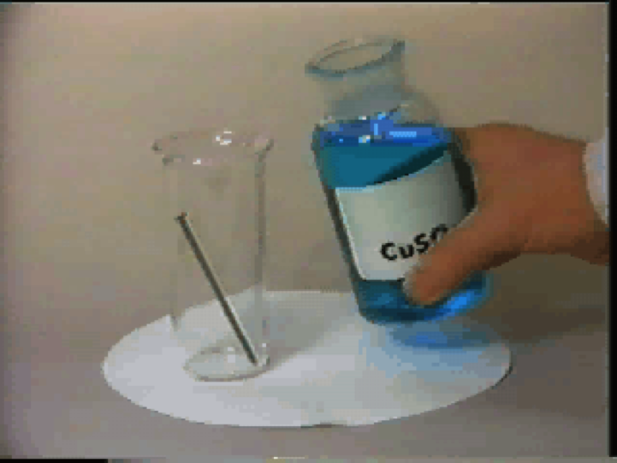
Cu²⁺ + Fe⁰ Redox Reaction
Play Video In YouTube
Notes:
DM27_011.mov

Slide 11
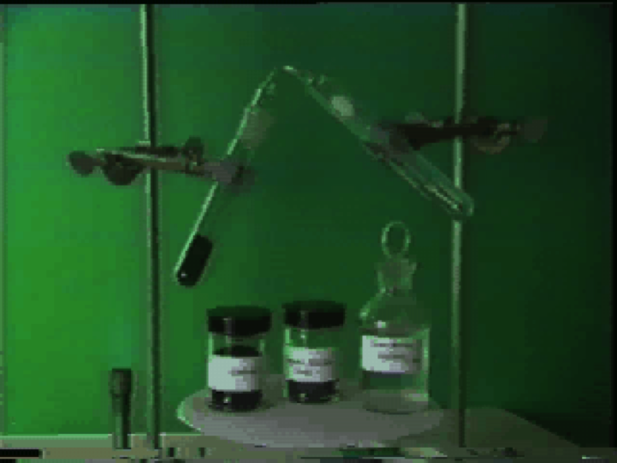
CuO + C Redox Reaction
Play Video On YouTube
Notes:
DM27_012.mov

Slide 12
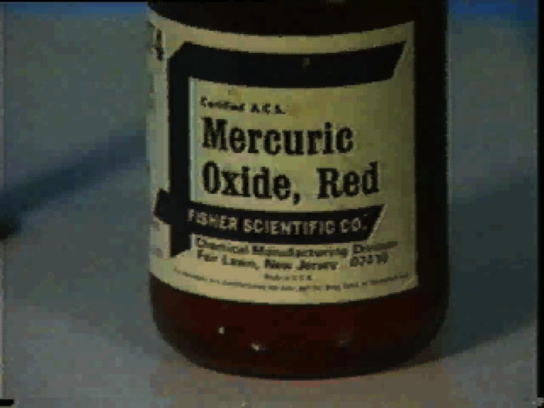
Mercury (II) Oxide Decomposition
Play Video On YouTube
Notes:
DM27_013.mov

Slide 13
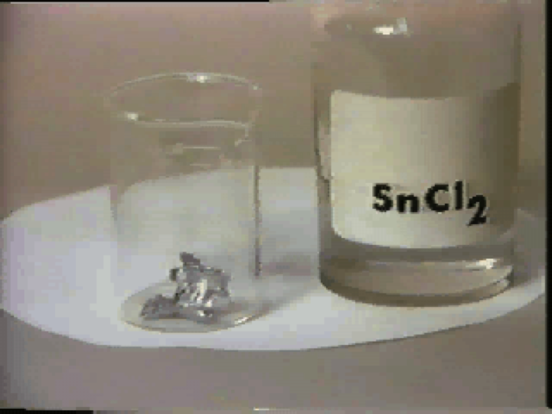
SnCl₂ + Zn⁰ Redox Reaction
Play Video On YouTube
Notes:
DM27_014.mov

Slide 14
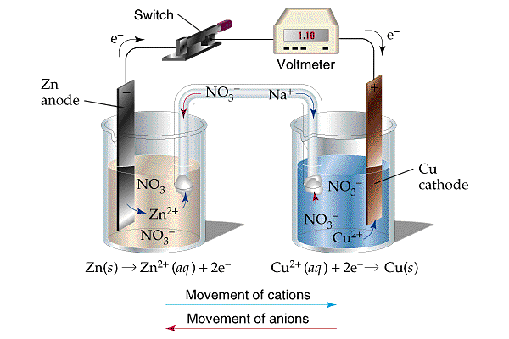

Slide 15
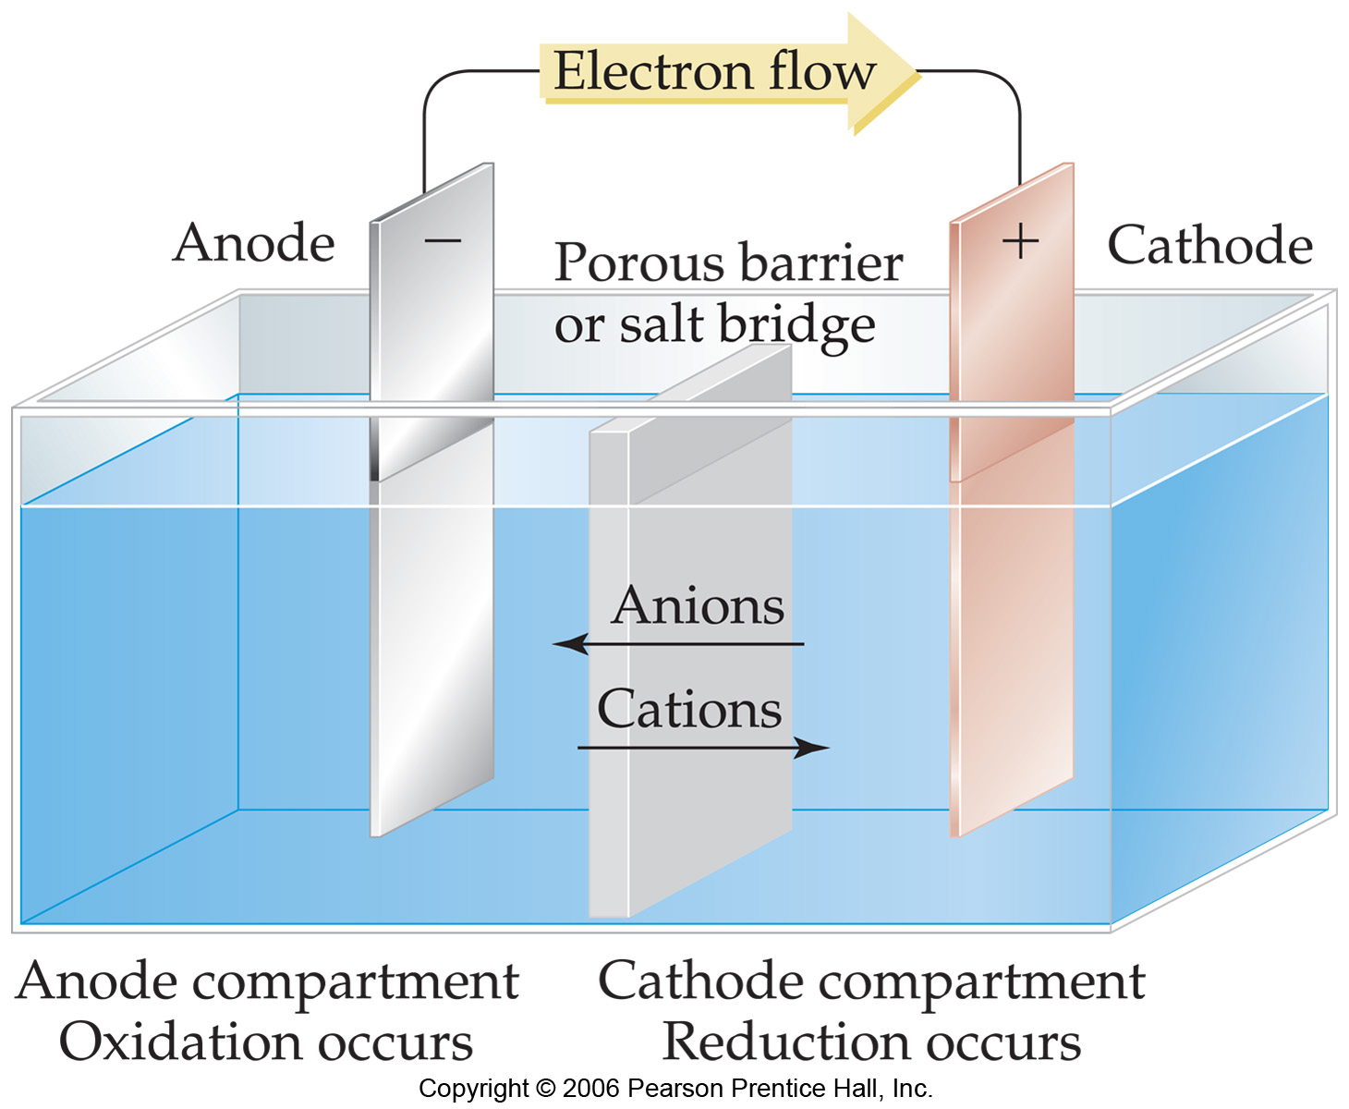

Slide 16
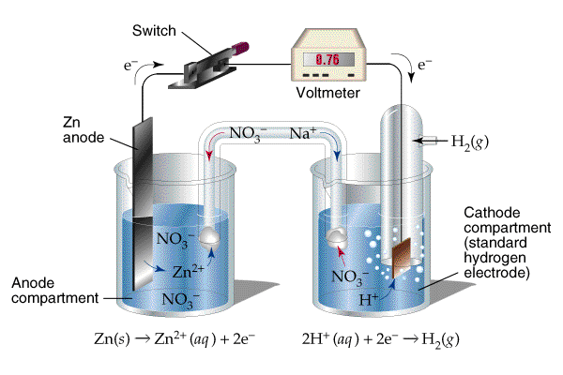

Slide 17
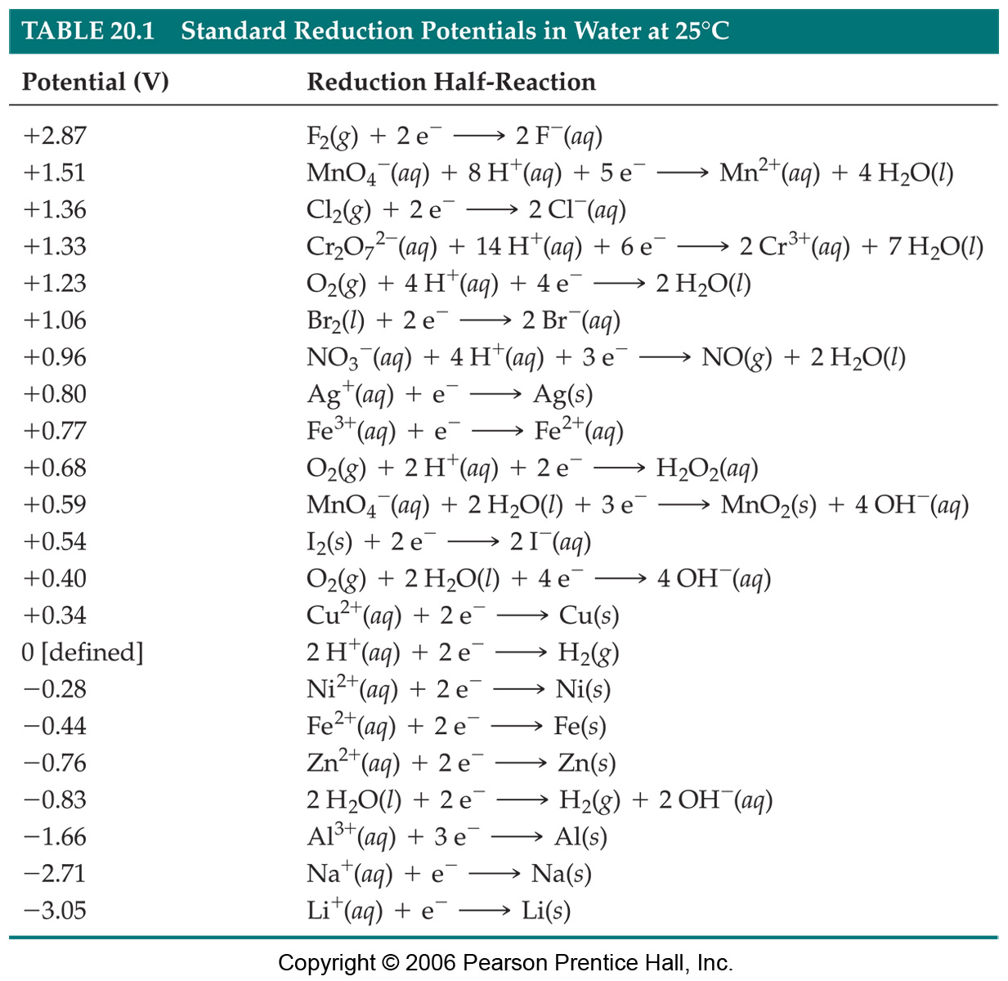

Slide 20
Nonstandard E Values
Nernst Equation: Analogous to nonstandard ∆G equation
∆G = ∆Gº + RTlnQ
E = Eº - (RT/eF)lnQ
Notice effect of opposite sign convention on direction of deviation from standard value
Notice RT (kJ/mol) becomes RT/eF (J/coul)
R = 0.008314 kJ/mol-K (∆G) vs. R = 8.314 J/mol-K (E)

Slide 22
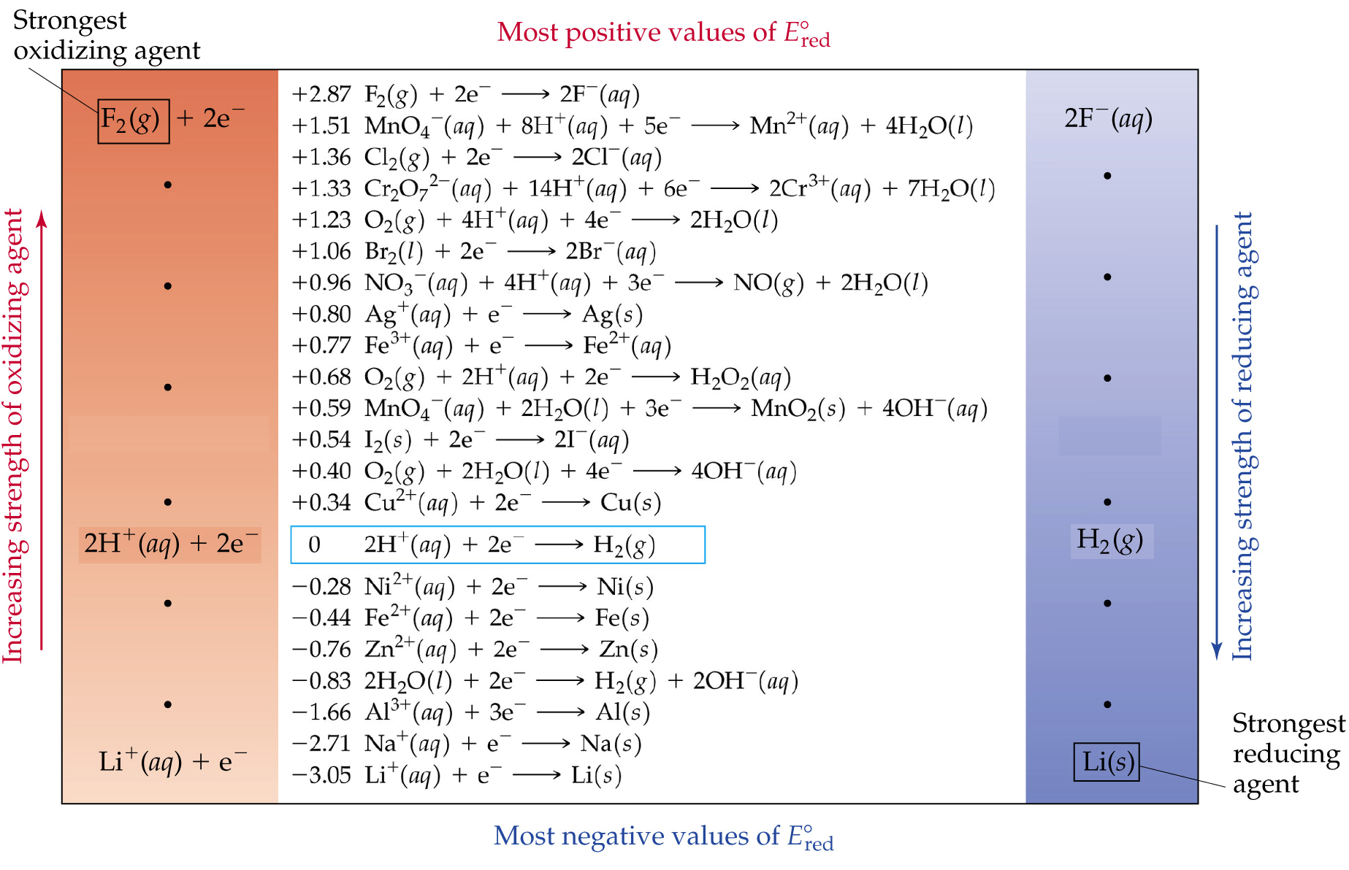

Slide 23
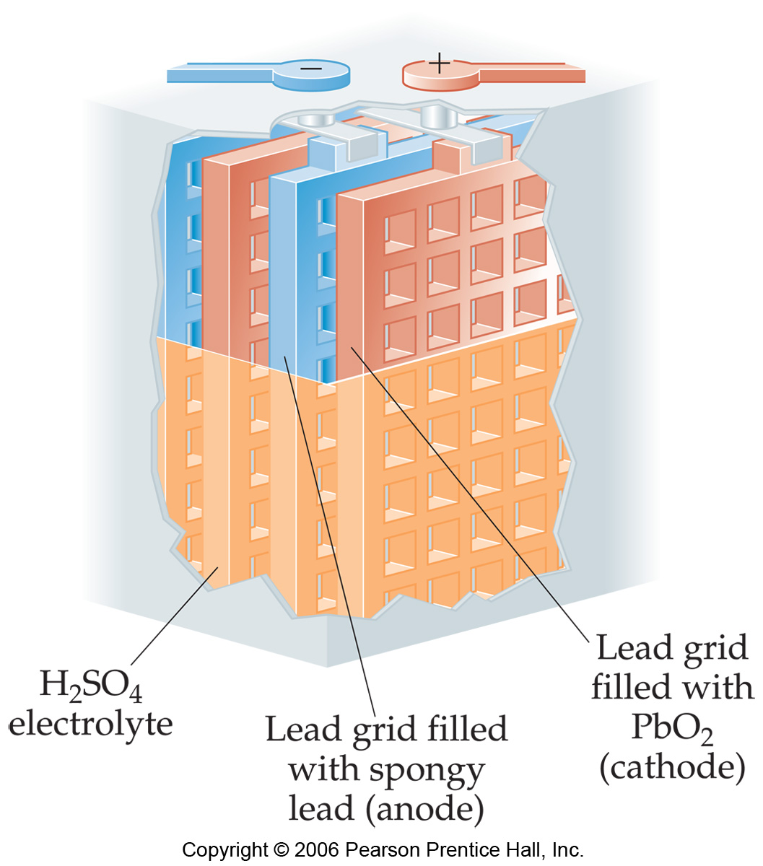

Slide 24
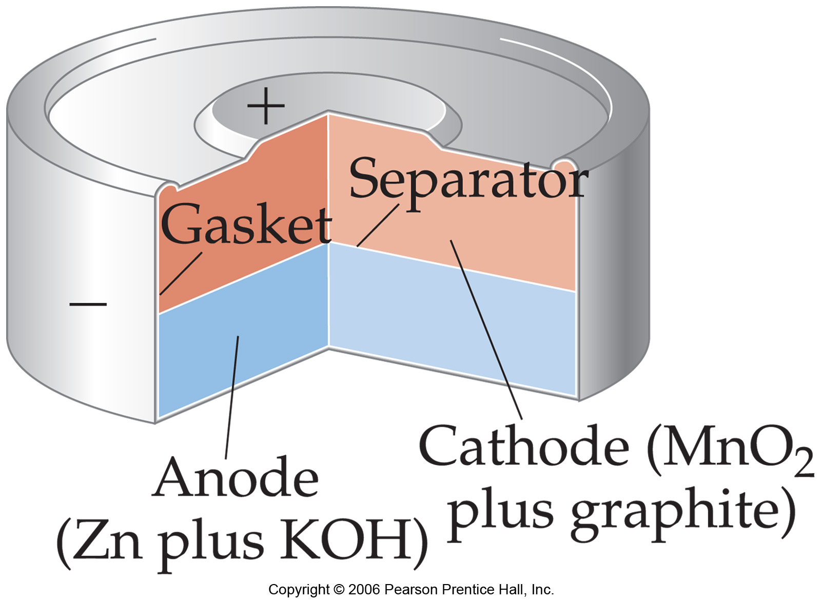

Slide 25
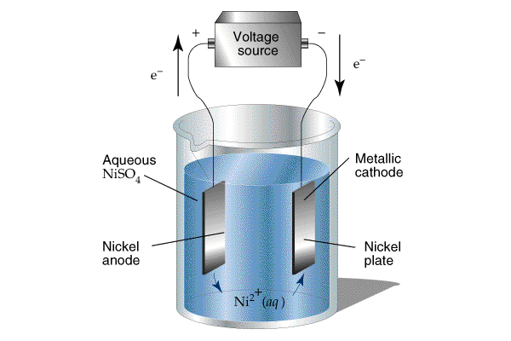

Slide 26
