Slide 1
Chapter 5

Slide 2
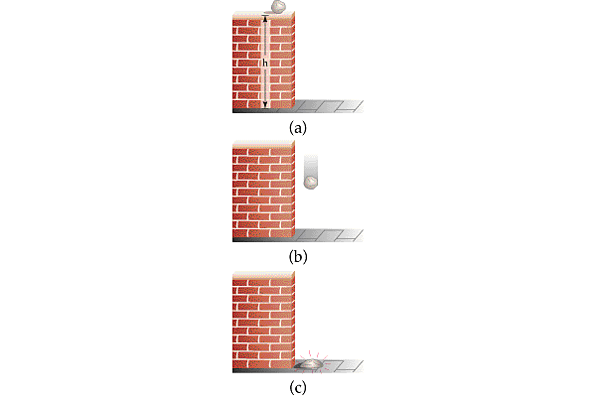

Slide 3
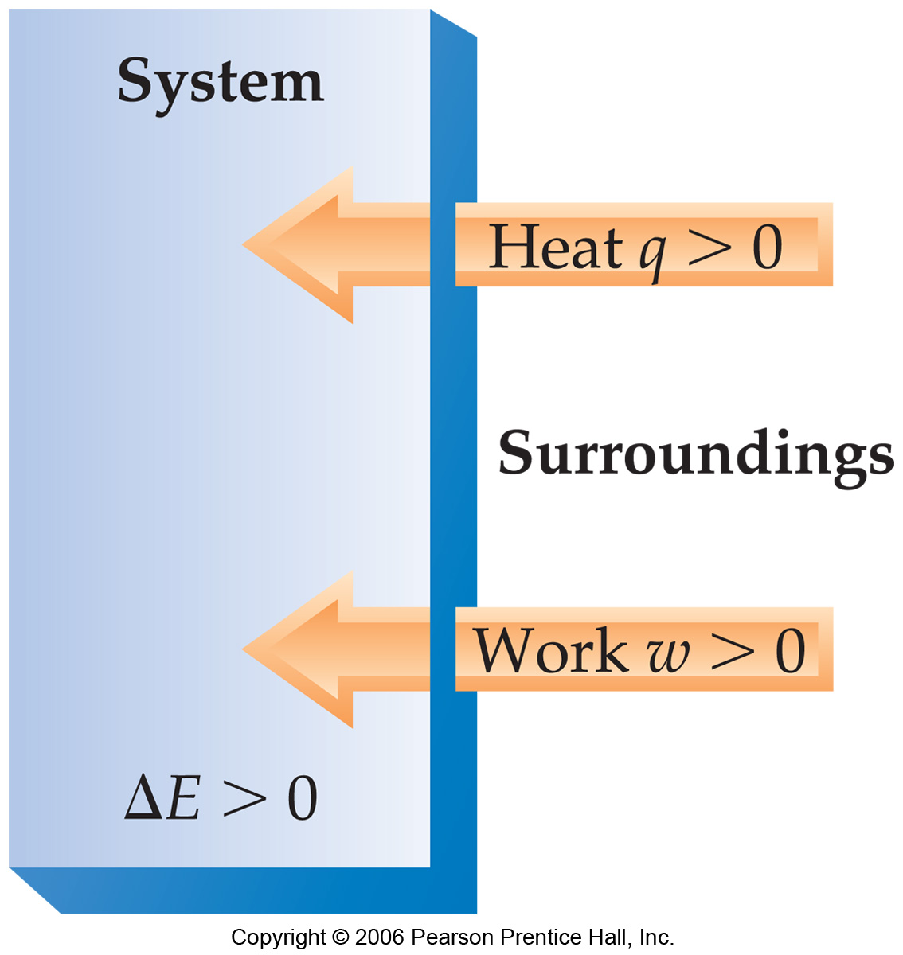

Slide 5
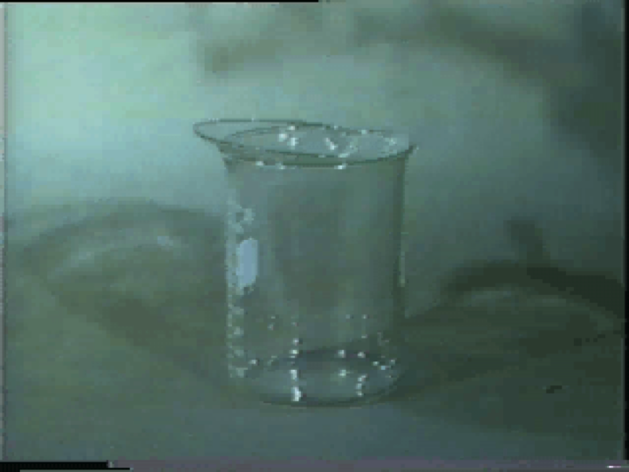
Oxygen Combustion Reactions
Play Video On YouTube
Notes:
DM27_015.mov

Slide 6
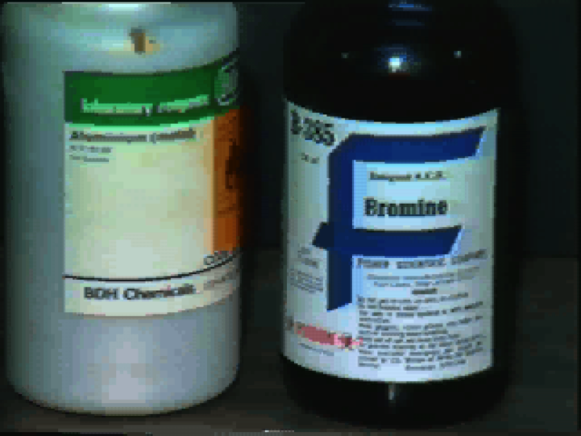
Al + Br₂ Combustion Reaction
Play Video On YouTube
Notes:
DM27_017.mov

Slide 7
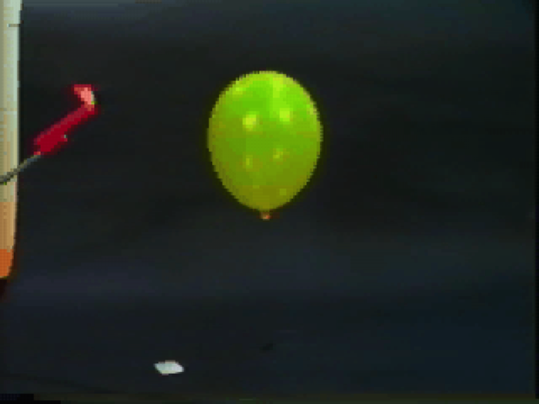
Hydrogen Combustion Reaction
Play Video On YouTube
Notes:
DM27_002.mov

Slide 8
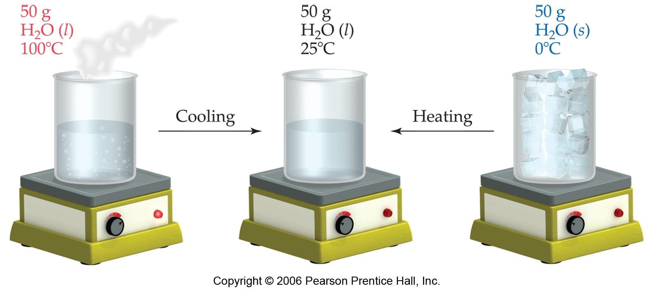

Slide 10
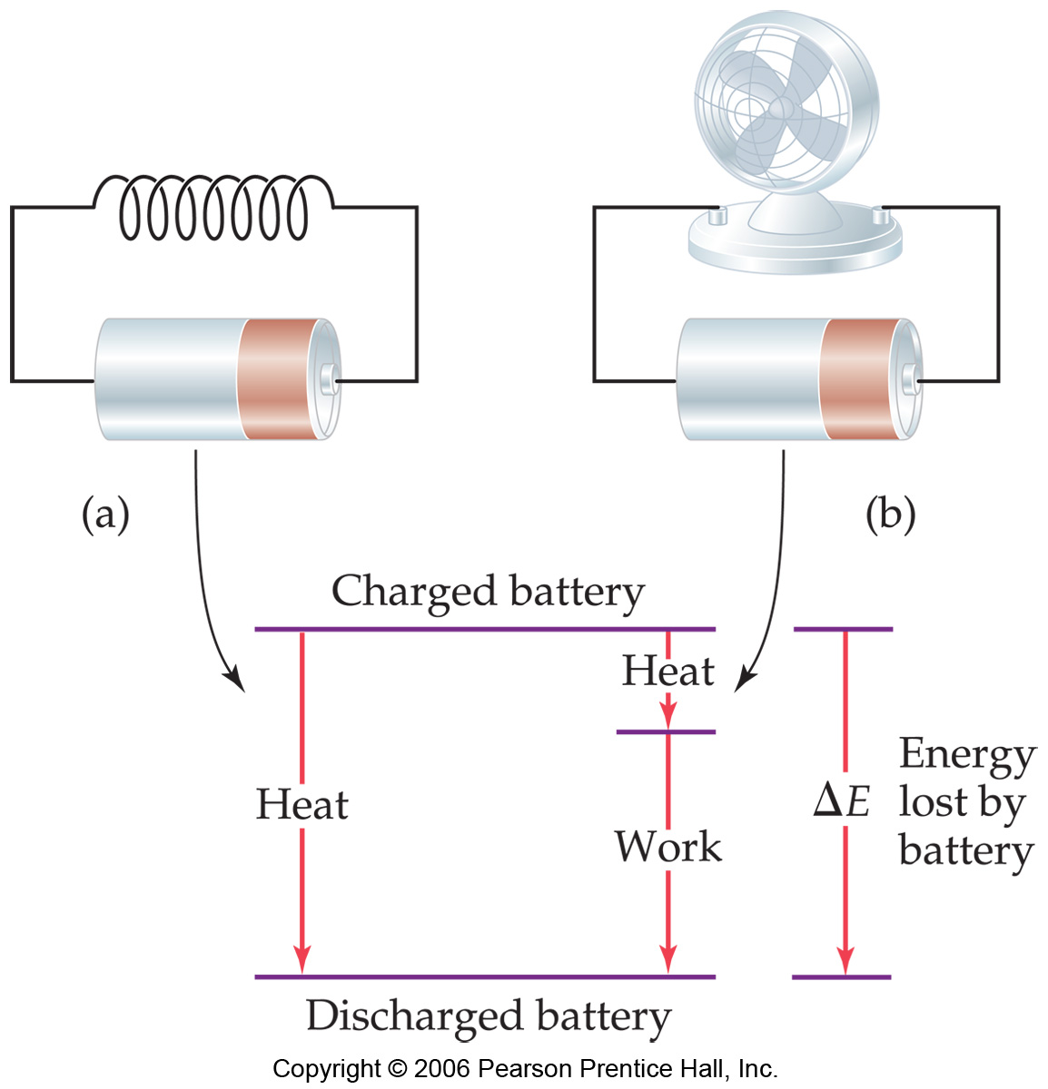

Slide 13
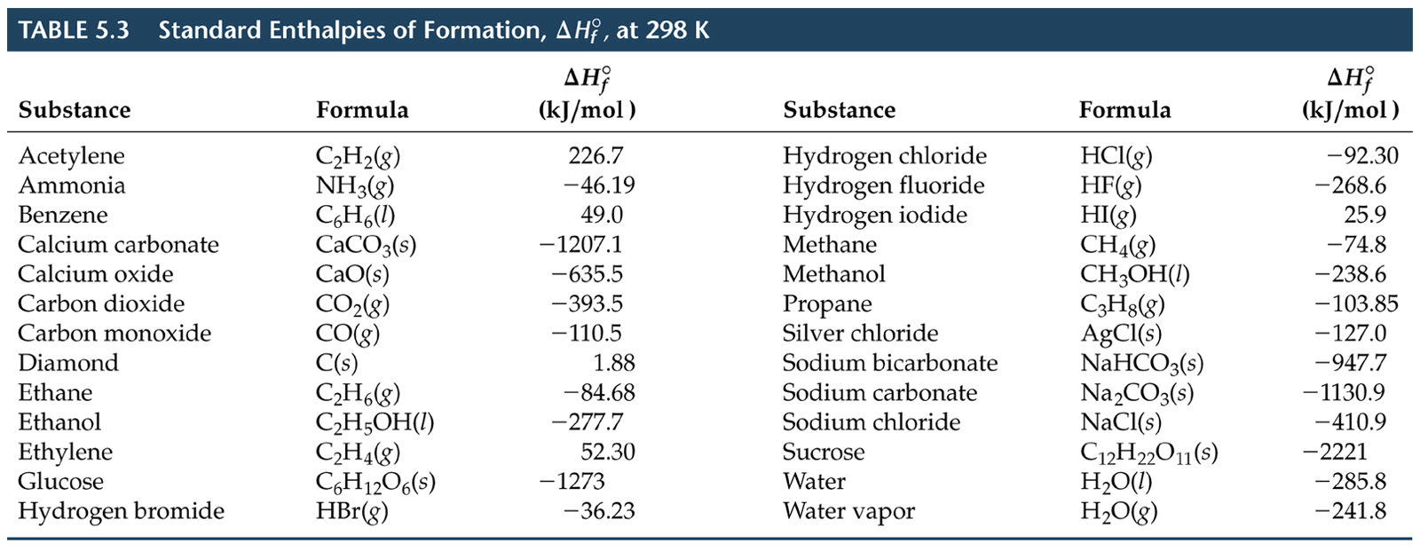

Slide 15
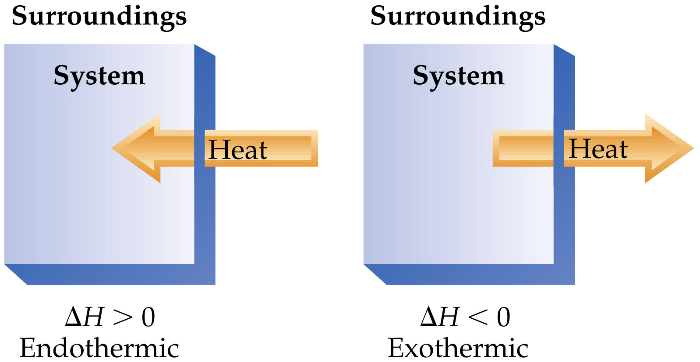

Slide 16
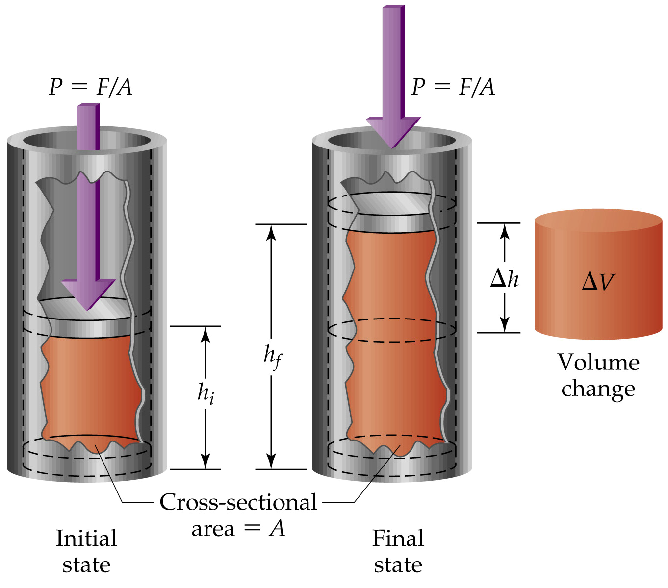

Slide 17
Work of Gas Expansion
Play Video On YouTube
Notes:
AN26_002.mov

Slide 18
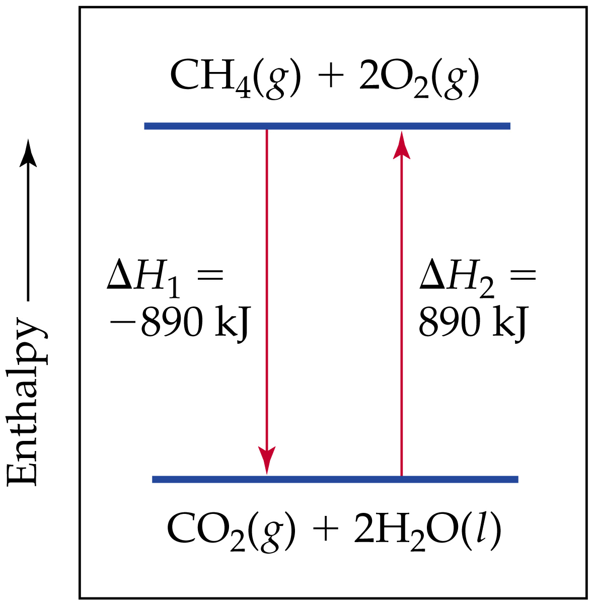

Slide 19
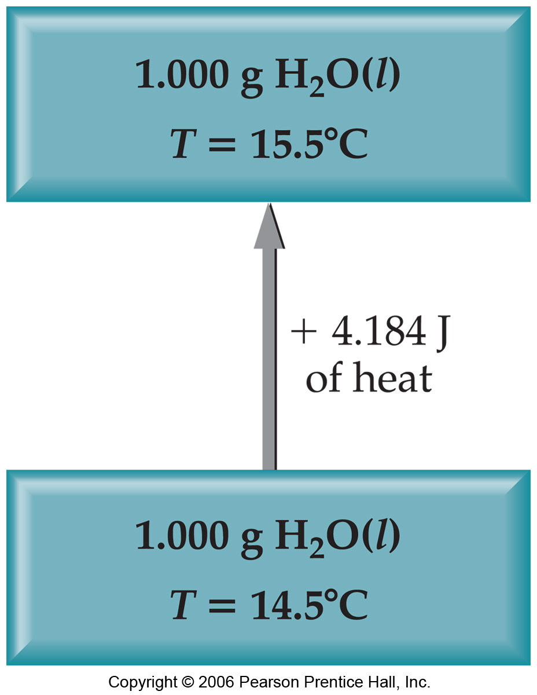

Slide 20
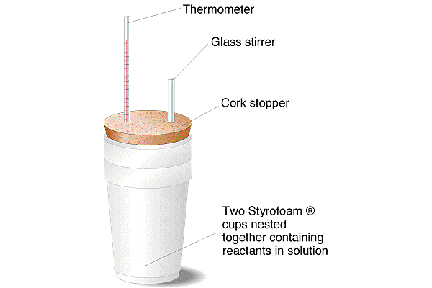

Slide 21
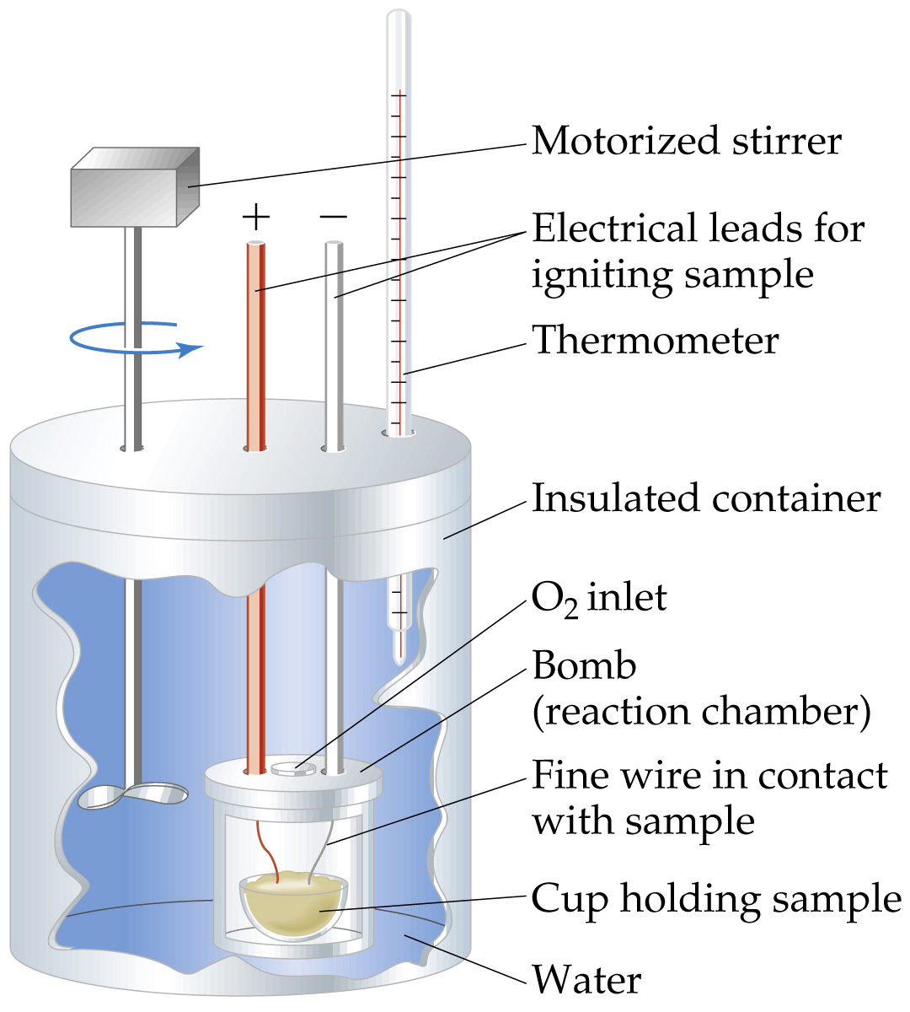

Slide 22
